Slide 1
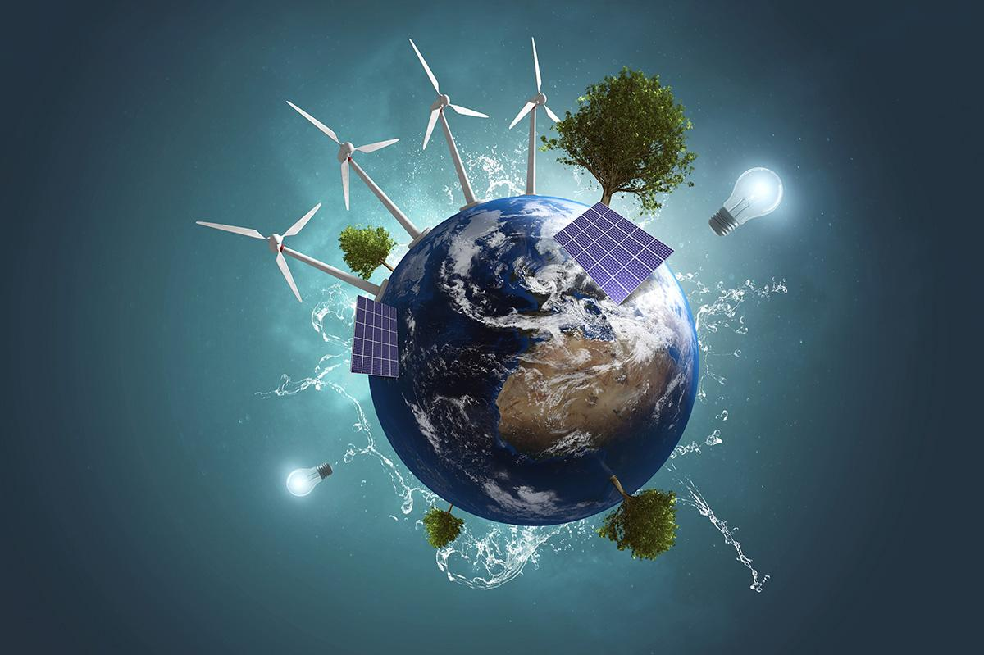
Energy
TECH FOR
To understand how technology is used in the energy industry and broaden my knowledge of careers available in this field
Notes:
Hi Everyone, my name is…… and this Tech We Can lesson is Tech for Energy
So …. our aim today is to show you lots of different and interesting ways technology is being used to produce the energy we need to power all of the things we use.
We also want to give you lots of ideas for the kinds of jobs you could have working with and creating the technology we cover today.
This lesson has also been made with the support of organisations like BP, EDF energy and SSE. If the careers we speak about today interest you then perhaps you could work for one of these companies in the future. You’ll find out more about some of their work a little later on …

Slide 2
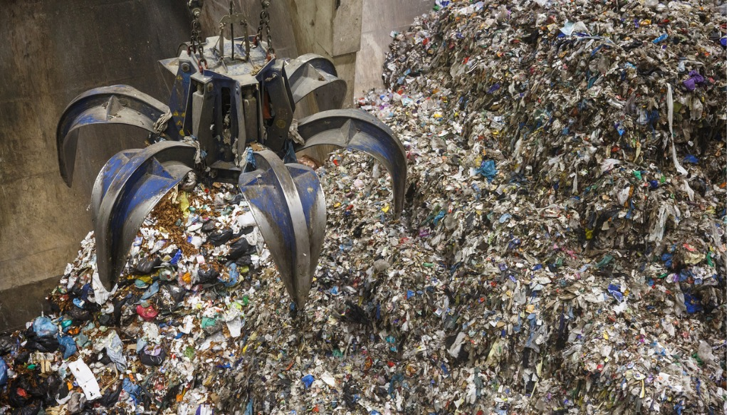
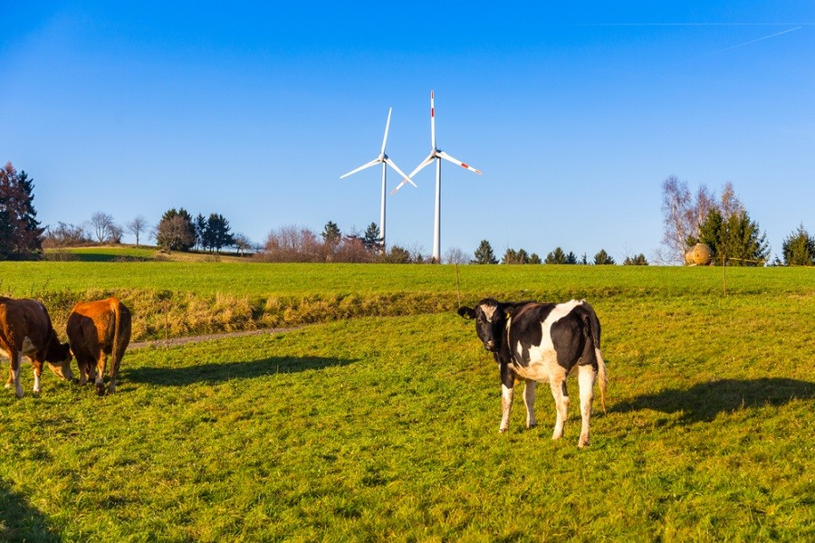
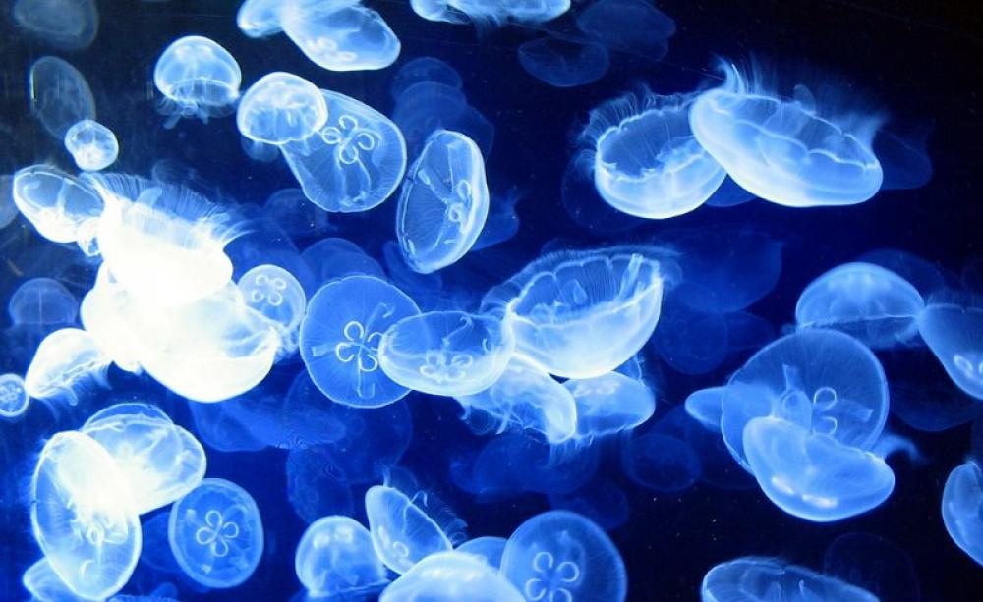
Technology used for renewable energy
#TechWeCan | Tech for Energy
Notes:
We are going to start today by having a look at the technology being used to generate renewable energy. You have probably heard of renewable energy before in your geography lessons. Renewable means an energy source that is sustainable and does not run out. Examples you might already know of are included in the top left picture on this slide. The giant wind turbine generates energy from the blades rotating around in the wind and the solar panels generate energy from the sun – both wind and solar energy do not run out when we use them therefor they are renewable and can be used again.
In the UK, renewable energy sources add up to around 30 – 40% of the energy we use. This means that most of our energy still comes from nonrenewable sources like burning coal, oil and gas. Burning coal, oil and gas adds pollution into our atmosphere and causes global warming and climate change. Here’s a little clip from BBC bitesize to explain more: https://www.bbc.co.uk/bitesize/topics/zp22pv4/articles/ztxwqty
It’s really important that we continue to develop more sustainable ways of generating our energy so we can continue to protect the environment and our world for future generations.
I’m going to now tell you about a few examples of renewable energy which you may not have heard of.
The picture in the top right shows a giant pile of rubbish or waste. Unfortunately, one thing humans are particularly good at is creating waste so we have plenty of it available. Rather than leave waste in large landfills to rot they either burn the waste or collect the gasses from the waste to be used again. For example, when they burn the waste this produces heat, this heat rises and then turns a turbine to generate energy. These processes of creating energy from rubbish can be quite expensive and it’s important to remember that preferably we should recycle and reuse our waste rather than need to try and convert it into usable energy. So recycle and reuse whenever you can to do your bit for the planet!
The picture in the bottom left is a cow. Now you might be wondering how a cow can actually help us produce energy. One thing we all know about cows is their poo can be very smelly and they can actually produce up to 36kg of poo in one day. One of the gasses released from cow poo is a gas called methane. Farmers put the poo from cows and other animals into a large machine which separates out the methane gas from the liquid and solid poo. The gas can then be used to generate electricity and the leftovers can be used as fertilizer for their land. Stinky but very clever!
And finally, the picture in the bottom right shows a group of jellyfish. Using jellyfish to produce energy also sounds strange but there is actually lots of research being completed in this area. The eerie glow that some jellyfish have is made my a special protein or substance in their bodies. When this protein is put under a UV light it reacts to the light and creates energy. Could jelly fish provide our power in the future – who knows?

Slide 3
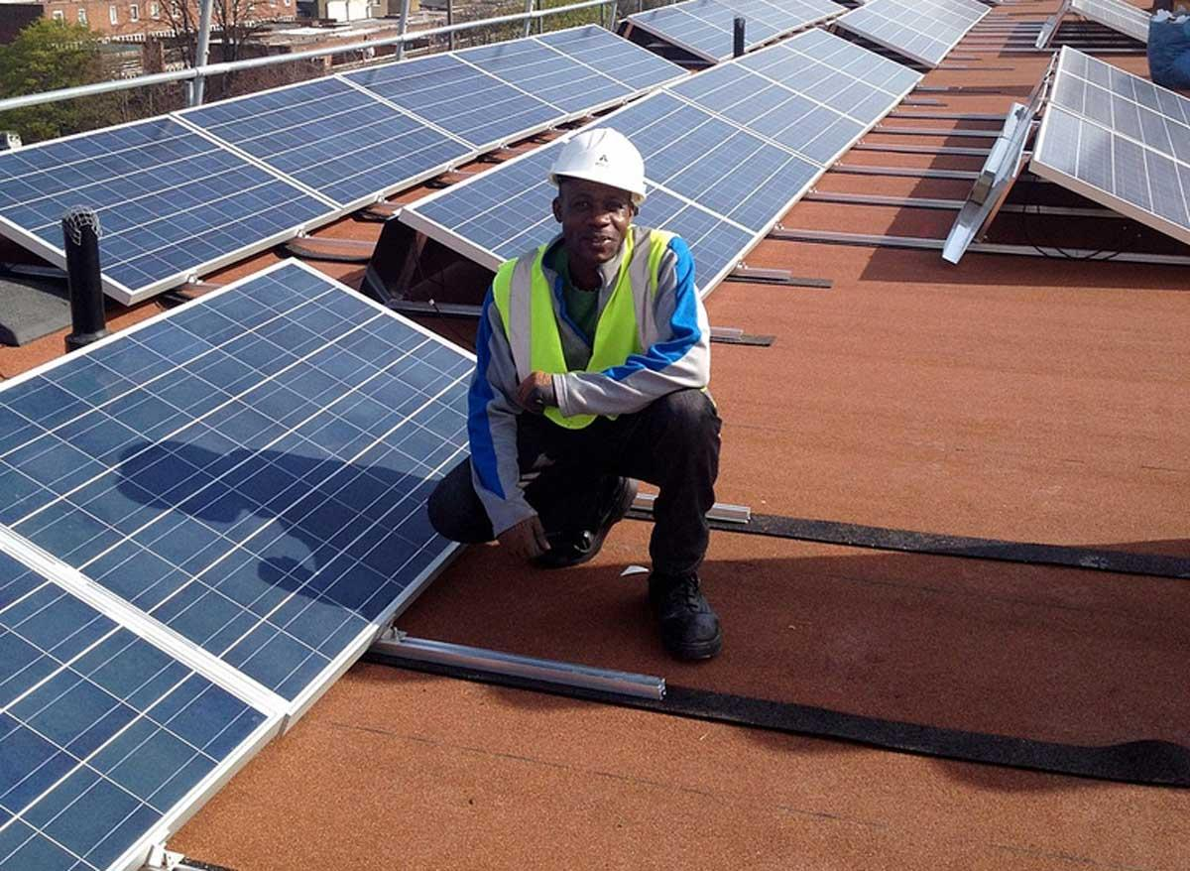
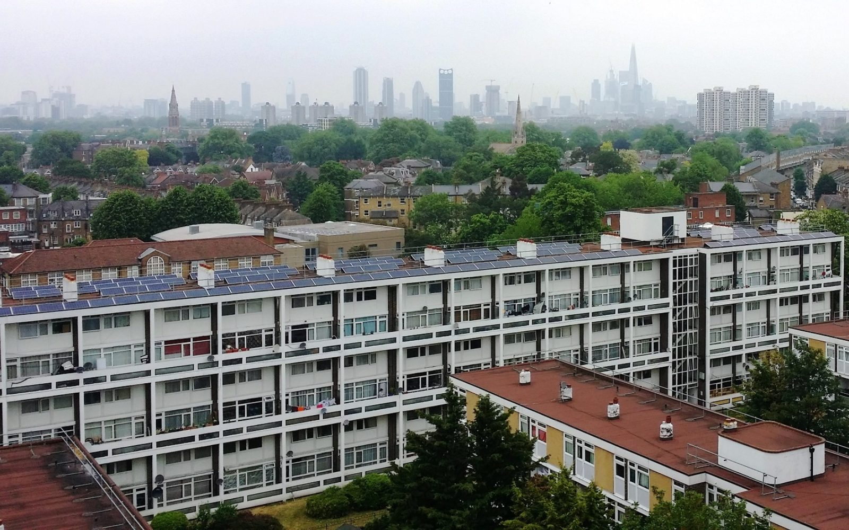
Technology used for renewable energy
#TechWeCan | Tech for Energy
Notes:
On this slide, I just wanted to take a moment to tell you about this fantastic project called CommUNITY being run in a place called Elmore House in Brixton in London.
EDF Energy and Repowering London installed a solar power station onto the roof of the building. This power station is special though as it allows everyone within the building to store energy in a large battery. The residents can use the energy they need and then with any left over they can sell or share with neighbours.
If for example, one of your neighbours didn’t have enough money to buy the energy they needed to heat their house or power their lights then the community can help them by sharing the leftover energy with them. They control all of this via a very clever app which all of the residents have access too. Here’s a little cartoon which explains the project – let’s have a look:
https://www.youtube.com/watch?v=h87vEtgvxJE (0.58 – End)
What a great idea, a really lovely way to be environmentally friendly, help you local community and use technology for good.

Slide 4
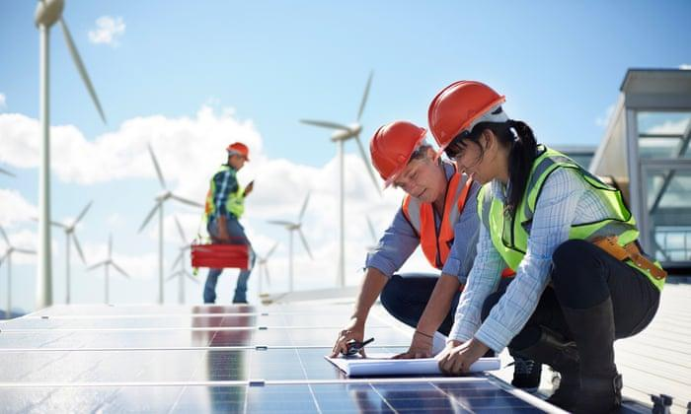
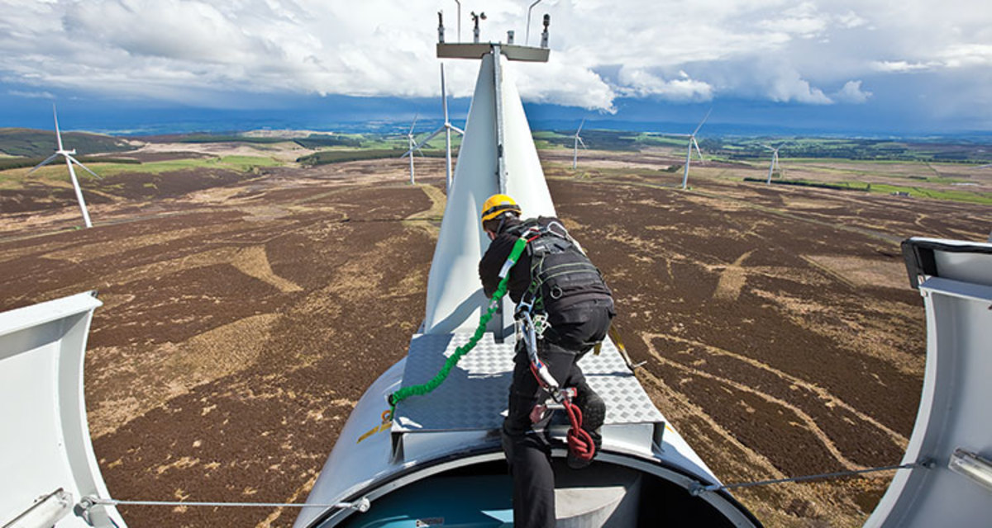
Careers in Tech for Renewable Energy
Renewable Energy Engineer
Ecologist
Wind Turbine Technician
As a renewable energy engineer, you will research and develop new machinery and equipment to create renewable energy and minimise environmental impact. This could include working with wind, solar, hydro or marine power.
As an ecologist, you could be responsible for helping research and further our understanding of how natural and human changes to the environment can influence ecosystems.
As a wind turbine technician, you could be responsible for keeping wind turbine equipment running smoothly. Your work would involve maintaining, testing and repairing the turbines. Wind turbine technicians work in a variety of different environments both in the sea and on land.
#TechWeCan | Tech for Energy
Notes:
If you would like to research and develop the renewable energies of the future, in order to help protect the environment, then you could have a future job as a renewable energy engineer. As a renewable energy engineer, you will research and develop new machinery and equipment to create renewable energy sources. This could include working with wind, solar, hydro or marine power.
You could also be an ecologist. As an ecologist, you would be responsible for helping research and further our understanding of how natural and human changes to the environment can influence ecosystems. For example, if an energy company would like to build a structure in an area (this could be a wind farm or solar panels), you could be responsible for researching how this would affect the plants and animals in that area and make suggestions to try and protect them or reduce harm.
If working outdoors and in different environments appeals to you. Then you could be a wind turbine technician and be responsible for maintaining, testing and repairing those giant wind turbines. From the look of that picture, it would be best to do this role if you are adventurous and like working at height. Eeek … that looks a bit high!
Governments, companies and people all around the world are trying to reduce our impact on climate change and find more sustainable and environmentally friendly ways of producing energy so these kinds of careers in the energy sector will continue to grow in the future.

Slide 5
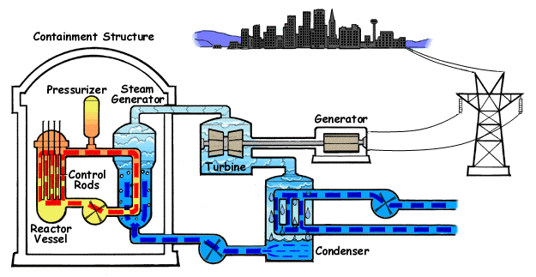
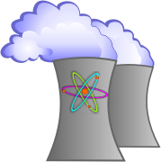
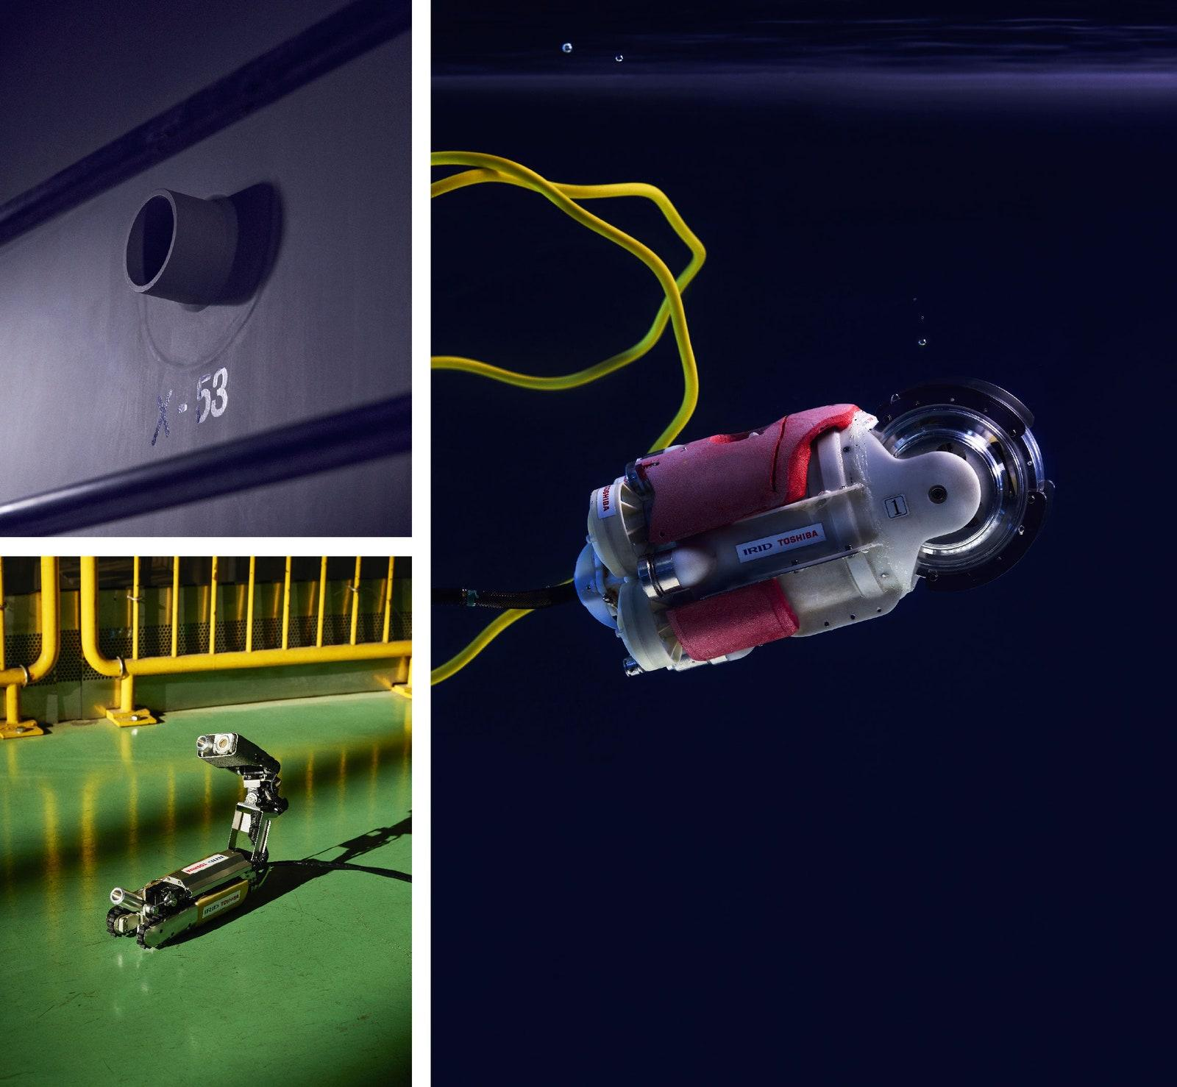
Technology used in nuclear energy
Credit: http://www.nrc.gov/reding-rm/basic-ref/students/animated-pwr.html
#TechWeCan | Tech for Energy
Notes:
We are now going to move onto how technology is being used for nuclear energy. So what actually is nuclear energy and how is it made?
Everything in the world is made up of teeny tiny invisible atoms. The middle of that atom is called the nucleus and this is where the energy is found. The energy can be released in two ways:
The atoms can come together to form a bigger atom – this is called fusion
OR
The atoms can break and split up to form smaller atoms – this is called fission
Watch this short clip where Sherry and Marie from EDF explain how they generate nuclear energy in their Power Plant. The diagram in the top left might help you picture what they are explaining
https://www.youtube.com/watch?v=a8T-F81vh14
Nuclear reactors are safely encased in 10 metres of specially reinforced concrete and steel. To get close to the reactor, engineers have developed robots to complete tasks such as investigating these areas for maintenance and monitoring. The picture in the bottom right is of two robots used in Fukushima in Japan. In 2011 an earthquake and tsunami caused explosions and damage at the nuclear power plant. For many years afterwards scientists have been working hard to make the area safe again, investigate the damage and make repairs as safely as possible.
The robot picture on the left is of the scorpion robot, this robot is designed to have a look at the damage inside the nuclear reactors. The robot picture on the right is of a robot called Little Sunfish – this robot can swim through water so scientists can investigate areas of the site which are flooded. It would have taken a whole team of researchers, nuclear physicists and robotics engineers years to test the materials and make these robotic designs.

Slide 6
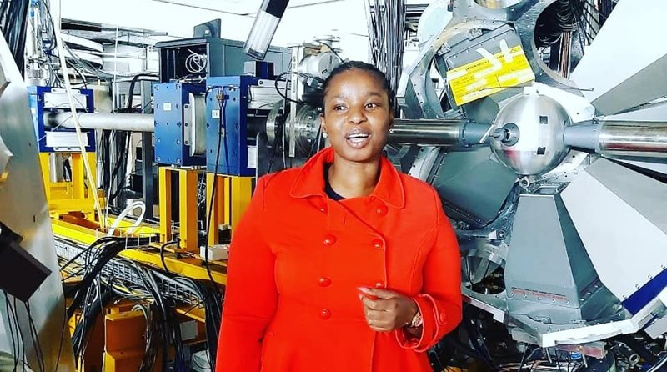
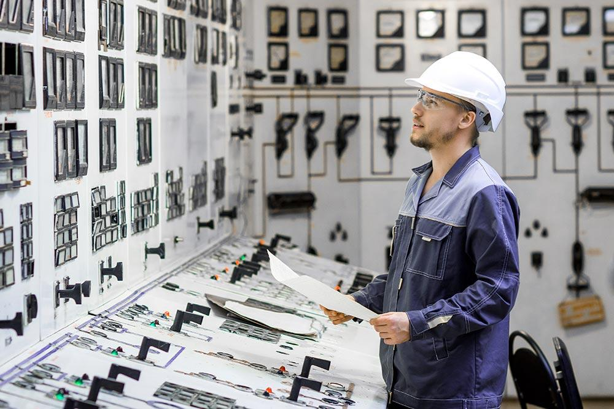
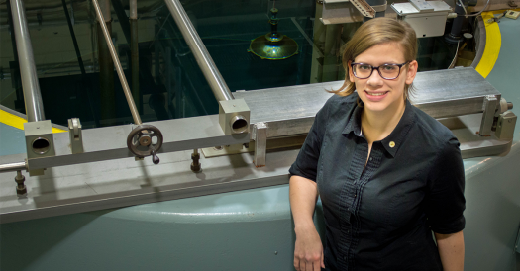
Careers in Tech for Nuclear Energy
Nuclear Physicist
Nuclear Power Plant Operator
Nuclear Engineer
As nuclear physicist, you could be in charge of studying the way different radioactive materials work to try and discover more ways to generate electricity from nuclear materials. You will also be responsible for making sure current nuclear fuels are being used safely.
As a nuclear power plant operator, you could be in charge of monitoring the nuclear reactor and making sure it is working as it should be.
As a nuclear engineer, you could be in charge of designing and creating the systems used in radiation and nuclear power.
#TechWeCan | Tech for Energy
Notes:
If working with technology and nuclear energy sounds interesting to you, you could be a nuclear physicist. As nuclear physicist, you could be in charge of studying the way different radioactive materials work to try and discover more ways to generate electricity from nuclear materials. You will also be responsible for making sure current nuclear fuels are being used safely.
Or you could be a nuclear power plant operator. As a nuclear power plant operator, you could be in charge of monitoring the nuclear reactor and making sure it is working as it should be.
You could also be a nuclear engineer. As a nuclear engineer, you could be in charge of designing and creating the systems used in radiation and nuclear power. Nuclear engineers can also work with things like X Ray machines and machines used to treat cancer patients which use radiation.

Slide 7
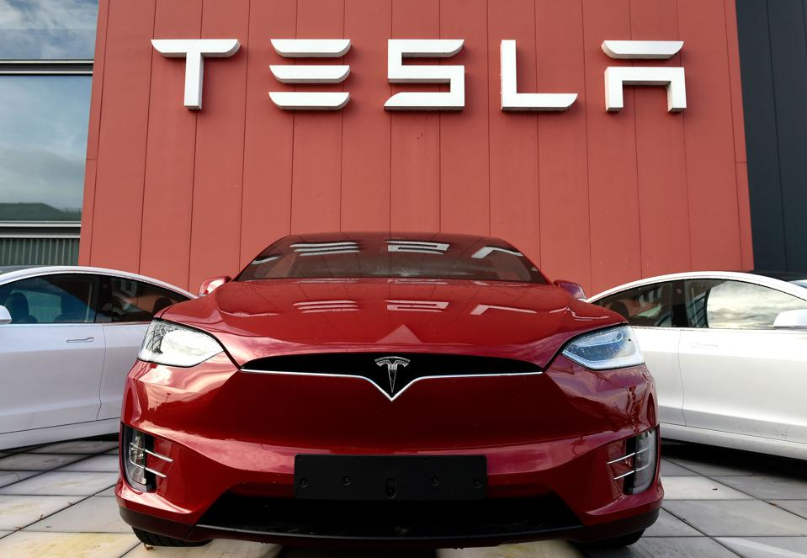
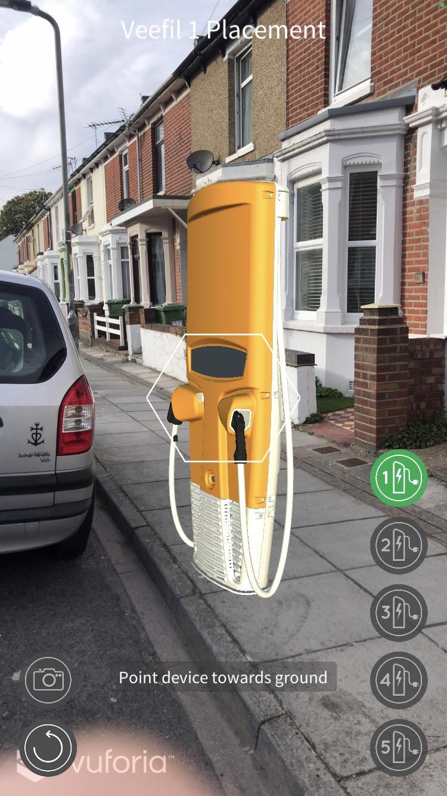
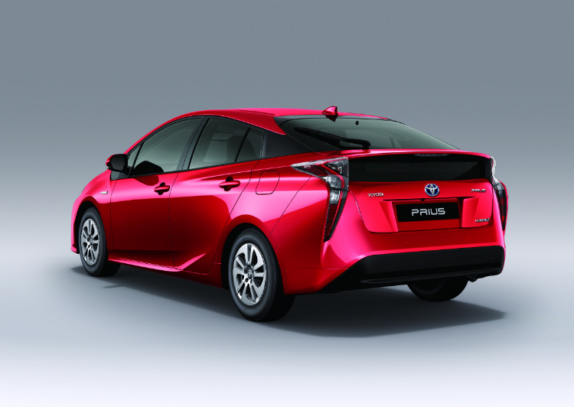
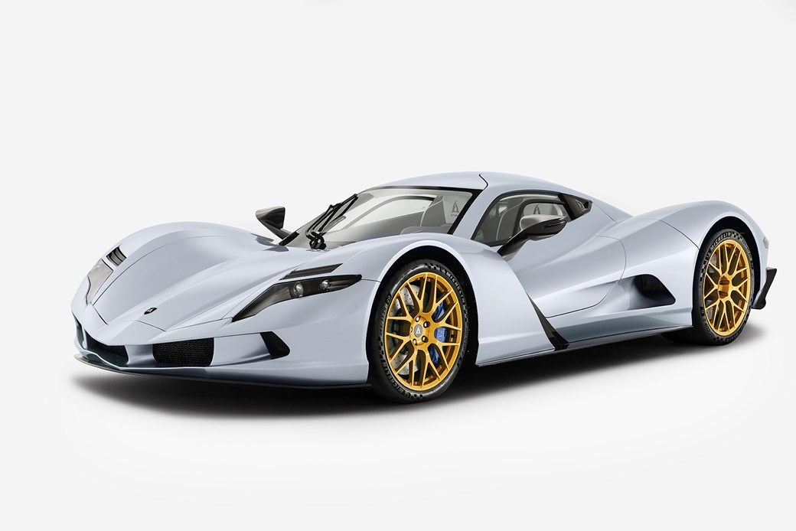
Technology used in electric vehicles
#TechWeCan | Tech for Energy
Notes:
We are now going to move onto one area of tech for energy which has really developed in the last few years is creating electric vehicles or EVs as they are also known.
EV’s are becoming more and more popular and around 1 in 10 new cars bought in the UK are now powered by an electric motor. One of the most famous electric cars, which you may have heard of already, is the Tesla – as you can see in the picture in the top left. I would love one of those!
You may have noticed electric car charging points being installed near where you live. BP are one of the companies which create charging stations for Electric Vehicles and they are the UK’s largest providers of EV charging stations. As you can see from the image on the top right, electric cars can be charged in many different places like at home, at work or even in the supermarket car park.
SSE are another energy company working on electric car technology. The picture in the bottom right is a really cool piece of augmented reality tech which SSE are using to decide where to install new charging points.
The picture in the bottom left is of a hybrid car. You may have seen the word hybrid on the back of cars, if not – have a look for this next time you are on a journey somewhere. Hybrid means that the car has both a petrol engine and an electric motor and the car can use both forms of fuel to power its movement.
And finally, electric cars were traditionally slower than petrol or diesel cars however that’s not the case now. The picture in the middle at the bottom is a car called The Owl created by a Japanese company called Aspark. It has a top speed of 249mph and costs £2.5 million.

Slide 8
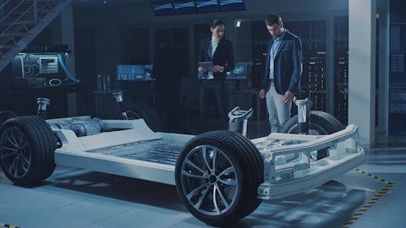
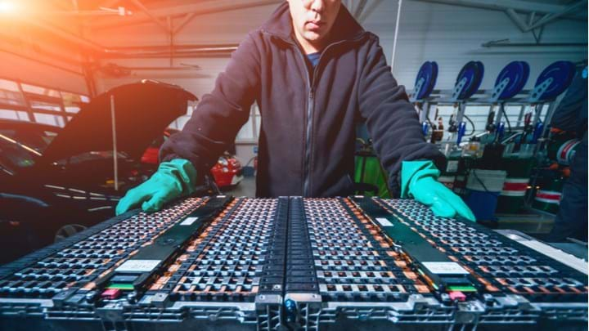
Careers in Tech for Electric Vehicles
Electric Vehicle Software Engineer
Chemical Engineer
As an electric vehicle software engineer, you could be responsible for developing ways in which the computers within an electric car communicate with each other and control all of the different parts of the car.
As a chemical engineer, you could work with the batteries within electric vehicles. You would be responsible for researching and designing new ways of creating batteries which are able to store energy more efficiently.
#TechWeCan | Tech for Energy
Notes:
If working with electric vehicles interest you or perhaps you would like a future role working for a company like Tesla then here are a couple of future careers you could consider.
Electric vehicles are actually like giant computers rather than cars. All of the technology in them needs to be programmed to work together. You could have a future job as an electric vehicle software engineer and be responsible for developing ways in which the computers within an electric car communicate with each other and control all of the different parts of the car.
You could also be a chemical engineer. Chemical engineers work with the batteries within electric vehicles. They research and design new ways of creating batteries which are able to store energy more efficiently.
Could you find a way in the future of creating an electric vehicle which is as fast as a Formula one car?

Slide 9
Meet today’s role models
Olivia Judd
Commercial Analyst
Dan Bower
Senior Software Engineer
#TechWeCan | Tech for Energy
Notes:
We are now going to meet our Tech for Energy role models. We are going to hear from Olivia who works for BP and Dan who works for SSE. Katie had a chat with Olivia and Dan about their jobs and what they think the future of energy and technology will be like – lets see what they said.
Olivia: PLAY VIDEO from 22:40 – 26.26 (image hyperlinked)
Dan: PLAY VIDEO from 26.26 – 31.48 (image hyperlinked)
I liked when Olivia mentioned ….
It was also really interesting when Dan mentioned …..

Slide 10
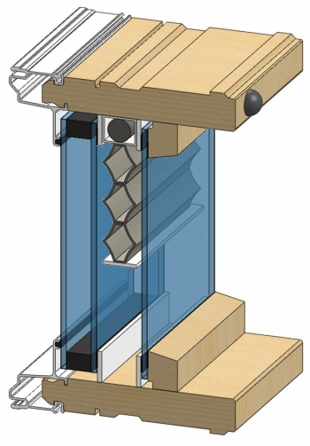
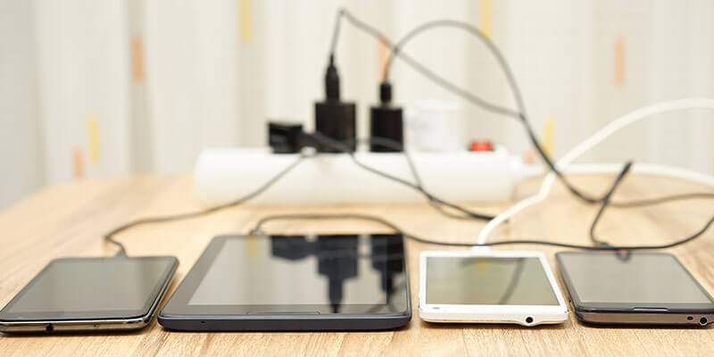
Tech used in homes to save energy
#TechWeCan | Tech for Energy
Notes:
And finally today, we are going to have a look at some technology specific designed to help us save energy in our homes.
The homes which we live in are becoming ‘smart homes’. This means we have lots of devices which are connected to each other. We can use these device to help us save energy. The picture on the top left shows a Nest Thermostat. A normal thermometer in a house is set to a certain temperature but a smart thermostats like the Nest can be controlled remotely from your phone, learns the patterns of people living in your house and can even be linked to other devices. For example you could programme it to know that if a window is open the heating should turn off.
The picture on the bottom left is of something called a Smart Power Strip. I wonder if when you go to bed, do you check that all of the plugs are turned off? Often we leave things like our TV and games consoles on standby. This does save more energy than having them turned on but they are still using energy. A smart power strip detects when devices are no longer in use, for example they have stopped charging and they cut the power to avoid any wasted energy.
Lastly, the diagram on the right is of these really clever insulated windows which have been developed by a group of scientist at the Lawrence Berkeley National Laboratory in California USA. The windows maximise the use of the sun in a home to keep the house at the right temperature for the people living there. The windows are fully automated and controlled by computers and sensors. In the summer, when the house gets too warm, the windows will automatically close and provide shade to cool the house down – therefor the owners won't put on air conditioning or a fan. In the winter, when it is sunny, the blinds will open and allow as much of the natural light and heat to warm the house as possible. Clever and saves energy and the effort of you opening and closing the blinds all of the time.

Slide 11
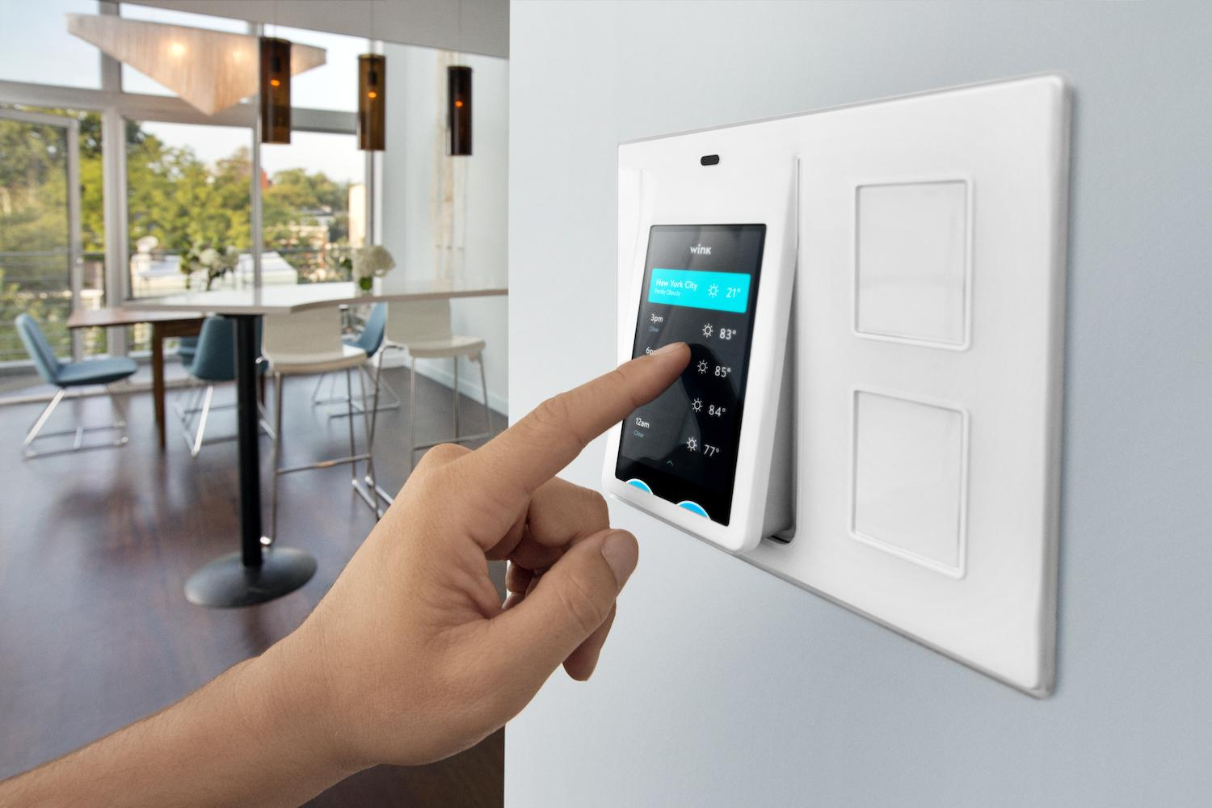
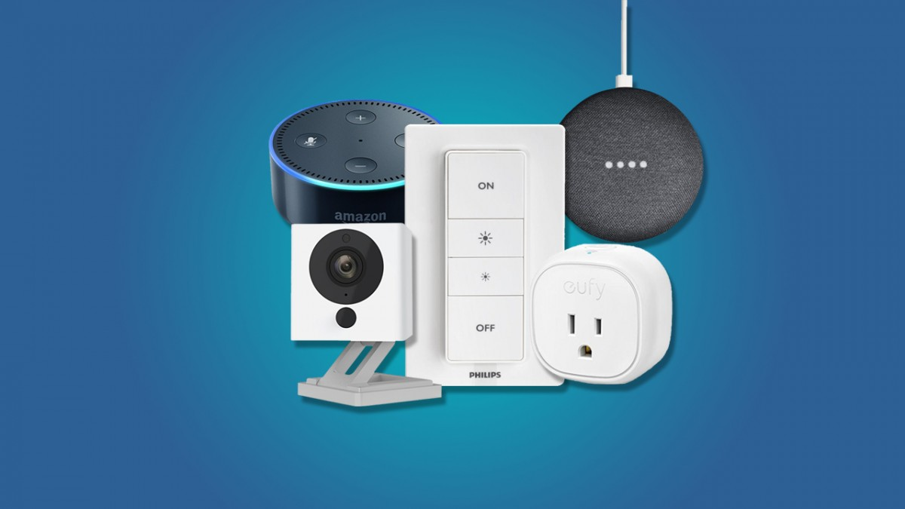
Careers in tech to save energy
Electronic Product Designer
As an electronic product designer, you could work closely with engineers, model makers, sales and marketing staff and other skilled people to design and create the electronic products of the future. This would include using drawings, 3-D models and computer designs to express your ideas. You could create the new smart home technology of the future.
#TechWeCan | Tech for Energy
Notes:
If you would like to work with technology to save energy in the future then you could be an electronic product designer, you could work closely with engineers, model makers, sales and marketing staff and other skilled people to design and create the electronic products of the future. This would include using drawings, 3-D models and computer designs to express your ideas. You could create the new smart home technology of the future.

Slide 12
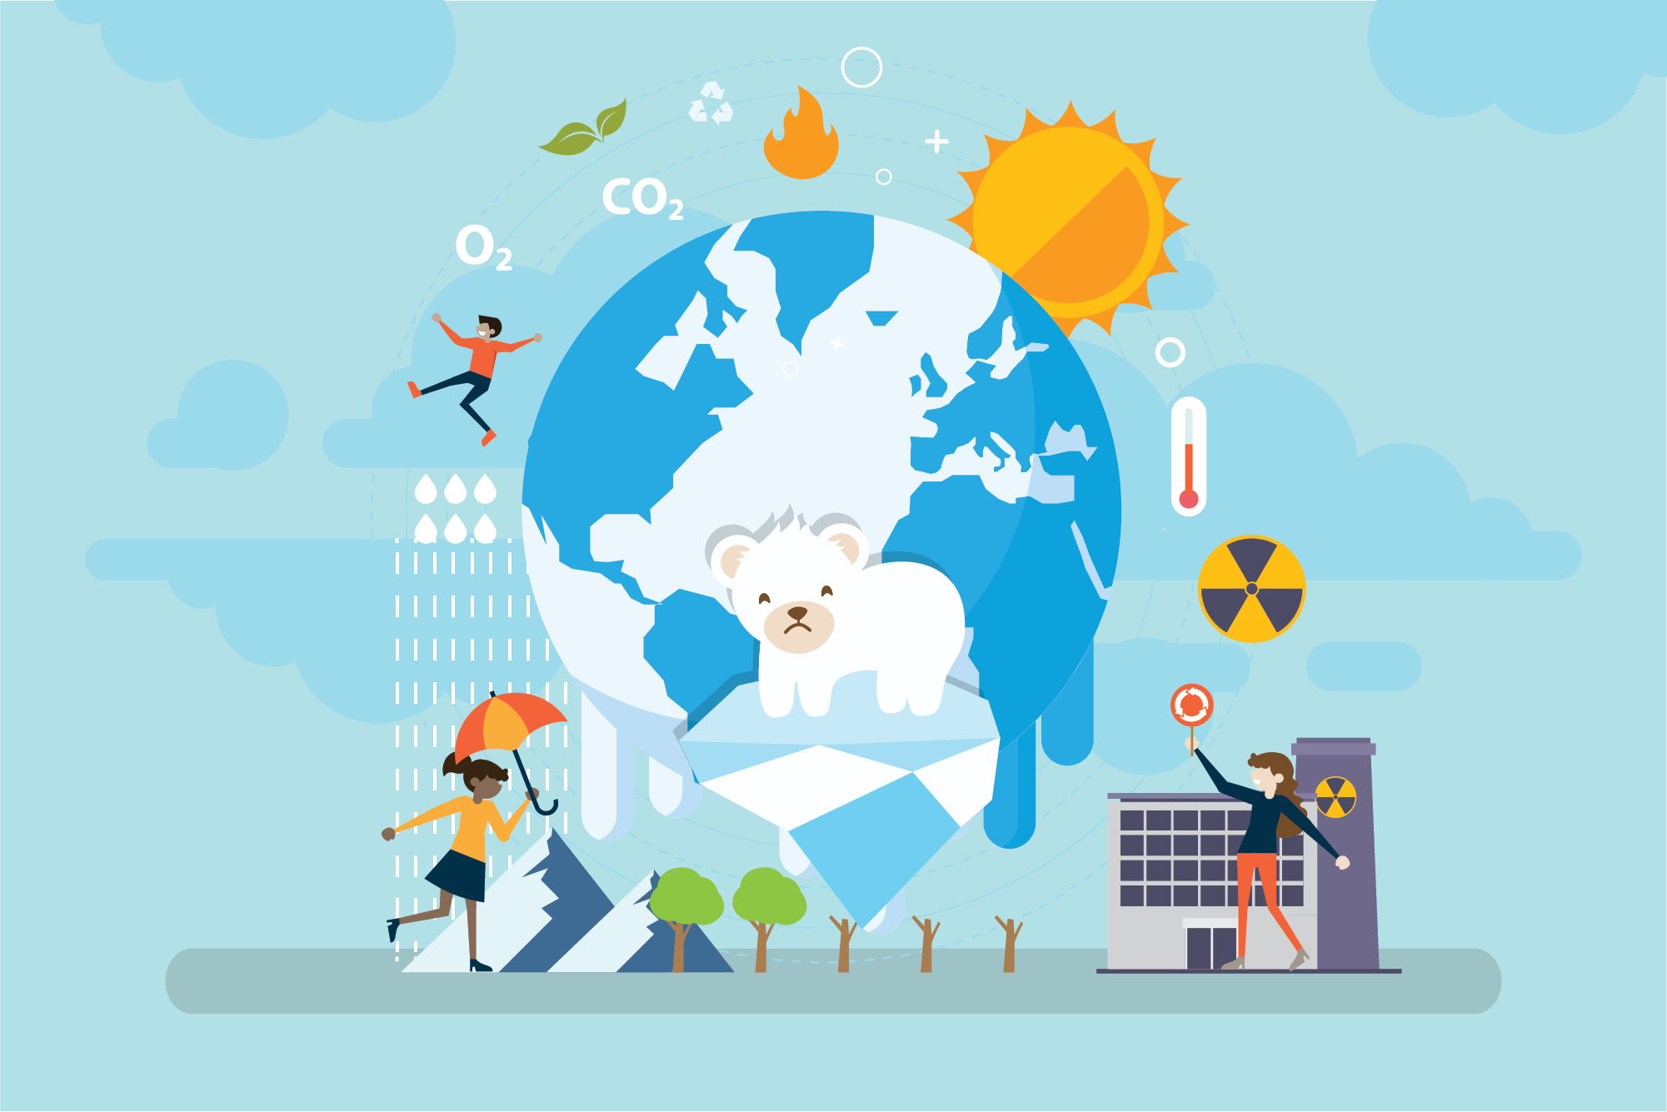
What does net zero mean?
#TechWeCan | Tech for Energy
Notes:
Now, before we end today, I just want to talk about something called net zero. All of the energy companies and technology we talked about today are aiming to work towards net zero. So what does net zero actually mean?
Here’s a short clip from the National Grid to explain:
https://www.youtube.com/watch?v=XKM7W4KtSjQ
So when you graduate from school and university we will have hopefully be well on our way to achieving net zero as a country and many individual companies will have hopefully achieved net zero by then. It’s definitely an exciting time to watch this area of technology and be able to have a career which could really make a difference to help us protect our planet for the future.

Slide 13
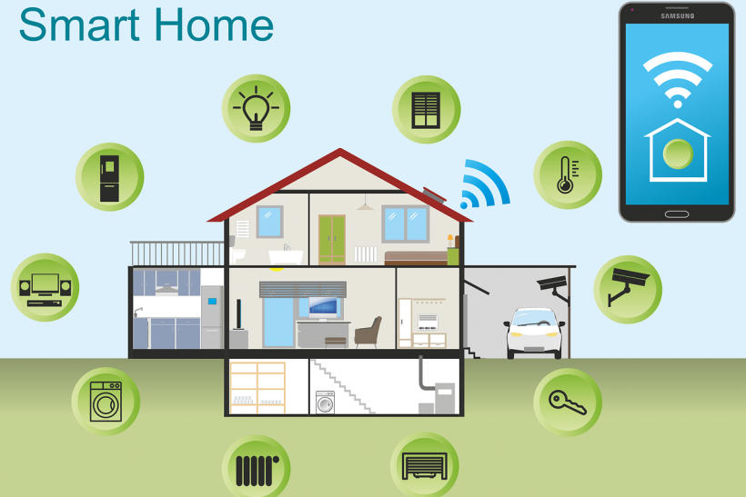
Your challenge: Design a smart home device of the future. Draw a diagram to explain how your device works and how it would help the home owner save energy.
Please ask your parents to share your work on social media using #TechWeCan or email us at info@techshecan.org
#TechWeCan | Tech for Energy
Notes:
Time for your Tech for Energy challenge and we would like to set you a task based around the smart homes of the future.
We would like you to think of a device which could be used in smart homes. We would then like you to draw us a design and label your smart home tech to explain how it works and how it helps save energy. Think about how you could link technology and devices around the home.
For example you could link a sensor in the mat by the bed to the bedside lamp. When you lift your feet off the mat it turns the light off and when you get out of bed in the night, maybe to go to the toilet, it turns the light back on. This could save people leaving lights on so they can see where they are going at night.
Or you could link the car garage door to all of the lights and plug sockets in the house. When you go out to work for the day, the sensor could turn off all of the plugs which are not needed. Obviously not things like the freezer or that could be messy when you get home!
We absolutely love to see your Tech We Can challenges and if you would like us to give you feedback on your work then please email it to us or ask your parents or teachers to share it on social media using the #TechWeCan.
I cant wait to see what you come up with. You never know, your tech designs could help us all save energy and therefor protect our planet in the future.

Slide 14
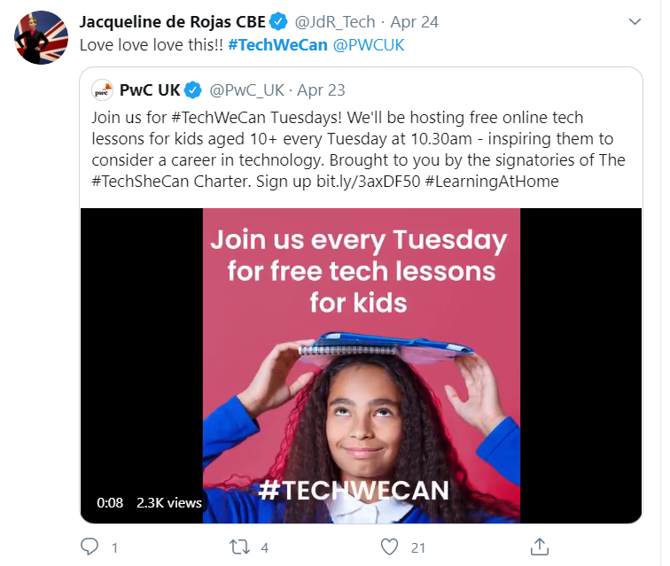
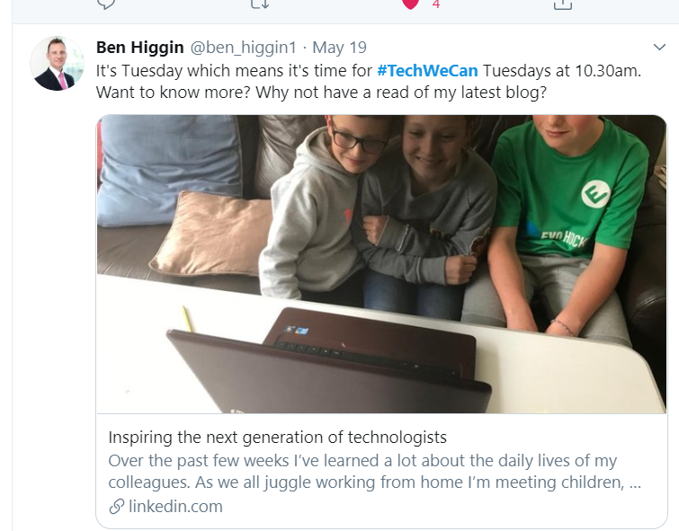
“Our Tech We Can lesson plans are part of our commitment to upskill the communities we’re part of - without urgent attention, many risk getting left behind as technology changes how we live and work. The current crisis we face has provided a stark reminder of the critical value of skills in science and technology.”
Sheridan Ash, Co-CEO Tech She Can
For more information about Tech She Can and free access to all of the Tech We Can resources we have spoke about today, please visit: https://www.techshecan.org/
Follow the hashtags #TechSheCan and #TechWeCan to stay up to date with us on social media.

