Slide 1
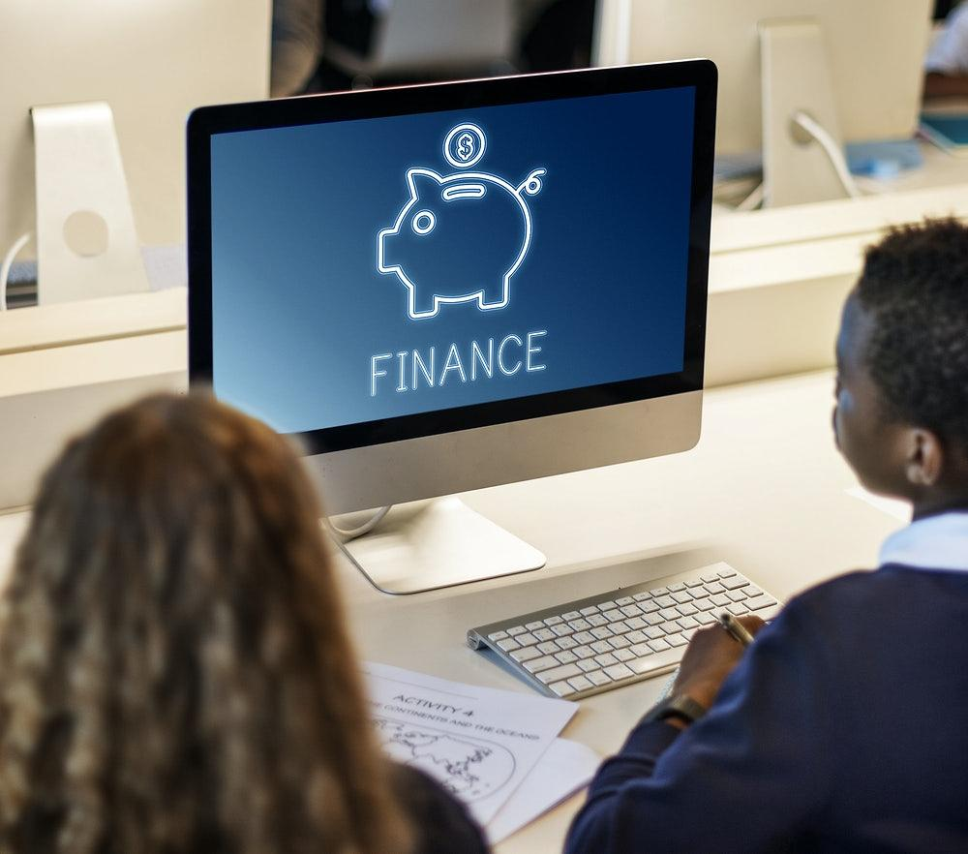
Money
TECH FOR
To be able to explain how technology is used for finance. To broaden my knowledge of careers available in this field.
Notes:
Hi Everyone, my name is ………. and this Tech We Can lesson is Tech for Money .
So …. our aim today is to show you lots of different and interesting ways technology is being used to buy and sell things and how technology is changing the future of money.
We want to highlight the people behind this tech and the types of jobs they have. Hopefully you might consider one of these jobs for your future.

Slide 2
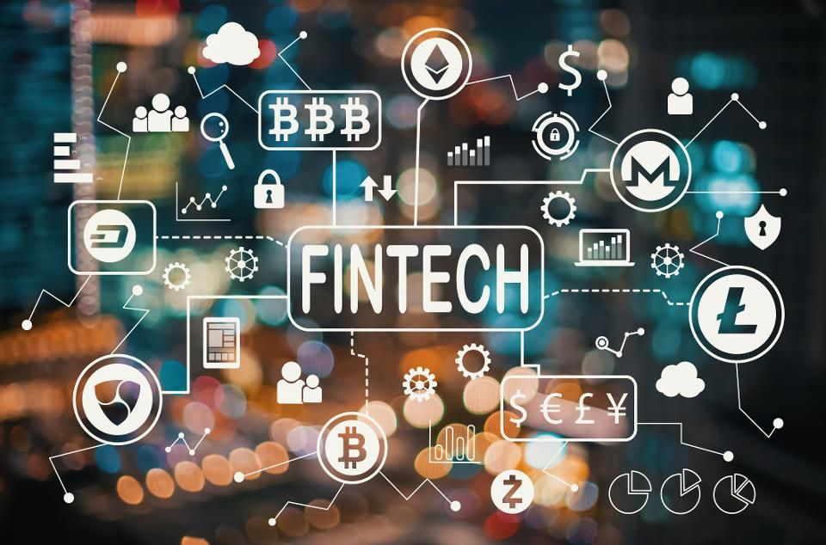
The history of money and how technology has changed how we buy and sell things.
#TechWeCan | Tech for Money
Notes:
Before we start looking at how technology is changing the future of money, I want to take a moment to look into the history of money.
When you think about it, money is actually quite a strange thing. Little bits of paper or metal which we give and receive to swap for things like food or toys.
Thousands of years ago, before money existed, people would actually trade items or even animals as payment for things (so here’s 10 cows and I’ll have your house please).
Coins first appeared around 600bc in what is now known as Turkey and paper money then appeared in China around 1000 years later. Cash Machines were then only invented around 50 years ago.
Today we are going to look at some of the ways technology has taken over the world of money and trading. As you can see from the top image, this will include everything from contactless payments to crypto currency.
You will also see and hear the word finance lots in today's lesson as this is another word we use when we are talking about money and transferring money to different places or people.
You might also here FINTECH which is simply short for financial technology. So this means any ways computer programmes and technology are used for the management and movement of money.

Slide 3
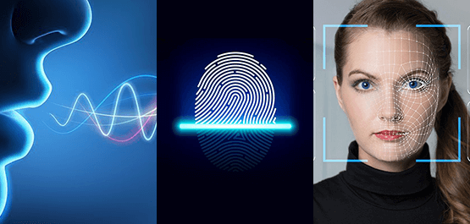
Cash to cashless society
#TechWeCan | Tech for Money
Notes:
So as technology has improved and advanced, we actually no longer need physical money or things to trade and this as this is now done through technology. Our society is moving towards a cashless society. A cashless society is where no physical forms of money like coins or notes are used and all payments and transfers are completed through the use of technology. The Covid19 pandemic has made this use of technology even more common and popular as cashless payments often mean you don’t have to touch anything else so you are less likely to spread germs,
Some countries like China now have the majority of their payments as cashless payments and in some towns and cities it is very rare for anyone to pay with cash.
With cashless payments, because we are not typing in a code or signing anything, the system must make sure it is the owner spending money and not someone trying to steal their money. Many banking apps now do this through biometrics. Biometrics simply means the unique feature of our bodies – this could be the way our voice sounds, our fingerprints or the shapes of our faces.
Let’s have a look at a clip from Natwest which explains biometrics in more detail: https://www.youtube.com/watch?v=BPFgJ5HOazQ
I wonder how long it will be until the area you live in becomes cashless or what we will be able to use instead of a password in the future?

Slide 4
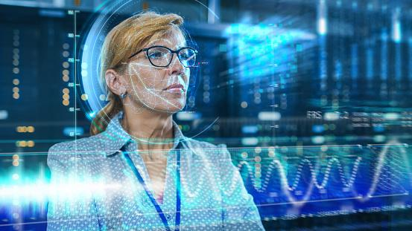
Careers in cashless technology
Fintech Software Developer
Biometric Engineer
As a fintech software developer, you could design, build and test the software used by banks and other financial companies. This could include creating brand new payment technologies.
As a biometric engineer, you could work to design new and more secure ways of using our unique features to protect our personal data and finances. Biometric engineers also work in other areas such as healthcare.
#TechWeCan | Tech for Money
Notes:
If you like the sound of a future job working with cashless technology then one of these jobs could be perfect for you to consider for the future.
You could be a fintech software developer. All of the cashless machines and technology we use has to be developed and designed by someone. As technology advances, people will be thinking of new and innovative ways we can pay for things in a cashless society. As a fintech software developer, you could design, build and test the software used by banks and other financial companies. This could include creating brand new ways of paying for things through tech.
You could be a biometric engineer. As a biometric engineer, you could work to design new and more secure ways of using our unique features to protect our personal data and finances. Could you possibly find a way of making voice recognition more accurate so we could pay for things simply using our voices. Biometric engineers also work in other areas such as healthcare.

Slide 5
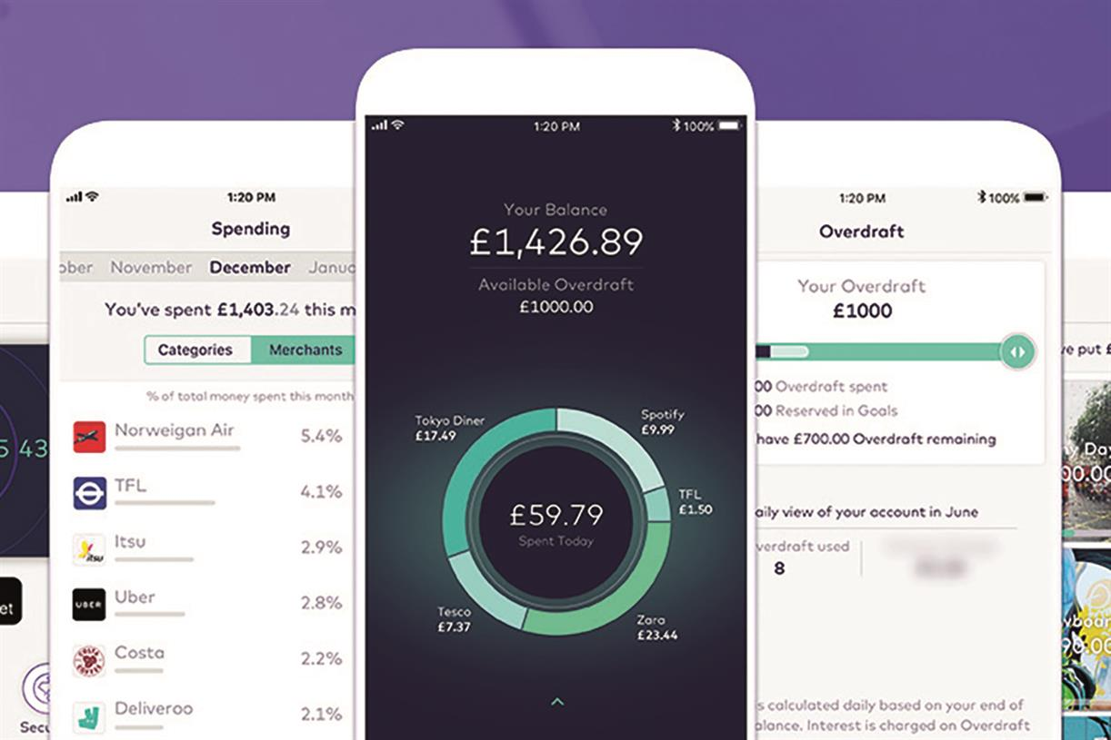
Tech used for money management
#TechWeCan | Tech for Money
Notes:
When it comes to money, one of the most important skills we can learn, no matter our age, is how to manage our money properly. We need to learn how to save for the future and how to budget to make sure we have enough money for essential things like a place to live and food. To add money into your bank account or transfer money, you no longer need to go to the bank or even log onto your computer – all these things can be done via apps on your phone. The picture on the left is actually from a bank called Starling Bank. Starling is a neobank also know as a digital bank. A neobank or digital bank is a bank which has no branches and everything is done online. Their app shows you exactly what you are spending, where you are spending exactly as it happens so you can better control your money. Also the app notifies you every time money goes in and out of your account so rather than having to remember to check you bank you are aware of this all of the time.
I also want show you an example of how a game can help teach children and adults money management skills.
The game in the picture on the right is called Island Saver. Island Saver is created by a bank called Natwest. Natwest have a number of fantastic resources to teach you about the world of money but this is one of my favourites. This game is designed for 7 – 12 year olds, it’s available on most consoles such as Nintendo, X-box and PlayStation and the game has already had millions of downloads. The game allows you to have fun whilst also learning how to manage your money and help fight climate change at the same time.
Here’s a little clip of the game in action:
Play intro clip from: https://natwest.mymoneysense.com/island-saver/
For games like this and many others – visit mymoneysense.com

Slide 6
Careers in tech to manage money
App Designer
Computer Game Designer
As an app designer, you could design the mobile banking and money management apps of the future. Perhaps you could design an even easier or safer way for people to transfer money to each other and pay for things.
As a computer game designer, you could design and create games to help teach people money management. Games can obviously be fun but we can also use games to help educate players at the same time.
#TechWeCan | Tech for Money
Notes:
If you like the sound of a future job helping other people to manage their money and save for the future then one of these tech jobs could be for you.
You could be an app designer. As an app designer, you could design the mobile banking and money management apps of the future. Perhaps you could design an even easier or safer way for people to transfer money to each other and pay for things
You could also be a computer game designer. As a computer game designer, you could design and create games to help teach people money management. Games can obviously be fun but we can also use games to help educate players at the same time.

Slide 7
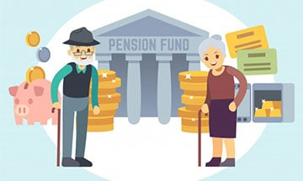
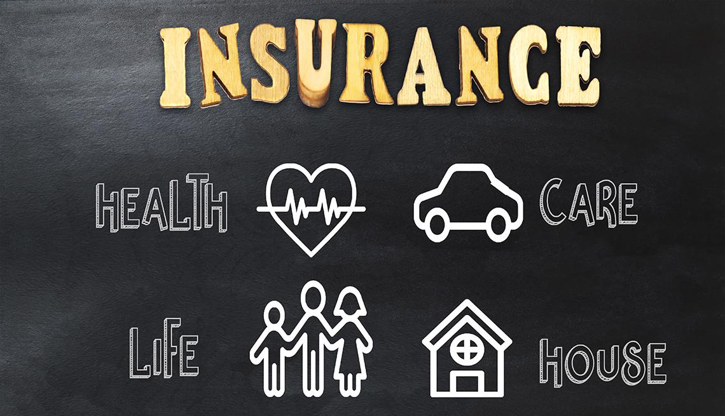
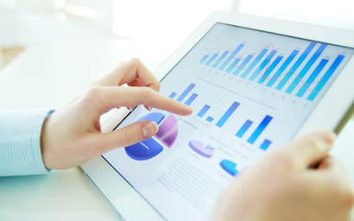
Tech used to protect future finances
 | If people die their income can be insured so the family who lost someone will still receive money to continue living their lives
 | If you accidentally lose or damage things you own they can be replaced or paid for
#TechWeCan | Tech for Money
Notes:
When it comes to money, we don’t only have to think about budgeting so we have enough money this week, or in a few months time, we also have to try and plan for the future.
You may have heard of the words pensions and insurance. When we grow older, many people stop working and retire. However they still need money for all of the essential things in their lives such as food and a place to live. This is when people start using their pension. Throughout their working lives people have the option of saving part of their money each month towards their pension. The more they save whilst working, the more money they will have to live from when they retire.
Then we also have insurance. Both people and objects can be insured. Insurance is when you pay a set amount to protect the loss of money or something which is important to you. For example, if an insured person passed away, their family would receive money to help them continue living their lives. Or you could insure your phone, so if it was lost or damaged then you could get a replacement for it. Insurance companies don’t just do this for free though. To have insurance, you pay an insurance company an amount of money each month to make sure something is insured.
Now this is where the tech comes in. To calculate all of these things, for example how much insurance you should pay or even how much money an insurance company should save just in case you break your phone or crash your car, lots of data (numbers, facts and statistics) needs to be analysed using computer programmes to try and predict the correct amounts of money that should be paid and saved.

Slide 8
Careers in tech to protect future finances
Actuary
As an actuary you could use your problem solving and mathematical skills to help people and organisations to reduce their risks of not saving enough money for the future (this includes pension companies and insurances companies). You will look at the past to try and predict the future. As an actuary you could also use your mathematical skills to help solve important worlds problems you such as helping to fight climate change and COVID-19.
#TechWeCan | Tech for Money
Notes:
Analysing all of this data is down to people called actuaries. As an actuary you could use your problem solving and mathematical skills to help people and organisations to reduce their risks of not saving enough money for the future (this includes pension companies and insurances companies).
Actuaries use their mathematical and statistics skills to solve important problems. They look into past events and predict the risk of these events happening again in the future. As an actuary you could also use your mathematical skills to help solve important worlds problems you such as helping to fight climate change and COVID-19.
If you enjoy maths, numbers and calculations then this could be a perfect role for you to combine this skill and helping others at the same time.

Slide 9
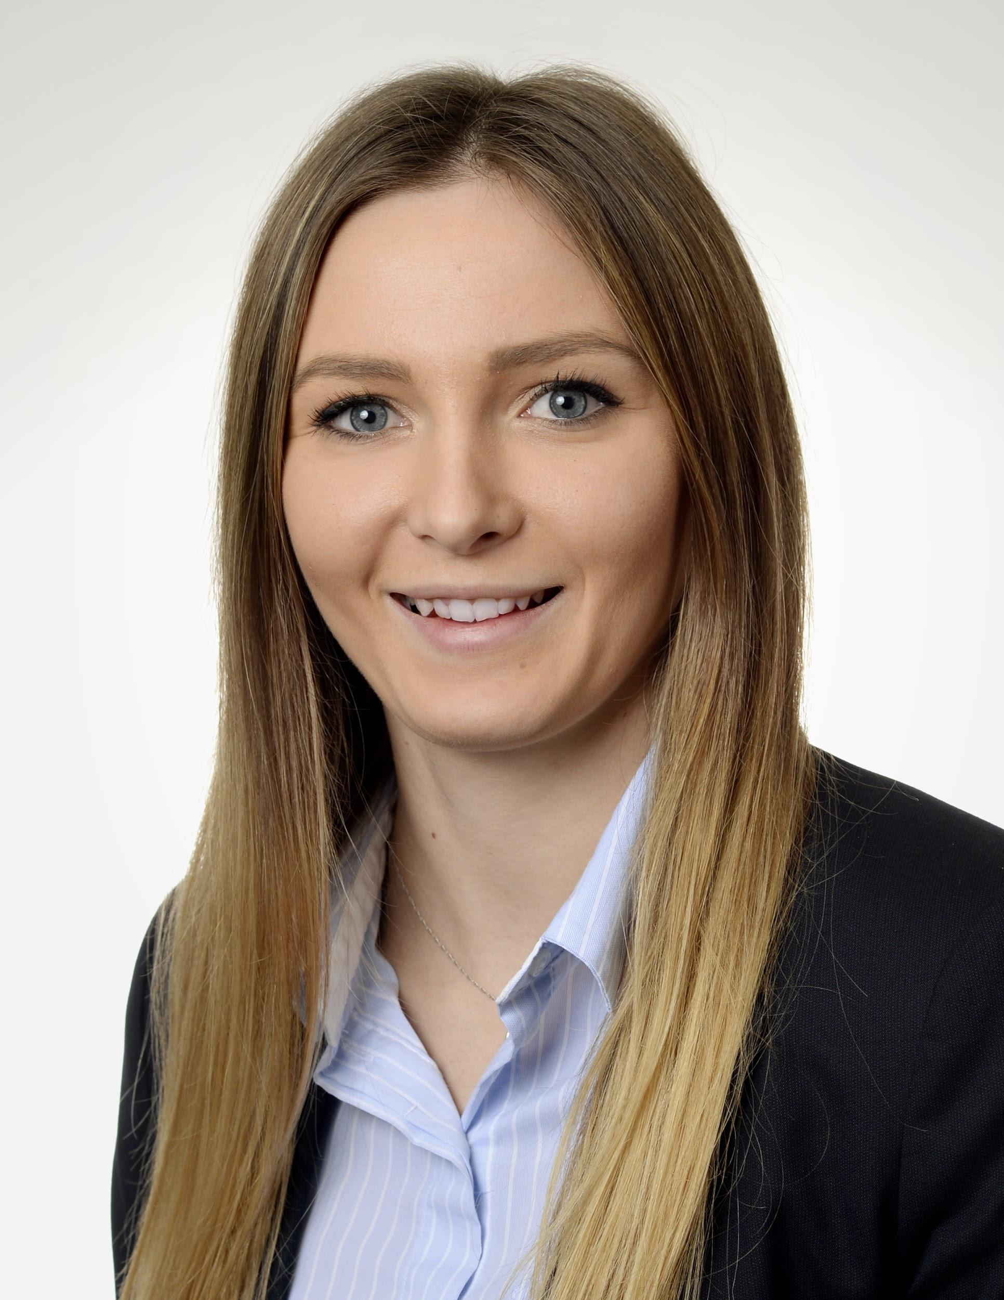
Meet today’s first role model
Lara Cooper
Senior Actuarial Associate - Risk Modelling Services
#TechWeCan | Tech for Money
Notes:
The role of an actuary can be quite tricky to understand so Becky from the Tech We Can team had a chat with Lara to find out more about what her job involves.
Lara works for a company called PwC. Let's have a listen to what it means to be an actuary so you can see if this role may interest you.
PLAY VIDEO (picture hyperlinked)from 19:10 - 26.25
I found it really interesting when Lara said ……

Slide 10
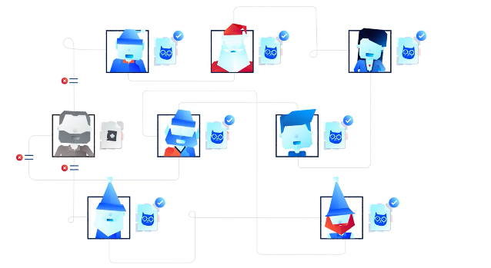
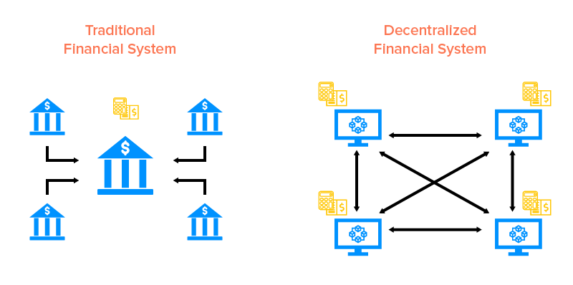
What is blockchain technology and how is this used to transfer money?
2009 - Bitcoin
Current - 9000 + Alt Coins
Tech We Can | Tech for Money
Notes:
We now going to move onto discussing a piece of technology called blockchain. Before I discuss how blockchain is used in the world of money, I just want to take a moment to explain what a blockchain is at how it works.
So a blockchain is way of digitally recording information so that it is secure and very difficult to change, hack or steal that information. How it works is rather than one computer storing something, that same piece of information is stored on many different computers at once.
Here is a short animation from a blockchain company called Lisk explaining how it works in a bit more detail:
https://www.youtube.com/watch?v=vPMDpb9ho4s
There are many different uses of blockchain but one use which relates to money is Decentralized Finance (also knowns as DeFi). Decentralized finance means that money is not stored in one specific place. When you go to Tesco and pay for your shopping with your bank card, Tesco send your bank a message to pay them the money which you have agreed to take out of your account. DeFi is when there is no middleman or middle bank you could say. The money goes straight from you to the person or company you are buying something from through the use of blockchain technology.
You may have also heard of something called crypto currency. Crypto currencies run through the use of blockchain technology. So users can safely and securely transfer cryptocurrencies to each other using the blockchain.
An example of crypto currency, which you may have heard of, is Bitcoin. In 2009 Bitcoin was launched and we now have over 9000 Alt coins. The alt stands for alternative. So Bitcoin was the original crypto currency and since 2009 thousands of other coins have been created for people to transfer to each other using the blockchain. This area of technology is rapidly developing so definitely something to keep an eye on if this interests you.

Slide 11
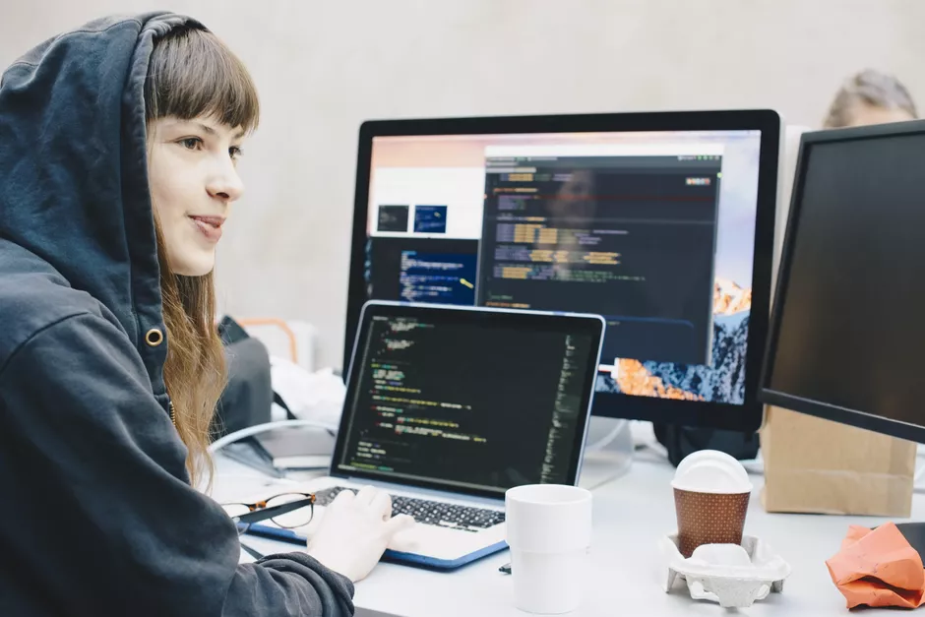
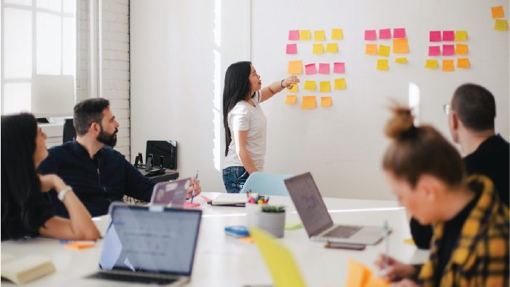
Careers in blockchain
Blockchain Developer
Blockchain Consultant
As a blockchain developer, you could be responsible for developing and creating blockchains. You could programme and code the computers within a blockchain to know exactly how they should work.
As a blockchain consultant, you could research, analyse and test blockchain technologies. You could help advise companies as to how they could use blockchain to enhance and improve the way they do business.
#TechWeCan | Tech for Money
Notes:
If you like the sound of working with blockchain or cryptocurrency then one of these future jobs could be for you.
You could be a blockchain developer. As a blockchain developer, you could be responsible for developing and creating blockchains. You could programme and code the computers within a blockchain to know exactly how they should work.
You could also be a blockchain consultant. As a blockchain consultant, you could research, analyse and test blockchain technologies. You could help advise companies as to how they could use blockchain to enhance and improve the way they do business.

Slide 12
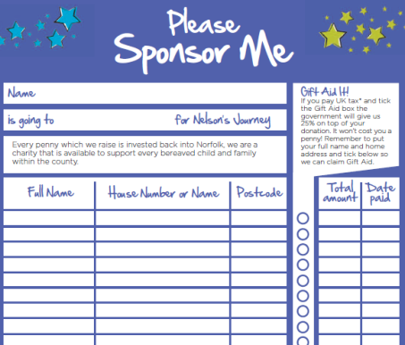
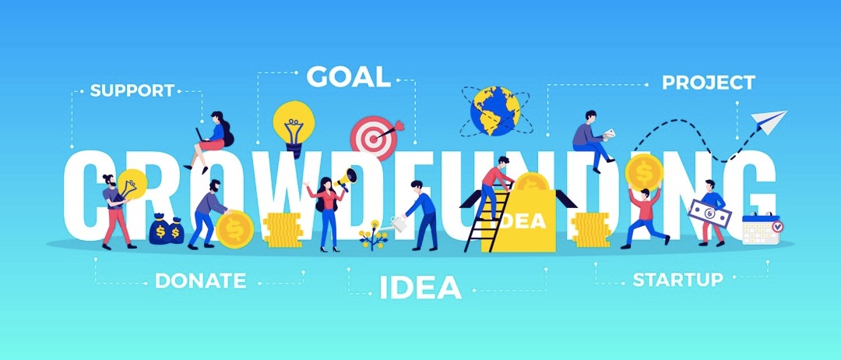
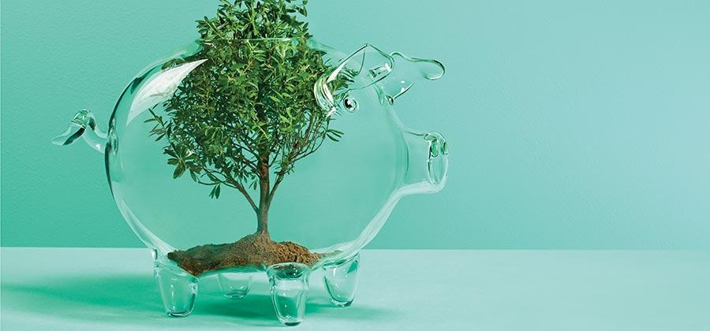
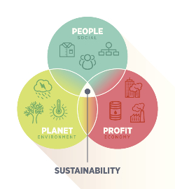
Tech for Good and Finance
#TechWeCan | Tech for Money
Notes:
I now want to move onto to talking through a couple more examples of how technology is used for good in the world of money and finance.
So …. when I was at school, if we wanted to raise money for charity, we would have a sponsorship form and have to go around our family and friends asking us to sponsor us. I often collected the money in a little envelope too. You can see and example of a sponsorship form in the top left. You may have used these too. There is a much easier way to raise money through the use of technology and crowdfunding. This is through websites or apps like JustGiving and GoFundMe. Through technology you can ask people to donate money to you. This could be for a charitable reason like helping someone get enough money for medical treatment or someone might have an idea to start a new business but doesn’t have enough money to start that business by themselves. One of the best things about using technology to raise money is how far and wide you can spread your request to help through the internet. People from all over the world could learn about you , what you are trying to do and donate money to help.
I think crowdfunding is a great example of using technology for good and to help others.
The big pig on the bottom of the page with the random tree growing inside it represents sustainable finance. Some companies look to invest in other companies. This means they give them money to help them develop or start their business. Sustainable finance is when the companies investing their money look very closely and carefully at business which are trying to be more sustainable. They will look for companies who are working towards protecting the environment or helping others in their society for example.

Slide 13
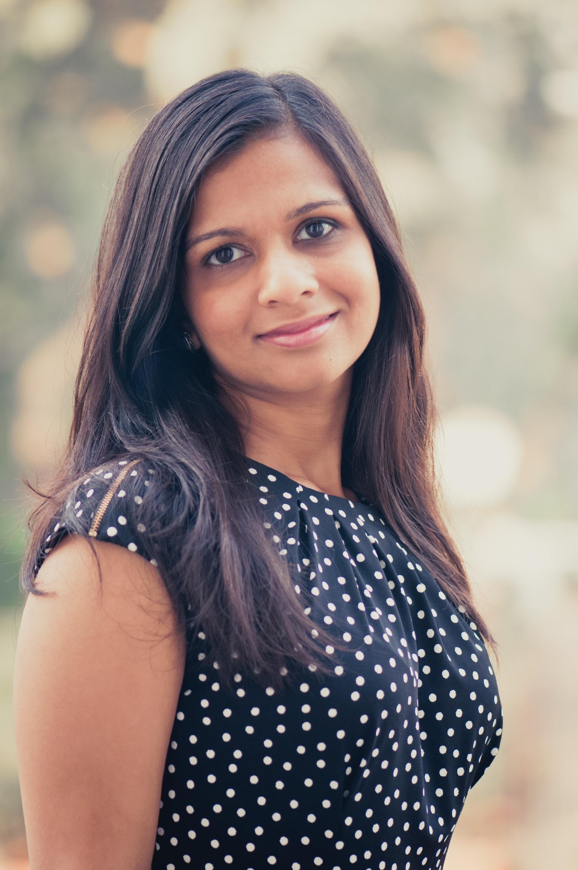
Meet today’s second role model
Jigisha Lock
Head of Global Products/Core Compliance Services Technology
#TechWeCan | Tech for Money
Notes:
In sustainable finance, you can have a job where you are both working with finance and looking at sustainability and protecting the future of our planet.
Our next role model today is called Jigisha. Jigisha works for a company called Credit Suisse. In Jigisha’s day job she focuses on both finance and sustainability. Becky from the Tech We Can team had a chat to Jigisha to find out a little more about what her job is all about. Let’s have a listen to what she had to say:
PLAY VIDEO (image hyperlinked) from 36.44 - 44:30
I found it really interesting when Jigisha said ……

Slide 14
Careers in tech for good and finance
Sustainable Finance Consultant
As a sustainable finance consultant you could help make sure banks and companies are more likely to support other organisation who are trying their best to look after people and the planet. You could also advise companies on how they could best invest and spend money to make their organisation more sustainable.
#TechWeCan | Tech for Money
Notes:
If you have a both a passion for finance/maths and for protecting the planet then you could be a sustainable finance consultant.
As a sustainable finance consultant you could help make sure banks and companies are more likely to support other organisation who are trying their best to look after people and the planet. You could also advise companies on how they could best invest and spend money to make their organisation more sustainable.
When you think about it, the history of money spans over thousands of years but many of the tech examples we have spoken about today have only been in use more recently.
I’m sure this area of technology will continue to grow and advance so who know what the future of finance and technology will be like when you leave school for the world of work.
Thank you for joining me today. I hope you have enjoyed the lesson and learnt about some uses of technology which you may not have heard of before. I also hope some of the jobs we have spoken about sound interesting to you.

Slide 15
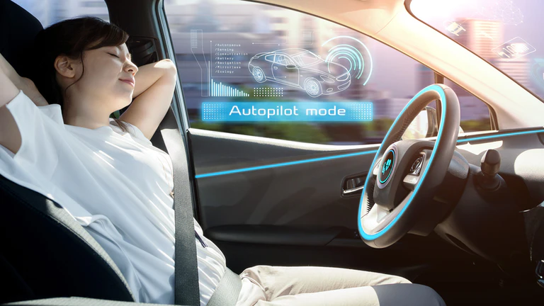
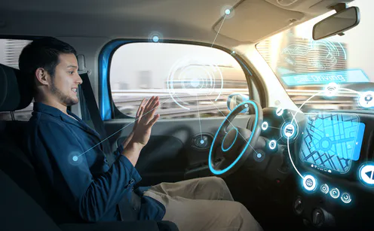
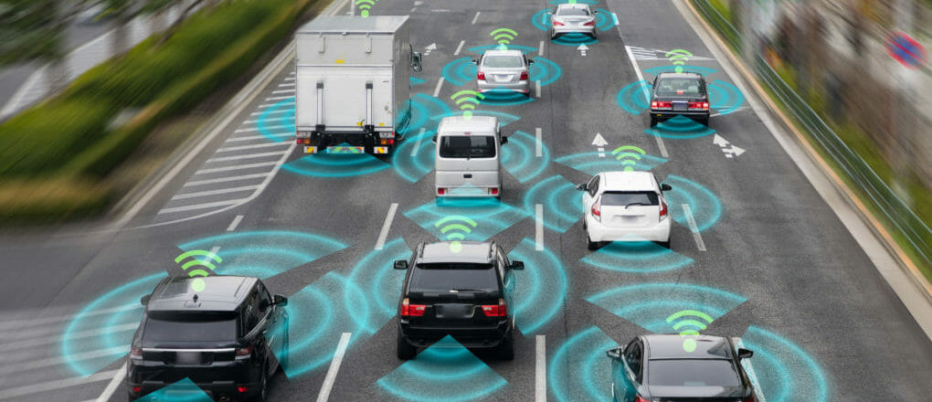
Your challenge: Could you be an actuary of the future? We would like you to test your actuary skills and decide if there will be more or less accidents on the road with driverless cars. Make a poster or presentation to show your research findings and prediction.
Background information
You are an actuary working for a car insurance company. More and more people are starting to buy driverless cars. You want to know whether the company should increase or decrease the price of car insurance.
Research and then make a poster showing the pros and cons of driverless cars. Make a predication as an actuary. Do you think there will be more risk? Does the insurance company need to increase the cost of their car insurance?
Please ask your parents to share your work on social media using #TechWeCan or email us at info@techshecan.org
Tech We Can | Tech for Money
Notes:
Time for your Tech for Money Challenge. We want to see if any of you could be a future actuary. Remember actuaries have to try and predict the risk of something happening so they can make sure companies like insurance companies save enough money to afford any payouts they might have to make to customers if they, for example, crash their car.
We would like you to try and decide if you think there will be more or less accidents on the road when the majority of cars are driverless. To do this, you will need to research driverless cars and find out some facts about them.
We would like you to then create a poster showing the pros and cons of driverless cars and state whether you think they will cause more accidents or not.
The Tech We Can team absolutely love to see your Tech We Can challenges and if you would like them to give you feedback on your work then please email it to us or ask your parents/teachers to share it on social media using the #TechWeCan.

Slide 16
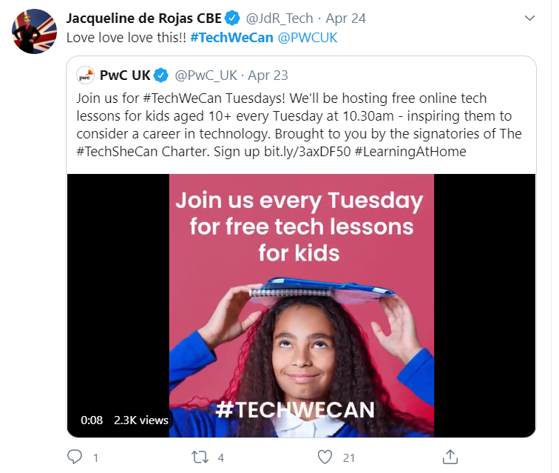
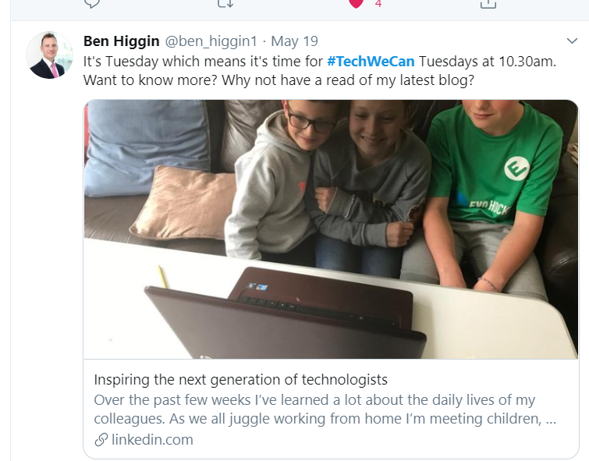
“Our Tech We Can lesson plans are part of our commitment to upskill the communities we’re part of - without urgent attention, many risk getting left behind as technology changes how we live and work. The current crisis we face has provided a stark reminder of the critical value of skills in science and technology.”
Sheridan Ash, co-CEO Tech She Can
For more information about Tech She Can and free access to all of the Tech We Can resources we have spoke about today, please visit: https://www.techshecan.org/
Follow the hashtags #TechSheCan and #TechWeCan to stay up to date with us on social media.

