Slide 1
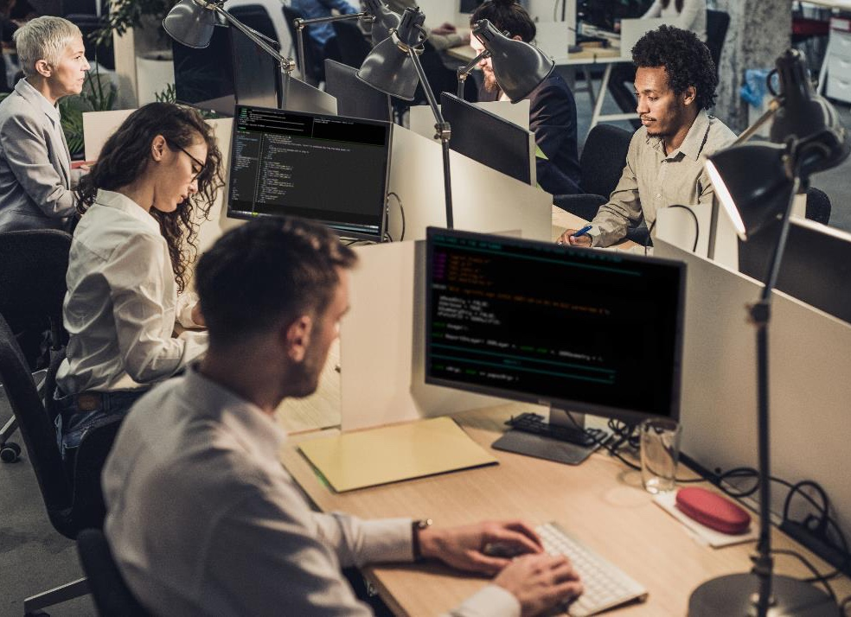
Safety and Security
TECH FOR
To understand how technology is used for safety and security To broaden my knowledge of careers available in this field
Notes:
Hi Everyone, my name is ?????? and this Tech We Can lesson is Tech for Safety and Security.
So …. our aim today is to show you lots of different and interesting ways technology is being used to keep us safe in our daily lives both online and offline. We want to highlight the people behind this tech and the types of jobs they have. Hopefully you might consider one of these jobs for your future.

Slide 2
Where can you go to get advice and guidance about keeping safe online?
#TechWeCan | Tech for Safety and Security
Notes:
Before I start today, I just want to highlight that we live in a very connected world where the uses of technology are changing all of the time. Unfortunately, this also means that we must stay up to date and aware of some of the dangers of being online.
In today’s Tech We Can lesson we are going to be focussing on technology being used to improve our safety online and offline and the careers people have in this area - we will not be giving you detailed advice about how to keep yourself safe online.
We do however think that it is very important for all of us, no matter our age, to know how to keep safe online and to know where to look for help and support. On this page, we have included some of the organisations which support children, young adults, teachers and parents with online safety. You can go to these organisations to get great advice and guidance about online safety. Please do check these out after the lesson today.

Slide 3
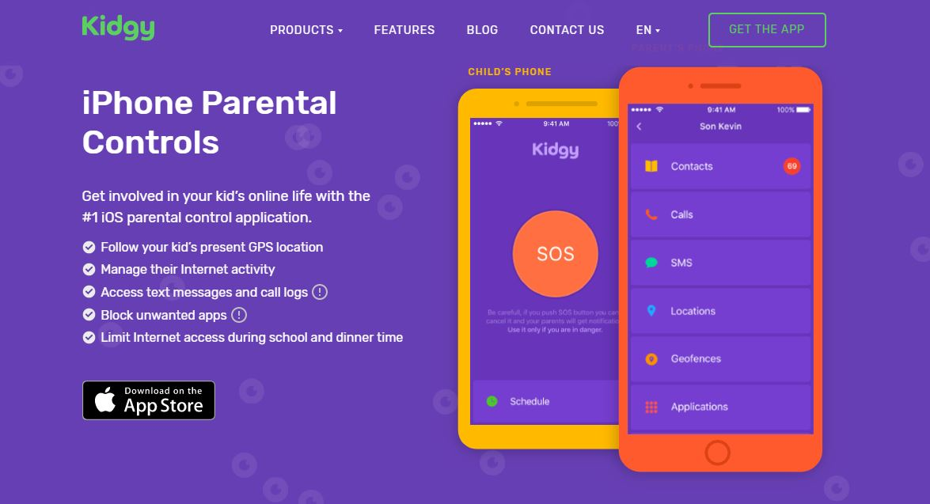
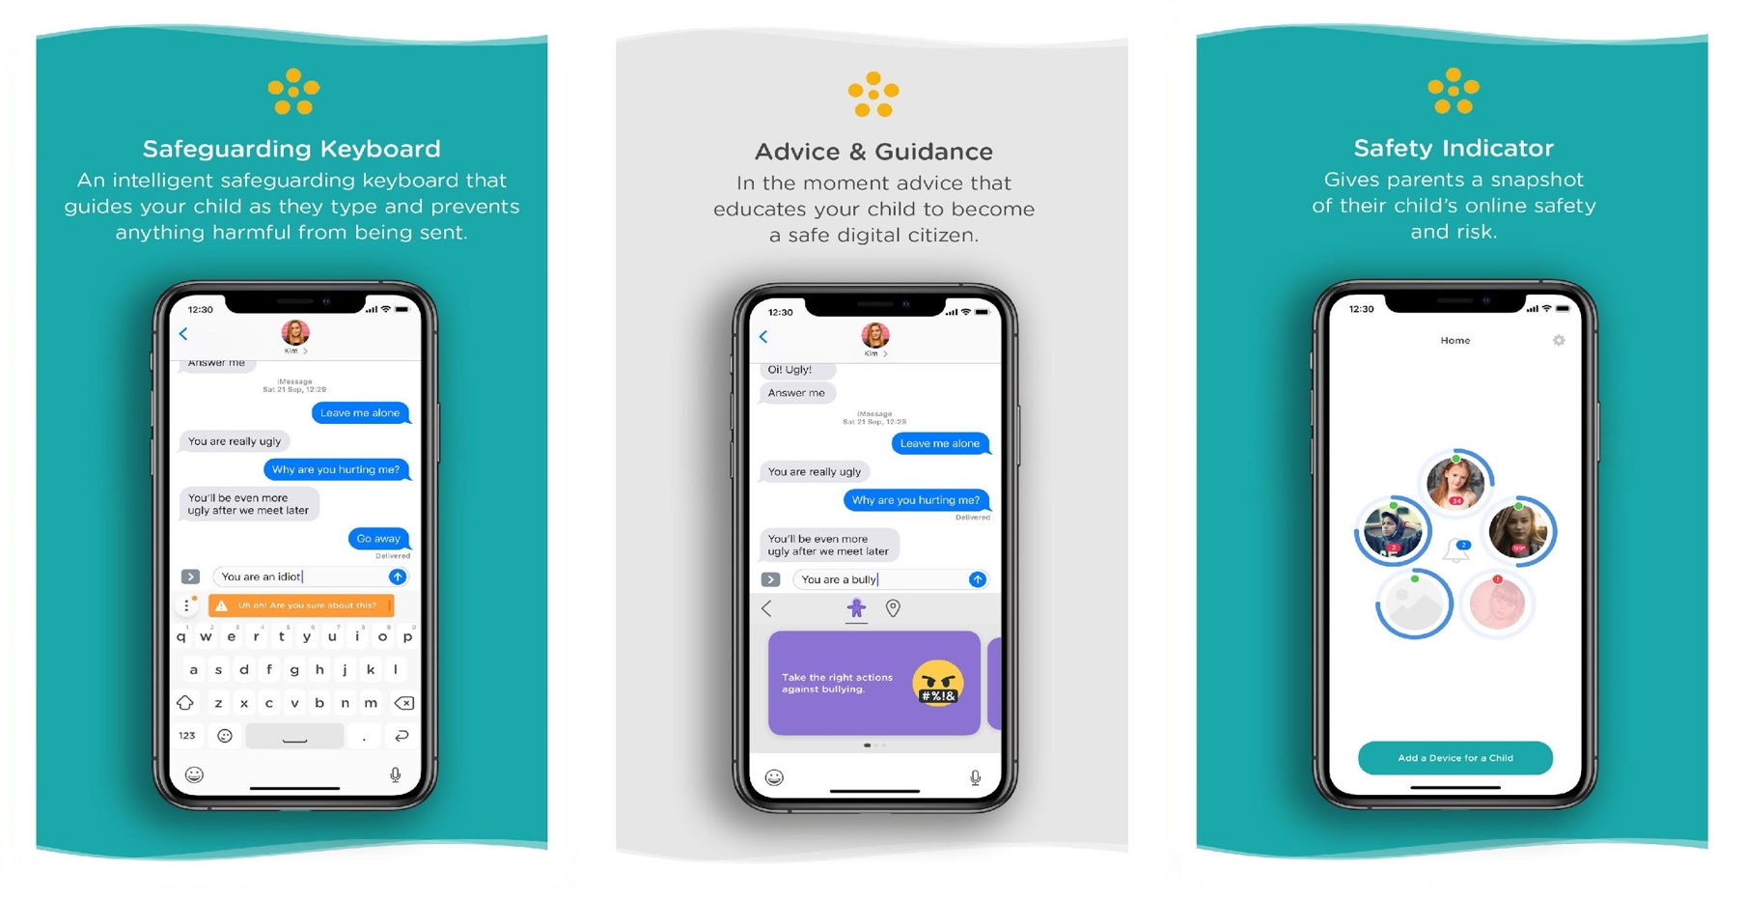
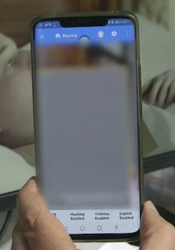
Technology used for personal safety online
#TechWeCan | Tech for Safety and Security
Notes:
We are going to start today by having a look at how technology is used for personal safety online. Remember … online doesn’t just mean when you use a search engine such as Google to find something. You can also be online through toys, games consoles and home devices like Alexa and Google home.
First I want to talk about search engines. Simply misspelling something on Google or searching a name of something which has more than one meaning, can cause images or information to pop up which is not appropriate or upsetting for us to see. KidzSearch is a great search engine which automatically searches Google and filters out content which is not appropriate for children or young adults to see or read. A fab idea for making sure children are safe when they are researching things online.
There are also a number of different apps which can be installed on devices to allow parents to keep children safe online. An example of this is Kidgy. The picture on the top right explains some of the features of the Kidgy app. Parents can use the app to get reports of their child’s internet activity, block unwanted apps and limit internet access time. Here is the Kidgy advert to explain more
PLAY CLIP - https://www.youtube.com/watch?v=noz3KwXQrYg
I know some of you might be thinking, “no way …. I don’t want Mum and Dad to know all of that” BUT it’s really important to remember that children much younger than some of you have access to the internet on so many different devices so it's really important that someone is looking out for them and keeping them safe from things they might accidentally come across. As we get older, we can then be much better judges of what is and isn't appropriate for us to watch.
Next I want to talk about 2 really clever pieces of tech created by a company called SafetoNet.
The first thing they have created is called the Safeguarding Assistant which is the picture in the bottom left. This uses a smart keyboard to monitor words children are typing in texts and messages. It doesn’t tell anyone about it or send the messages to parents – they only get an overview of the child's activity. Instead, the Safeguarding Assistant pops up warning to reminding the child that words they are using might not be kind or they might be seen as bullying or aggressive. Also if a child types in words like depressed, the tech directs them towards safe places to get advice and support. I think that’s such a good idea!
The second piece of tech created by SafetoNet hasn’t been fully developed and tested yet but it’s another very clever idea. An AI system (which means Artificial Intelligence) monitors video content as it being viewed and blurs anything unsuitable before a child sees it. For example if you were watching a video and inappropriate violence or nudity was in the video, the screen would become blurred. It will be very interesting to see how that piece of tech develops.

Slide 4
Meet today’s first role model
Caroline Allams
Founder
Natterhub
#TechWeCan | Tech for Safety and Security
Notes:
We are now going to meet our first Tech for Safety role model. We are to hear from Caroline who is the founder of a company called Natterhub. Caroline's company specialise in online safety and digital literacy for children – so the Natterhub website is another great place for you to check out after today’s lesson.
Here is a clip of Caroline explaining what Natterhub is all about and what she really enjoys about her job.
PLAY VIDEO from 7:37 – 10:50 (Caroline image hyperlinked)
Isn’t it fantastic that Caroline had an idea and decided to do something about it. Perhaps some of you could be the entrepreneurs of the future like Caroline and set up your own companies.

Slide 5
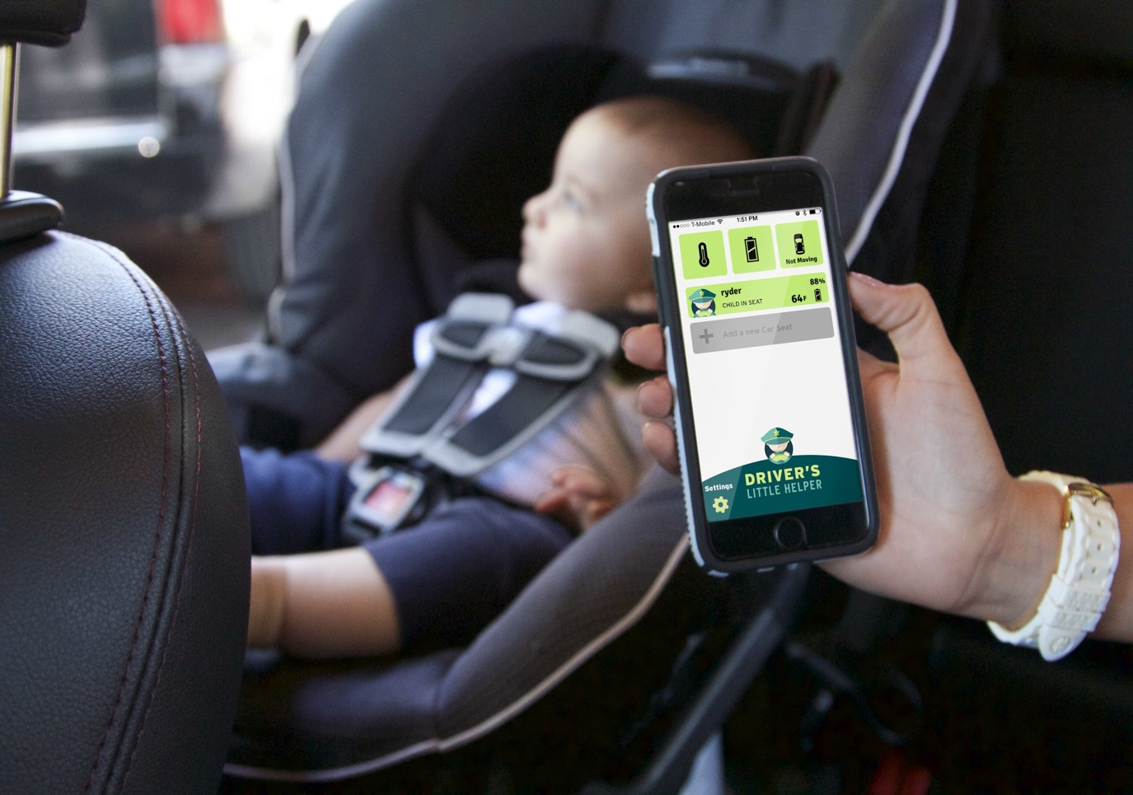
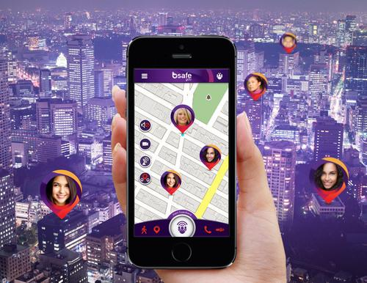
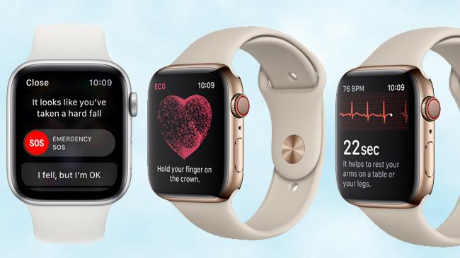
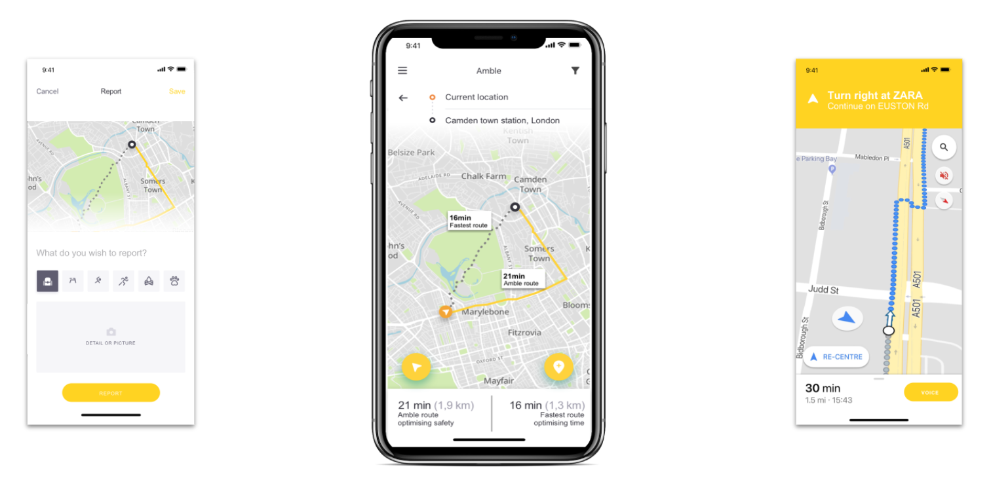
Top 5 tips for Cyber Safety
Technology used for personal safety offline
even worse, many small children are left in cars accidently each year.
Tech We Can | Tech for Safety and Security
Notes:
We are now going to have a look at how technology is being used for safety offline. This means in our everyday lives when we are travelling around. There are so many examples of tech I could show you here but I wanted to show you a few you may not have heard of before.
The first picture on the top left is of a special electronic monitoring system which can be put into babies and children’s car seats – it’s called Driver’s Little Helper. Often when parents are driving, they can’t see or monitor if children in the back of the car have stayed in the seat. Young children especially have a habit of wiggling their way out of the seatbelt. This can be very dangerous, especially if the car breaks sharply. Driver’s Little Helper is a sensor which goes under the pads on the car seat and connects to the drivers phone. It then send alerts to the phone if they are out of their seat. It even gives you a temperature reading so the driver can tell if the baby or child is too hot or too cold.
The picture on the top right is of an app called bSafe. How many times have you heard people say “text me when you get there or ring me when you get home?” . Well bSafe allows the user to select family and friends to track where you are. Also, if you're ever in a dangerous situation while walking alone, you can press a big red SOS button in the app. With the premium version, you can simply say a codeword to activate the SOS button. bSafe will immediately notify your connections and will start a live audio and video stream of what's happening around you. Your family and friends can then call the police if they see that you're in danger.
I’m sure you know that the bottom left picture is an Apple Watch but did you know about all of the clever safety features in the watch. Most recently this includes fall detection. Your watch can actually detect if you fall over or faint and gives you the option to call the emergency services by simply swiping across. I’m sure that will help so many people now and in the future.
The picture on the bottom right is of another really clever app called Amble. Amble isn’t just a standard GPS mapping device like Google Maps – it allows you to personalise your travels. For example, if you are walking home at night time, Amble can map out the a route for you which is the safest and best lit because areas which are better lit are more likely to be safer to walk through. It also uses landmarks to direct you rather than distance because we all know it can get a little confusing when your navigation app says ‘turn left in 30 meters’. It also speaks to you so you can keep it in your pocket rather than be looking down at your phone. So many clever features!

Slide 6
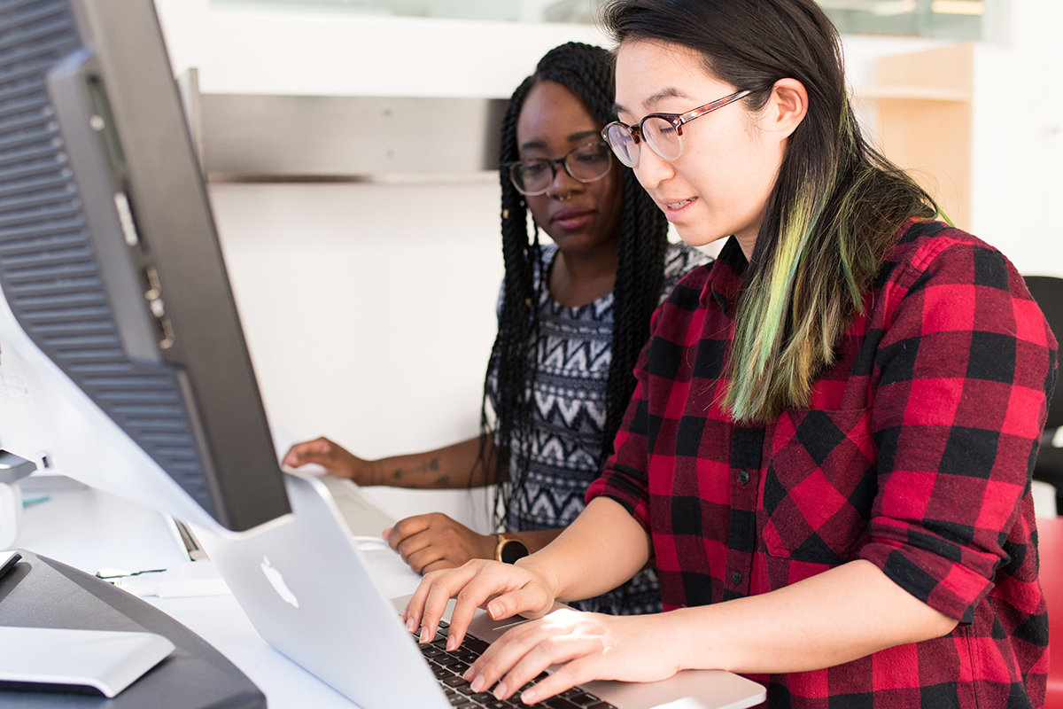
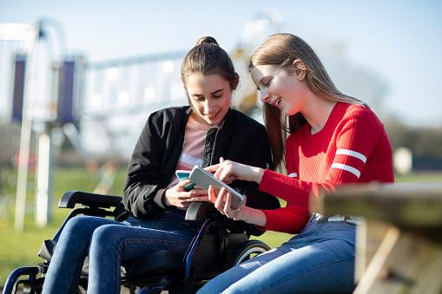
Careers in tech for personal safety online and offline
Net Developer
App Developer
As a net developer, you could be responsible for designing and developing online software for companies. This could include creating the safe search engines of the future or designing software to help protect people online and find threats or inappropriate content.
As an app developer, you could design and develop apps to help keep both children and adults safe online or offline.
#TechWeCan | Tech for Safety and Security
Notes:
I think what is really key to remember about online safety is that we will always need people working in this area and developing new technology. As technology advances, it brings with it new risks and dangers so its so important we have people continuously working to keep us safe in the online world.
If you would like a future career working to protect others online. You could be a Net Developer . As a net developer, you could be responsible for designing and developing online software for companies. This could include creating the safe search engines of the future or designing software to help protect people online and find threats or inappropriate content.
You could also be an app developer. As an app developer, you could design and develop apps to help keep both children and adults safe online.

Slide 7
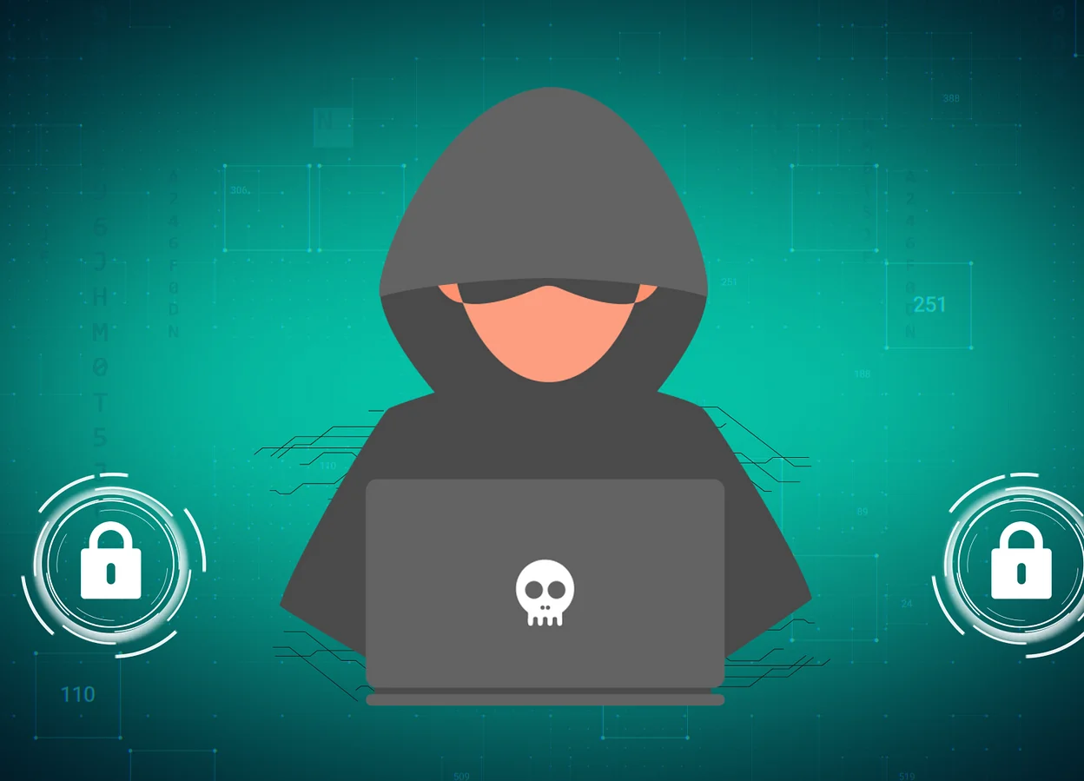
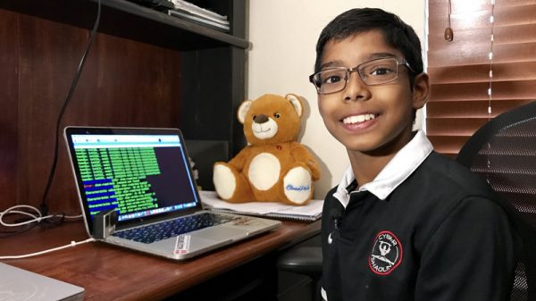
What is a cyber attack and who are hackers?
Cybercrime costs the UK government around £3 billion a year (gov.uk)
In 2020 around 50% of UK business’ experienced a cyber attack breach. (DCMS)
Cyber attacks are carried out by cyber criminals, hacktivists, governments, military or unhappy employees
#TechWeCan | Tech for Safety and Security
Notes:
We are going to move on now to how technology is used to reduce risks for businesses. Before we look into the tech in this area I just want to discuss the meaning of some of these words and also why it’s so important that we have people working in these areas.
So what is cyber crime? Cybercrime is any criminal activity that targets or uses a computer or device connected to a network. People usually commit this crime as they are trying to steal money or information from a person or company.
Cyber attacks can be carried out by cyber criminals, hackers, governments, military or even unhappy employees of a business.
It is not rare unfortunately and in 2020 alone, it cost the UK government £3 billion and around half of UK companies had a cyber attack breach - which means they had money or information stolen from them.
'Hackers’ is likely to be a word you have heard of before. Hacker used to actually mean someone who liked to do new things with a computer. Now hackers are known as cyber criminals - so people using things like computer programmes and viruses to steal money or data or sometimes just cause damage to other people’s computers.
The picture in the bottom is of one of the most famous child hackers in the world - his name is Reuben Paul. Reuben is actually what we call an ethical hacker. Ethical hackers try to hack into things to see if it is possible. They then use this knowledge to help stop others being able to do the same. You basically need to think and act like a hacker to be able to stop them. Let’s watch a short clip about Reuben:
https://www.youtube.com/watch?v=swckduMfnf8 (Play YouTube Clip)
If you search for Reuben’s name you will find lots of fantastic talks he has given about cybersecurity and the many different things he has been able to hack - including toys and tech you might have in your home.

Slide 8
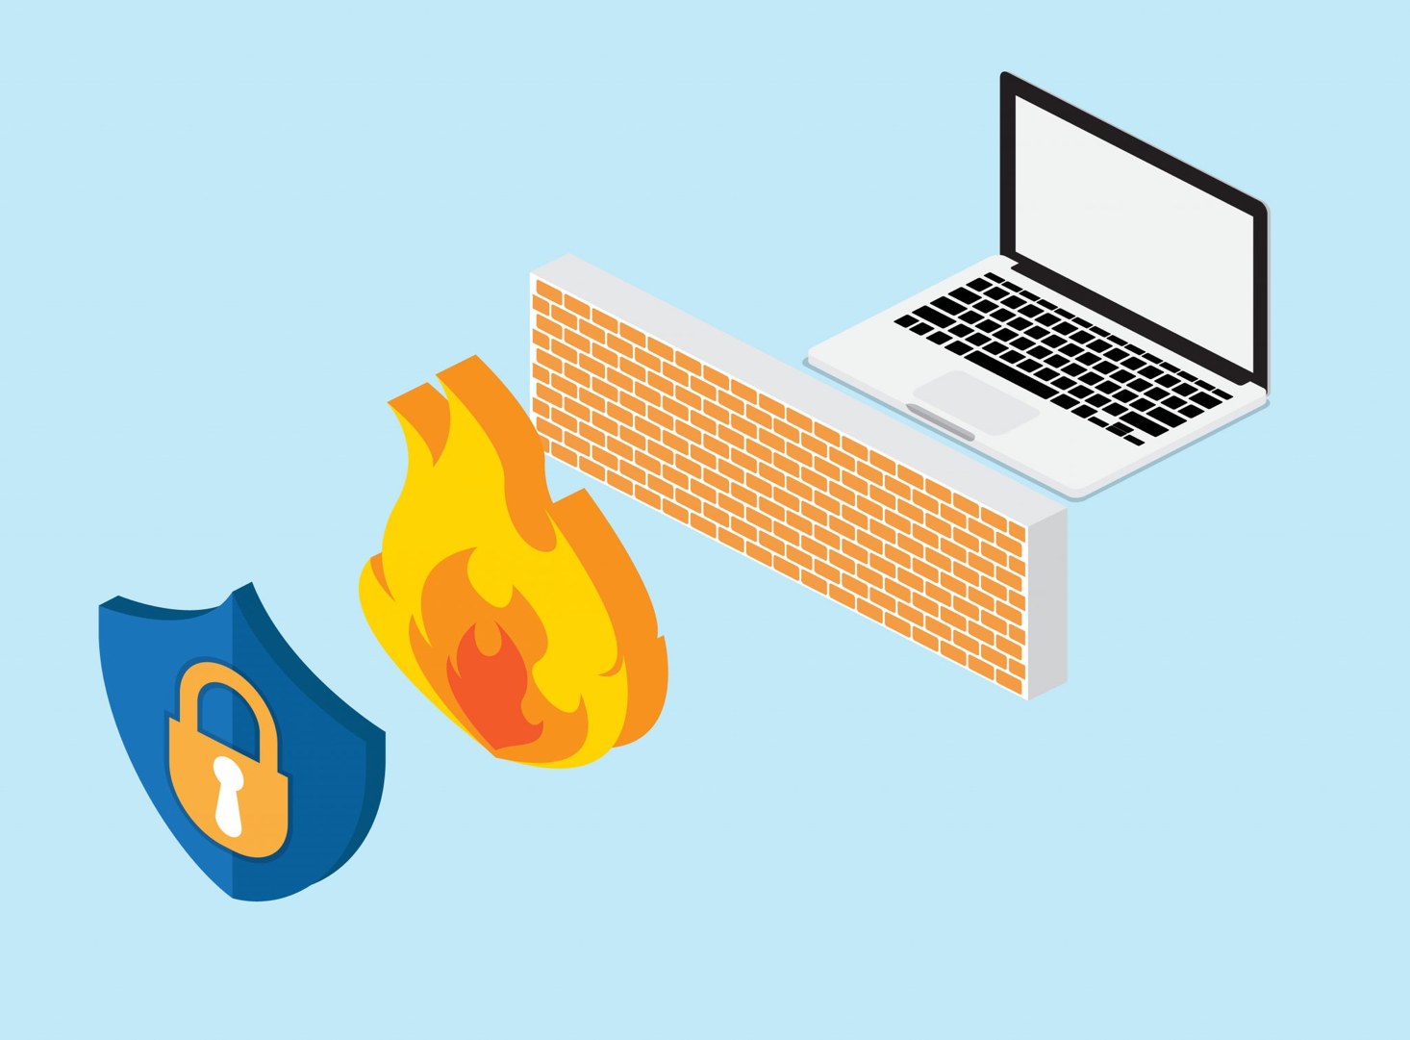
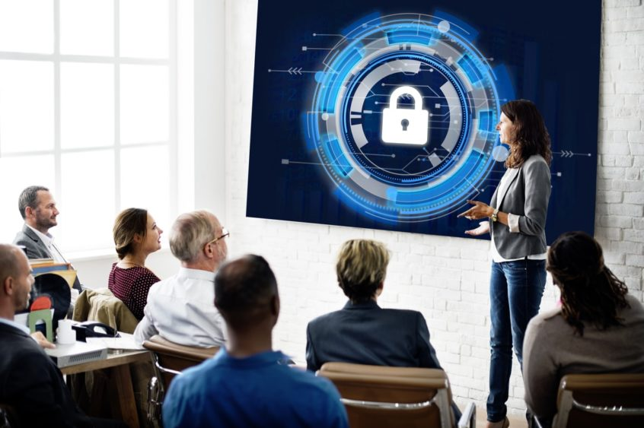
Tech used to reduce online risks for businesses
#TechWeCan | Tech for Safety and Security
Notes:
So now we have discussed the threats businesses face from hackers and cyber criminals. Let’s have a look at some of the tech trying to stop hackers. These actually all apply for us personally as well as businesses.
You might have heard of FIREWALLS. Often schools have very strong firewalls so when a teachers try to play a clip, maybe from YouTube – you may have seen a pop up to say that that they cannot access it due to the firewall. Firewalls are software (so a programme on a computer) or hardware (a physical device) which monitors ingoing and outgoing traffic from and to a computer. This could be websites you try and access or emails you try to send or receive. If a firewall does not recognise where something is from then it will block you sending or accessing that. Many businesses install firewalls to try and protect the data and information they store on their computers.
You might have also heard of storing things in the cloud. This does not actually mean we send things up in the air. Many companies are storing data and information in the cloud so what does this mean? Basically in the past we have stored things on our computers and maybe even backed this up on a hard drive or USB stick. When you save something to the cloud, that data gets sent to a server (which is like a supercomputer) – these are located all over the world. Rather than one single device your data will be stored on lots of different servers. This means we can access that information from different devices and you less likely to ever lose something. So if your phone was lost or stolen and you got a new one, this is how you can restore your photos and contacts – because they have been stored on a cloud.
And finally and some would argue most importantly, educating people about cyber security is actually one of the best ways we can help stop cyber criminals and hackers breaking into our computers. It’s so important that businesses train their employees to understand the importance of things like using a strong password which will be hard for a hacker to guess and changing your password often. It’s also important for employees to spot things called ‘phishing emails’ which are the emails trying to trick you to click on links which contain a virus or send information which you think might be for a competition but actually its for a hacker to help guess your password or break into your computer.
Of course these things are also really important for everyone to personally do but for a company, one employee making a mistake and allowing a hacker access to information could cost them lots and lots of money.

Slide 9
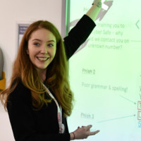
Meet our role models
Lianne Dings
BNP Paribas Group
Cyber Risk Intelligence Analyst
Alisha Chambers
Tesco
Security Awareness & Technical Training Manager
#TechWeCan | Tech for Safety and Security
Notes:
We are now going to meet our final role models for Tech for Safety and Security. We are to hear from Lianne who is a Cyber Risk Intelligence Analyst for BNP Paribas and Alisha who is a Security Awareness and Technical Training Manager at Tesco. They both work trying to protect their companies from cyber security threats.
We had a chat to them both to find out more about their roles
Alisha PLAY VIDEO from 26:30 – 32.43 (image hyperlinked)
Lianne PLAY VIDEO from 32:43 – 38:01 (image hyperlinked)
I found it really interesting when Alisha mentioned that cyber security is all about problem solving. So even if you don’t consider yourself ‘techy’ you could have the perfect skills to try and stop hackers.
I also liked it when Lianne spoke about how her degree in Intelligence and National Security (which I am renaming to ‘The Spy Degree’) led her into cyber security and also allowed her to meet people from the MI5 and the FBI. How cool is that?!?

Slide 10
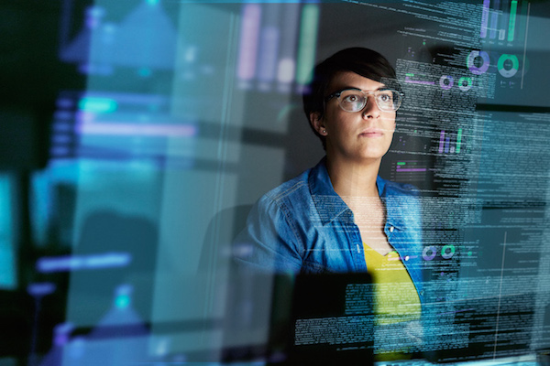
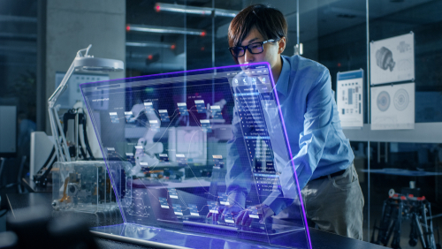
Careers in tech to reduce risks for businesses
Certified Ethical Hacker
Cyber Security Engineer
As a Certified Ethical Hacker, you could improve the security of a company’s computer system by identifying weaknesses in the system.
As a Cyber Security Engineer, you could analyse computer networks, ensuring they're running securely, and try to foresee possible future security issues.
#TechWeCan | Tech for Safety and Security
Notes:
If you would like a future career working in tech to reduce risks for businesses, you could be an Ethical Hacker. As a Certified Ethical Hacker, you could improve the security of a company’s computer system by identifying weaknesses in the system.
You could also be a Cyber Security Engineer. As a Cyber Security Engineer, you could analyse computer networks, ensuring they're running securely, and try to foresee possible future security issues.
Like we mentioned earlier, it's so important we have people continuously working in this area because as the hackers find more was to access data and information they shouldn’t – we need people trying to figure out how they do it and how to stop them.

Slide 11
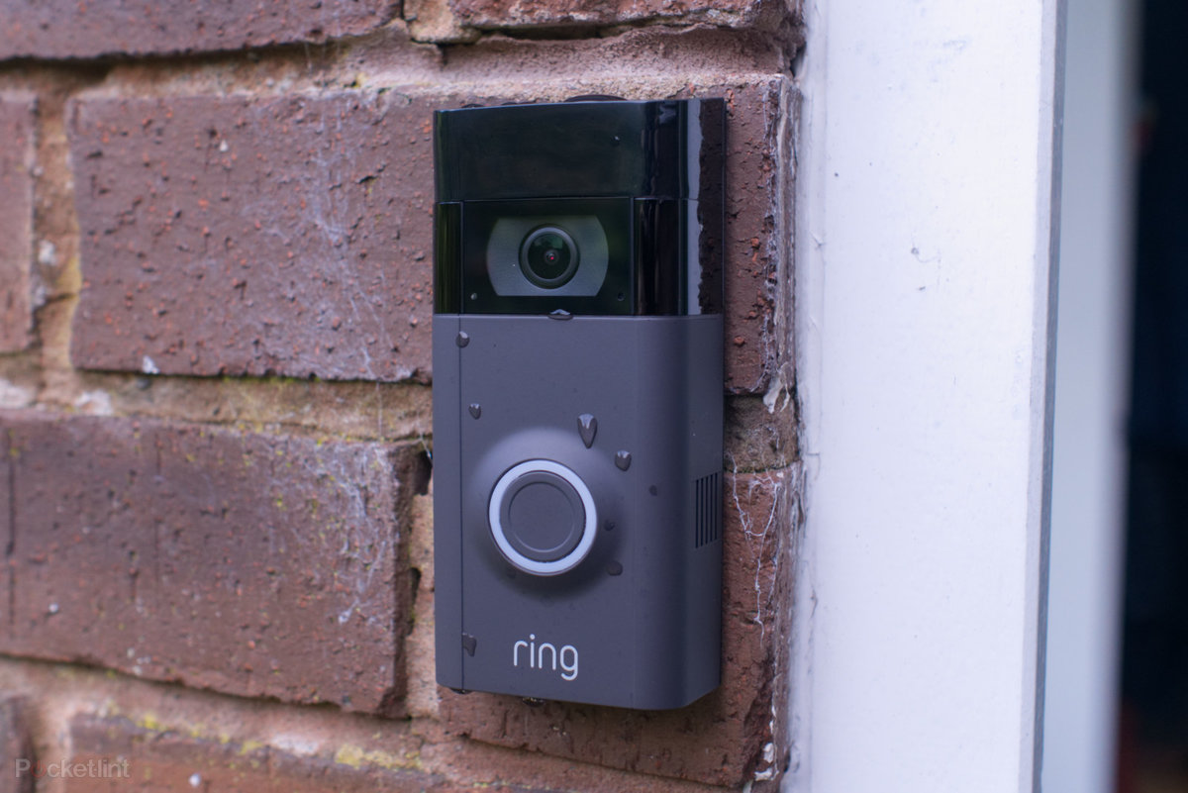
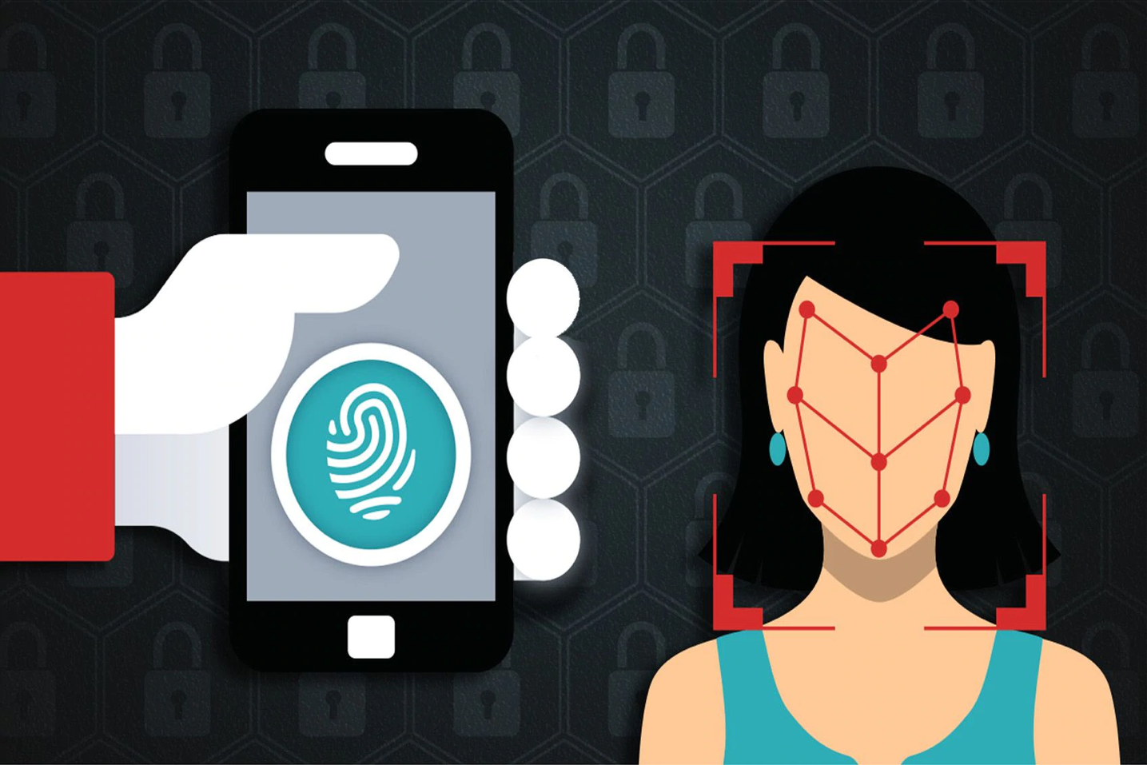
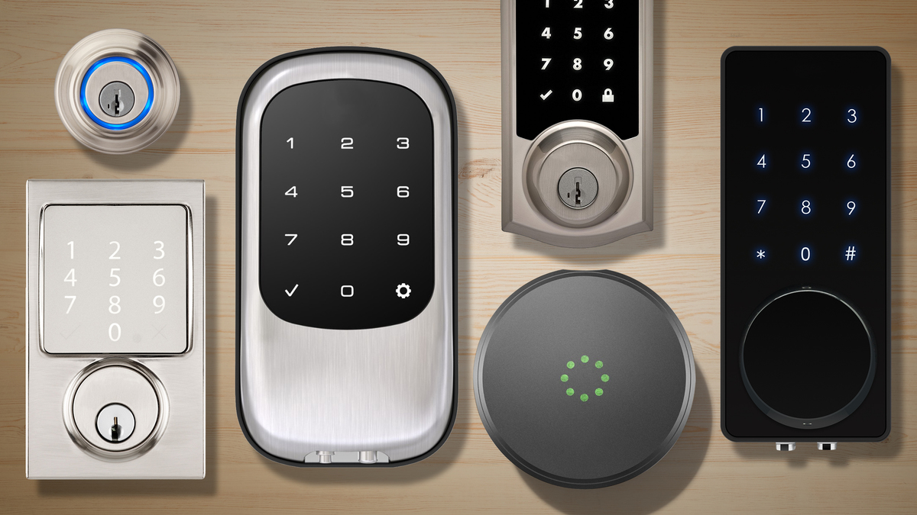
Technology used to keep our possessions safe
Tech We Can | Tech for Safety and Security
Notes:
And finally today, we are going to look at how tech is used to keep our possessions safe using technology. Possessions simply means the things we own like our homes, or phones or money.
One great piece of tech which helps us protect our homes and some of you may even have at home are things like the Ring doorbell. When a visitor or delivery driver rings your bell, whether you are in the house or out and about you can instantly see who it is through a video feed on your phone. You can even talk to them through it. This makes the user and their home safer as they can always check who is at the door before answering it. It’s also handy to tell the delivery driver where to leave your parcel.
Another piece of tech which helps us keep our possessions safe is both fingerprints and facial recognition. It is much easier for a hacker to guess our password or pin numbers than it is for them to copy our entire face or unique fingerprint. There is still some work to be done in these areas as they are not 100% accurate all of the time but it’s a much safer way to access things like your bank account or your phone.
The picture in the bottom left is of a selection of different smart locks. Smart locks have lots of handy features. For example, many of them connect to an app on your phone and you can lock and unlock your house with the press of a button from wherever you are (so no more worrying and rushing back to see if you locked the door correctly). Some can even be programmed to open with voice commands so if your parents were perhaps really worried about you losing the house key then maybe you could use the voice command instead. This is another area of tech which it will be very interesting to see how it develops. How will we get into our houses of the future??

Slide 12
Careers in tech used to keep possessions safe
Product Designer
Digital Marketer
As a product designer, you could design and create new products or improve existing ones. This could be the techy gadgets of the future which we can all use to protect ourselves and our possessions.
As a Digital Marketers, you could specialise in using tech to market and advertise products. This includes things like creating adverts for social media, designing information to market a product on a website or creating emails and messages to try and persuade more people to buy a product.
#TechWeCan | Tech for Safety and Security
Notes:
If you would like a future career designing and developing technology and gadgets to help people keep their possessions safe, you could be a product designer. Product designers design and create new products or improve existing ones. You may have already looked at one of the pieces of tech we have covered today and thought, ‘That’s cool but it would be great if it could also do this’. If you think like that, then perhaps you are a product designer of the future.
Also, once all of these new products have been researched, designed and created, there is a whole team of people who work to market that device or gadget so people will want to buy it. Digital Marketers specialise in using tech to market and advertise products. This includes things like creating adverts for social media, designing information to market a product on a website or creating emails and messages to try and persuade more people to buy a product.
When you actually think about it, there are so many different people and jobs involved in the journey from creating a piece of tech to that piece of tech being sold and used by someone.
I hope you have enjoyed the lesson and found out about some cool piece of tech for safety and security. I also hope some of the jobs we have spoken about sound interesting to you.
I wonder what Tech for Security and Safety could look like in 10 years time when you are ready to leave school and enter the world of work.

Slide 13
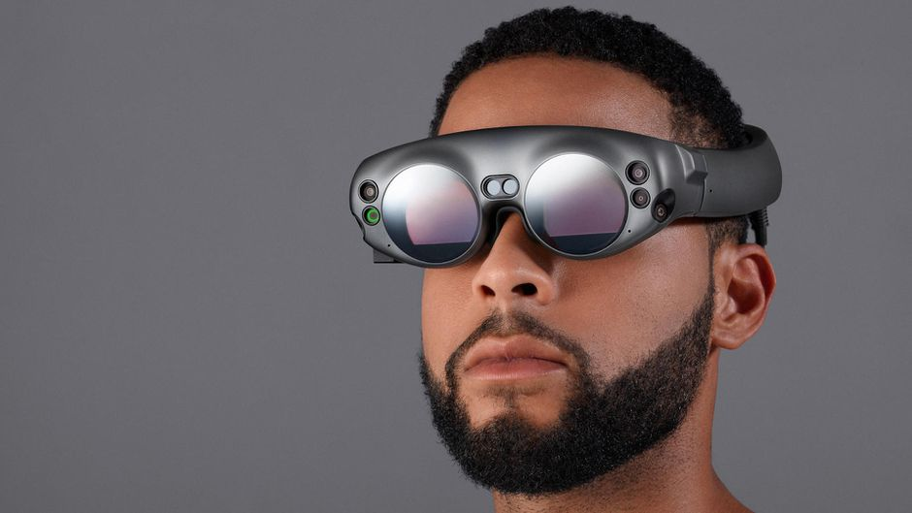
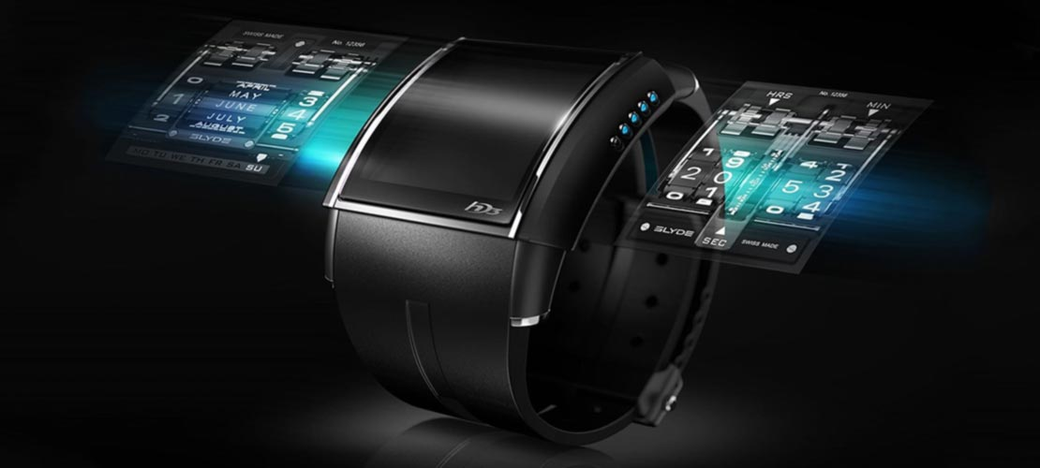
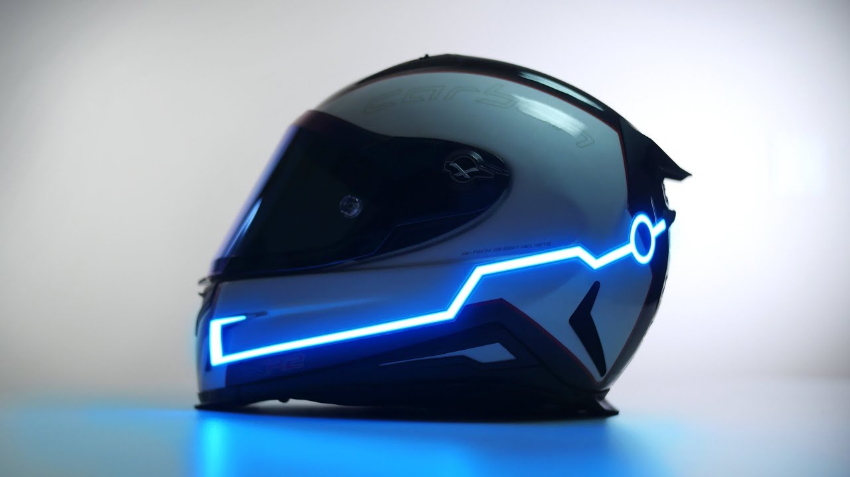
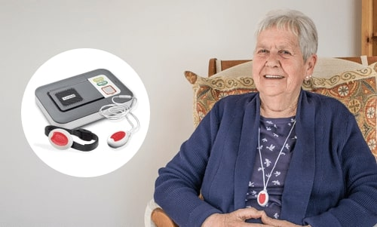
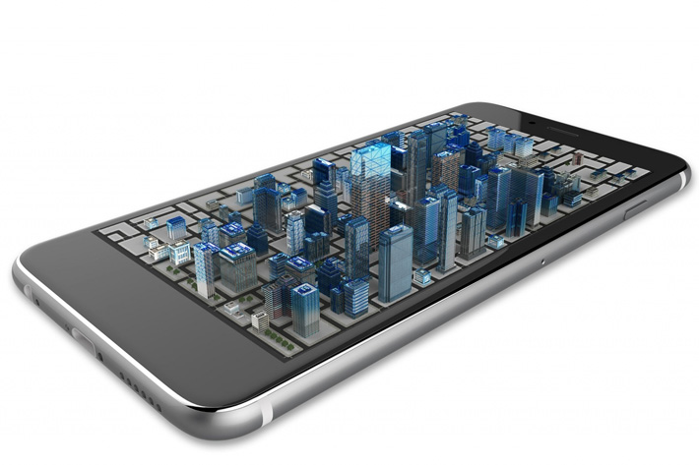
Your challenge: Design a piece of wearable or portable safety tech and label your diagram to explain how it helps keep the user safe.
Please ask your parents to share your work on social media using #TechWeCan or email us at info@techshecan.org
Tech We Can | Tech for Safety and Security
Notes:
Time for your Tech for Safety and Security Challenge. We would like you to design a piece of technology which a user could wear or carry to help keep them safe offline, online or both. This could be a feature of a watch, maybe tech hidden in jewellery or even clothes. Perhaps it could be a new app on a phone or you could even think very futuristically and beyond the tech we have available at the moment.
The pictures on the slide will hopefully give you some inspiration for an idea.
Please draw and label your design either on paper or on a computer programme and label your design to explain all of the techy features it has and how it keeps the user safe.
We absolutely love to see your Tech We Can challenges and if you would like us to give you feedback on your work then please email it to us or ask your parents/teachers to share it on social media using the #TechWeCan.
We can't wait to see what you come up with. You never know, you could see your design created in future – protecting people all over the world.

Slide 14
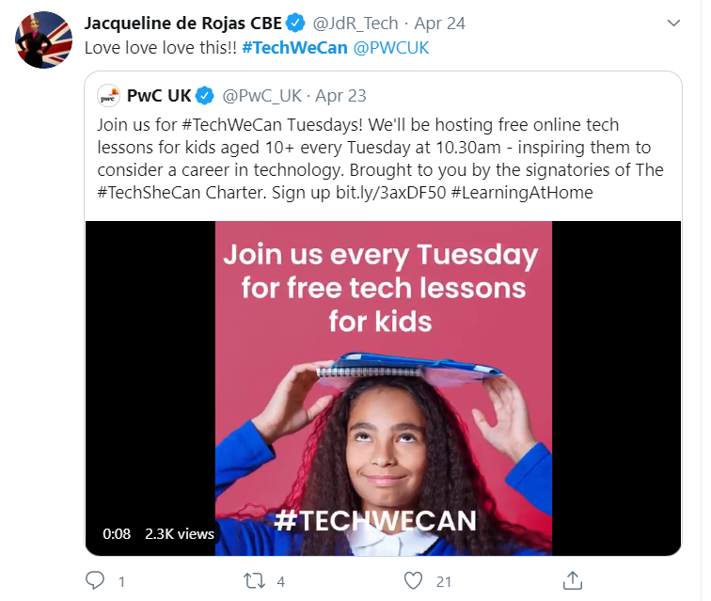
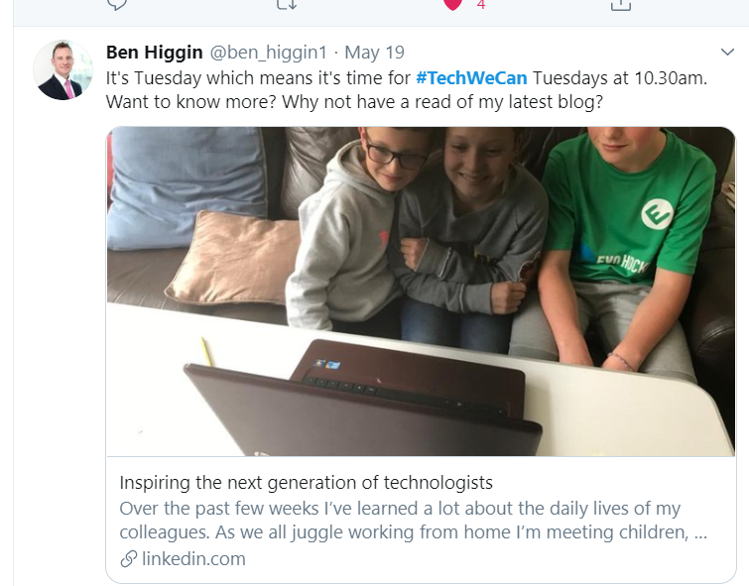
“Our Tech We Can lesson plans are part of our commitment to upskill the communities we’re part of - without urgent attention, many risk getting left behind as technology changes how we live and work. The current crisis we face has provided a stark reminder of the critical value of skills in science and technology.”
Sheridan Ash, Co-CEO Tech She Can
For more information about Tech She Can and free access to all of the Tech We Can resources we have spoke about today, please visit: https://www.techshecan.org/
Follow the hashtags #TechSheCan and #TechWeCan to stay up to date with us on social media.

