Slide 1
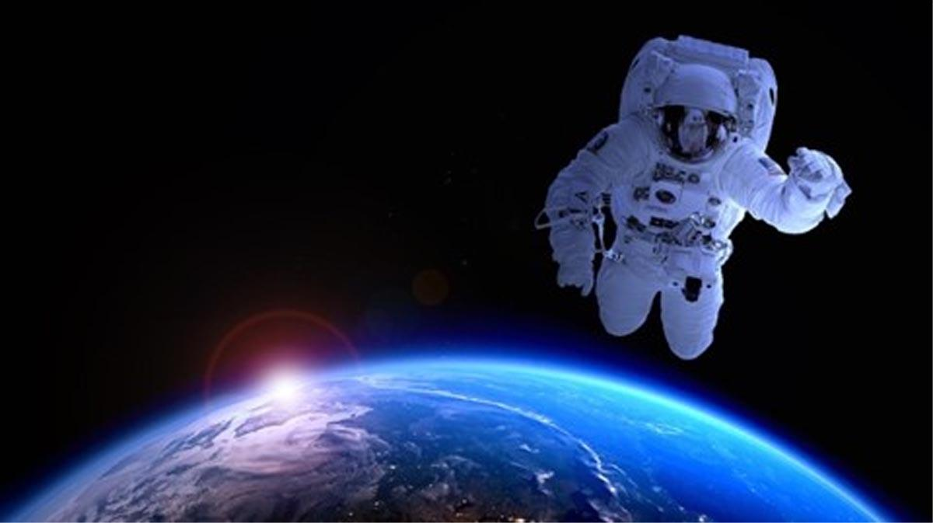
Space
TECH FOR
To understand how technology is used in the space industry and broaden my knowledge of careers available in this field
Notes:
Hi Everyone, my name is ????????? and this Tech We Can lesson is Tech for Space
So …. our aim today is to show you lots of different and interesting ways technology is being used to explore, travel to and live in space. We also want to give you lots of ideas for the kinds of jobs you could have working with and creating the technology we cover today.
Today we are going to focus on Tech for Space but we have lots of other Tech We Can lessons available for you to choose from. We want to show you how your interests and passions could lead you into a career in tech.

Slide 2
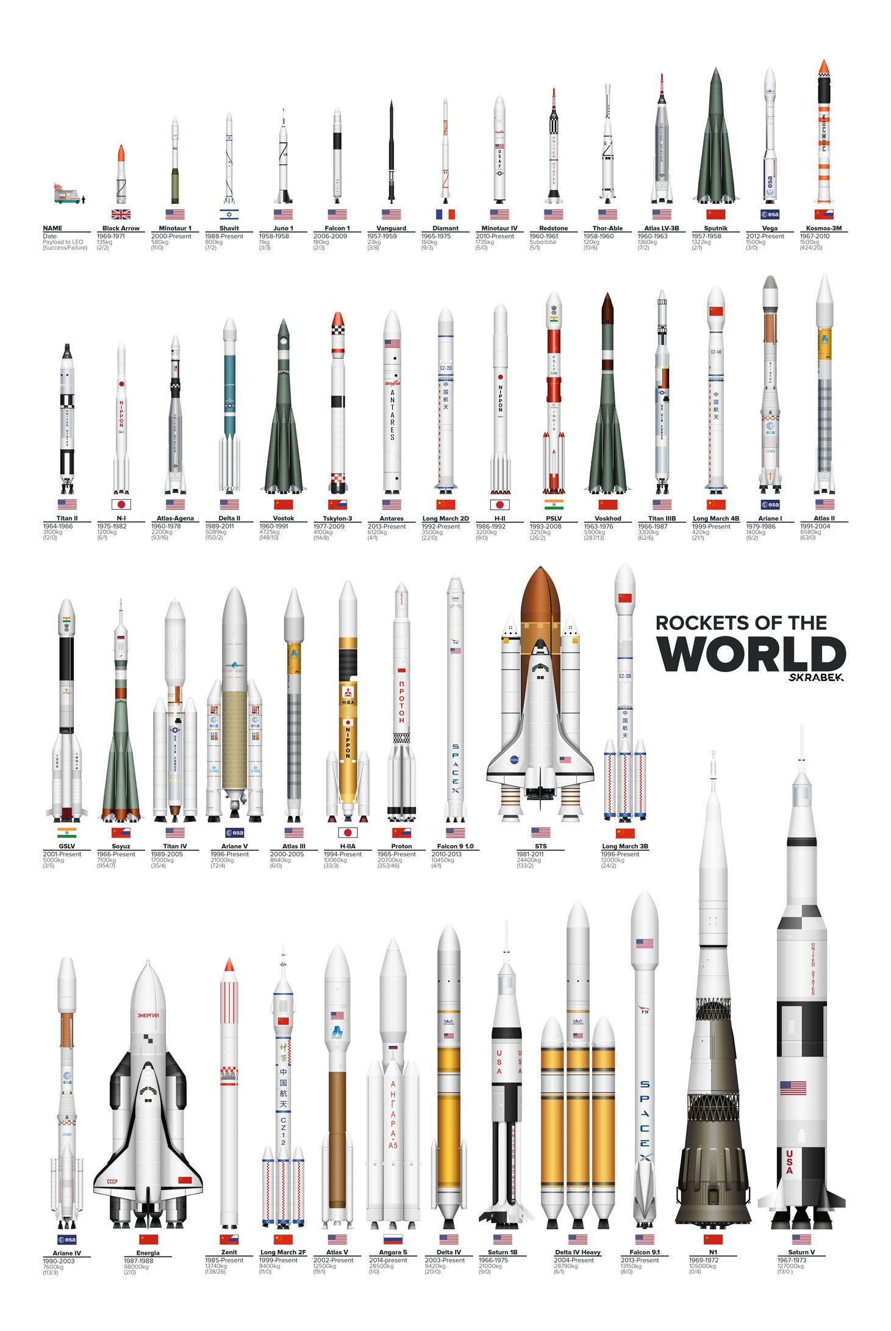
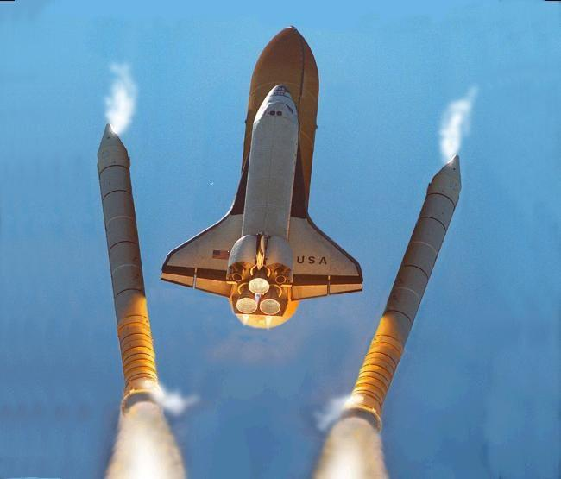
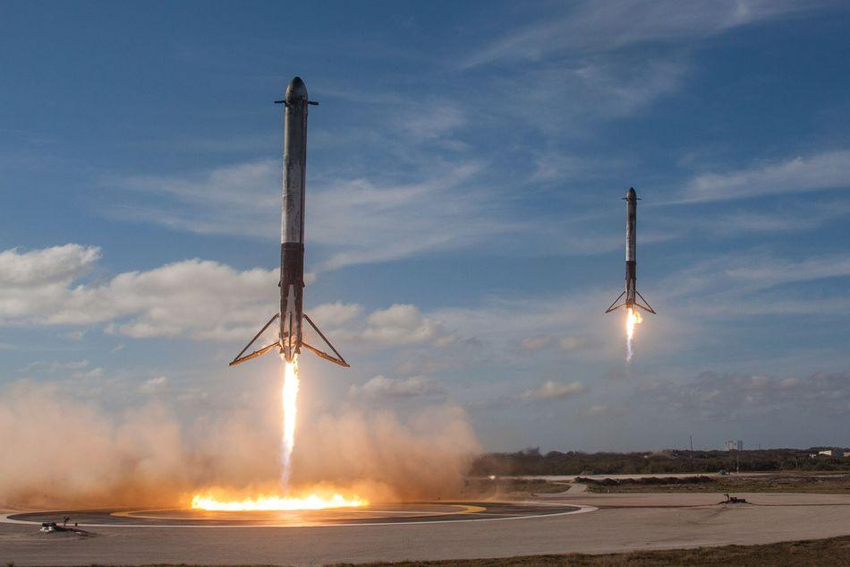
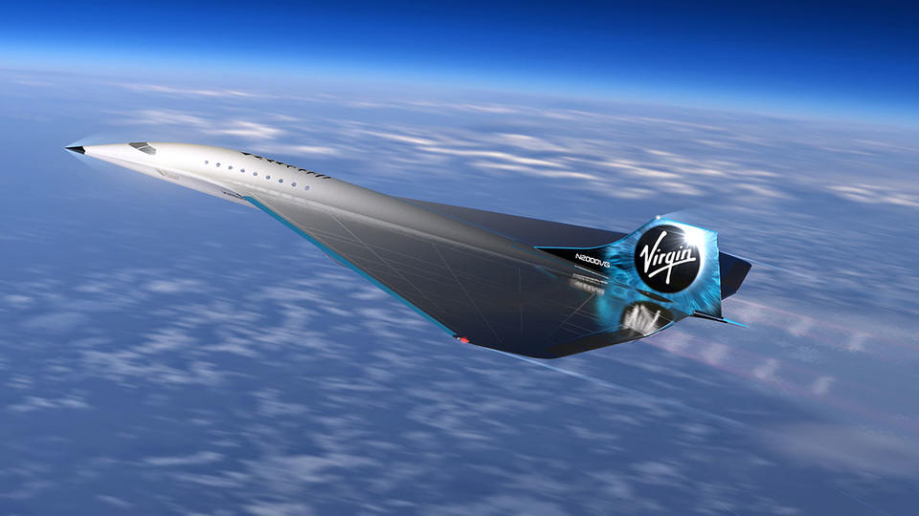
Technology used to travel to space
#TechWeCan | Tech for Space
Notes:
We are going to start by having a look at the technology used to travel to space.
There are many different types of spacecraft (as you can see from the picture on the left) – they come in all shapes and sizes and perform lots of different jobs. Some are designed to transport humans into space and others are designed to transport equipment or technology to study space and travel to other planets.
In order for anything to travel to space it must first be launched on a rocket. Rockets are used to launch satellites and space shuttles into space. When a rocket launches a shuttle or satellite into space the rocket detaches from the spacecraft and the spacecraft continues its journey (you can see this in the picture on the top). Traditionally, rockets were only used once. They would either burn up in the earth's atmosphere or break into small pieces and full into the ocean. However the technology now exists to safely and successfully land these rockets back on earth – the picture in middle is of 2 Space X rockets landed safely back on Earth at the same time. They then successfully reused the rockets in a later flight.
A number of companies are currently working on ways to allow commercial passengers to travel to space- this means that people could buy a ticket and fly into space and land back down on Earth. In February 2019 a company called Virgin galactic successfully took their first passenger into space. Let’s have a little look at the journey : https://www.youtube.com/watch?v=kmPG0Hqhay8 (play selection from video not whole clip 0:38 - 1:53)
The picture on the bottom is actually of the a new Virgin Galactic spacecraft called the Mach 3 which they are currently working on.
This technology is advancing so rapidly – imagine what will be happening in the world of space travel when you leave school.

Slide 3
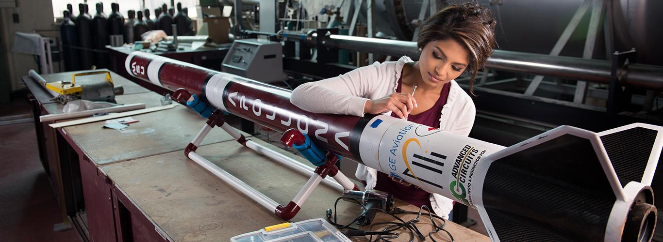
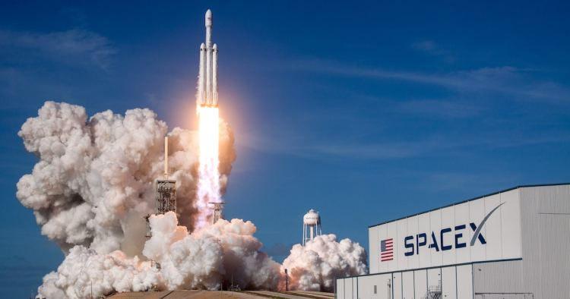
Careers in Tech for Space Travel
Aerospace Engineer
Propulsion Engineer
As an aerospace engineer you could specialise in spacecraft. You could be responsible for designing and creating the spacecraft or you could also work in researching and developing the space travel technology of the future.
As a propulsion engineer you could specialise in designing and testing the machines and fuels needed to provide the energy to launch spacecrafts into orbit.
#TechWeCan | Tech for Space
Notes:
If designing and building technology to help humans travel to space interests you then you might be interested in a future career as an Aerospace engineer.
Aerospace engineers actually design, test, manage and make many different flying machines such as aircrafts and satellites however they often specialise in a certain area. Aerospace engineers can specialise in creating spacecraft and you could have a future job designing and creating the technology and machines to help future astronauts travel safely into space.
If the actual rockets excite you the most then you could specialise as a propulsion engineer. Propulsion engineers create and test the fuels needed to provide the energy to launch satellites and spacecraft into space.

Slide 4
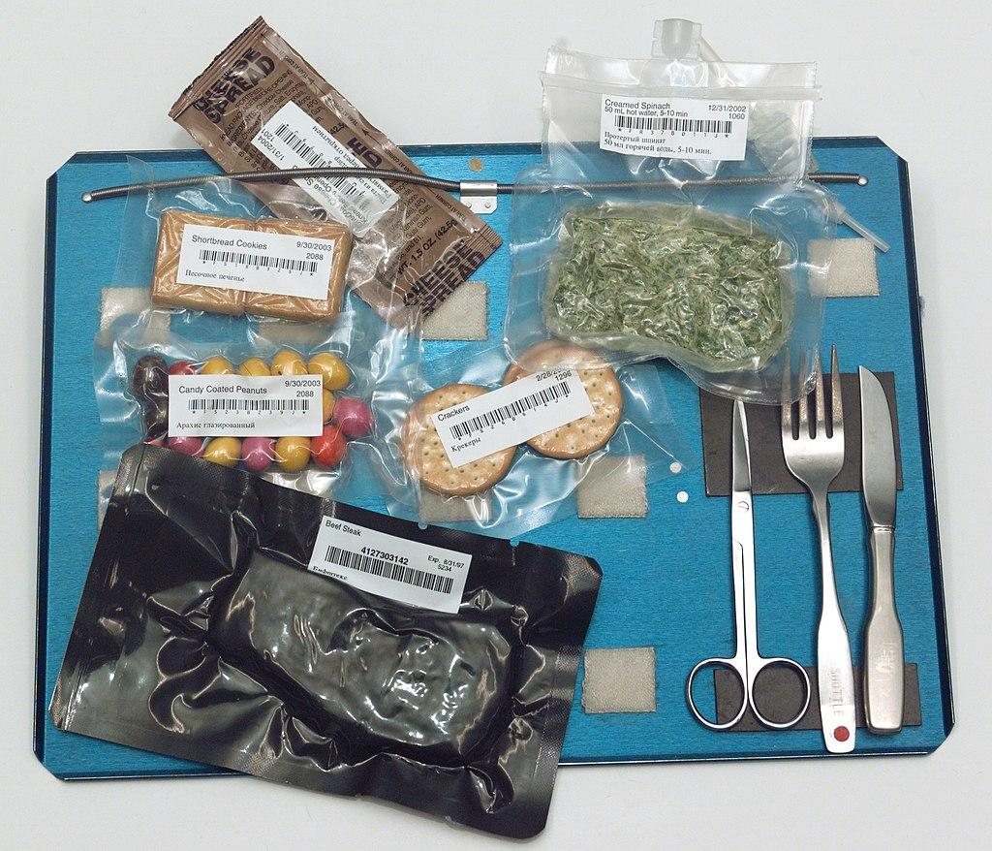
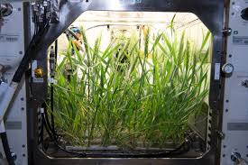
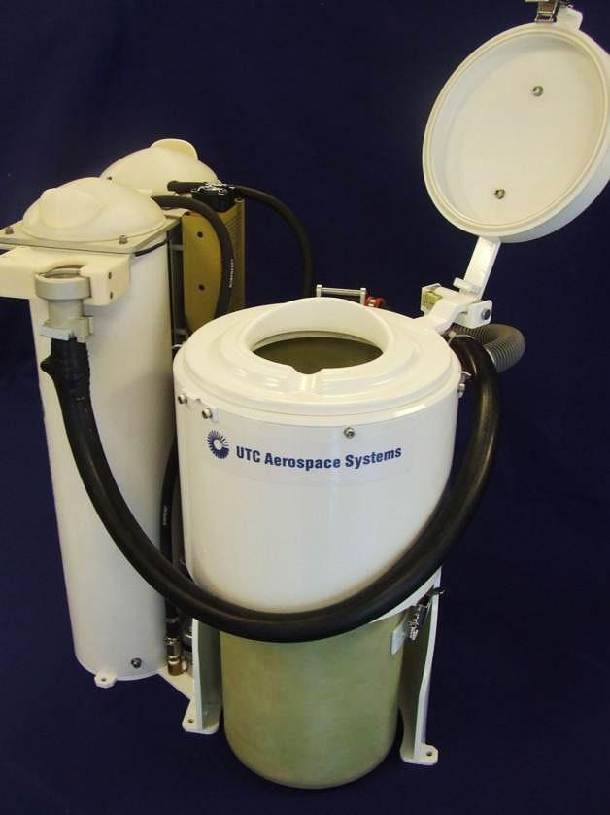
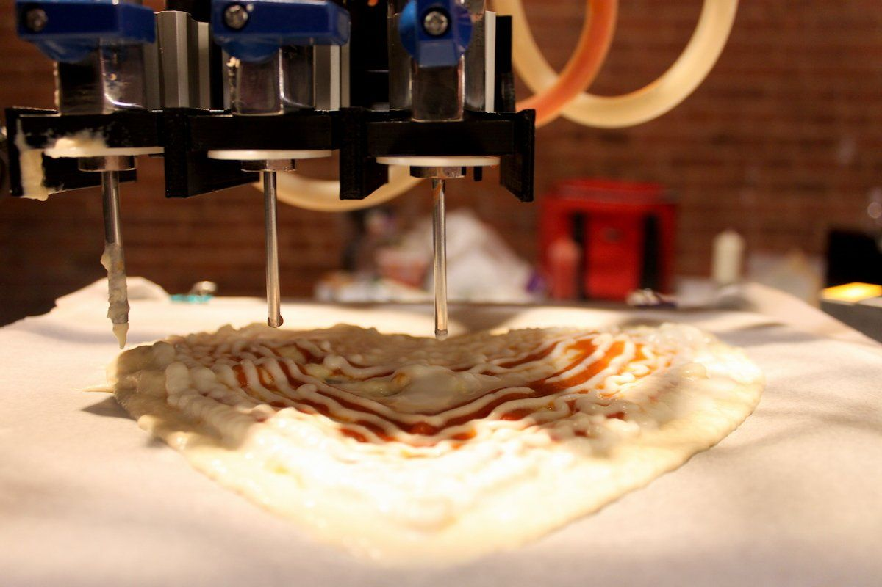
Technology used to live in space
#TechWeCan | Tech for Space
Notes:
So what happens when the astronauts actually arrive in space ….
When astronauts travel into space they are often up there for weeks and months at a time. They use a variety of different technology to be able to continue to live comfortably in space. The lack of gravity provides them with a number of daily challenges.
Future space flights, like a potential manned mission to Mars are likely to be much longer so it's important that we continue to develop ways of keeping the astronauts fed. For food, astronauts usually have to rely on freeze dried and vacuum packed food (like you can see in the picture on the top left). The food they currently take with them to space will not last long enough for journeys further into space so scientist are working on ways of allowing astronauts to grow their own food.
Nasa are trying to develop ways of growing plants with as little soil as possible. Dirt and soil are heavy and take up precious room on the rocket and we are also yet to find another planet with soil suitable to grow food to eat. Another issue is – how could they stop the food and plants from ripening and rotting. This all comes down to a gas called ethylene. Ethylene is the gas which causes fruits and vegetables to ripen and therefor ‘go off’. The picture in the top left is of a very special chamber created by NASA to allow them to take out the ethylene so the plants are not destroyed by the gas – clever stuff!
The picture in the bottom left is of a 3D printed pizza. NASA actually funded this project and they now have the ability to print pizzas in space. The diet of future astronauts is going to be a lot more interesting.
Another thing people are often curious about is how astronauts go to the toilet in space. The picture on the bottom right is of Nasa’s new space toilet. It is known as the Universal waste management system and has cost $23million to design and create. This toilet is heading to the International Space Station for a 3 year testing in September 2020. Nasa specifically developed this toilet to better meet the needs of female astronauts which is a fantastic change. It also recycles and fully cleans urine so it can be reused as water again! Sounds gross but actually the water they end up with is purer than most of the water we drink on a daily basis here at home on Earth.

Slide 5
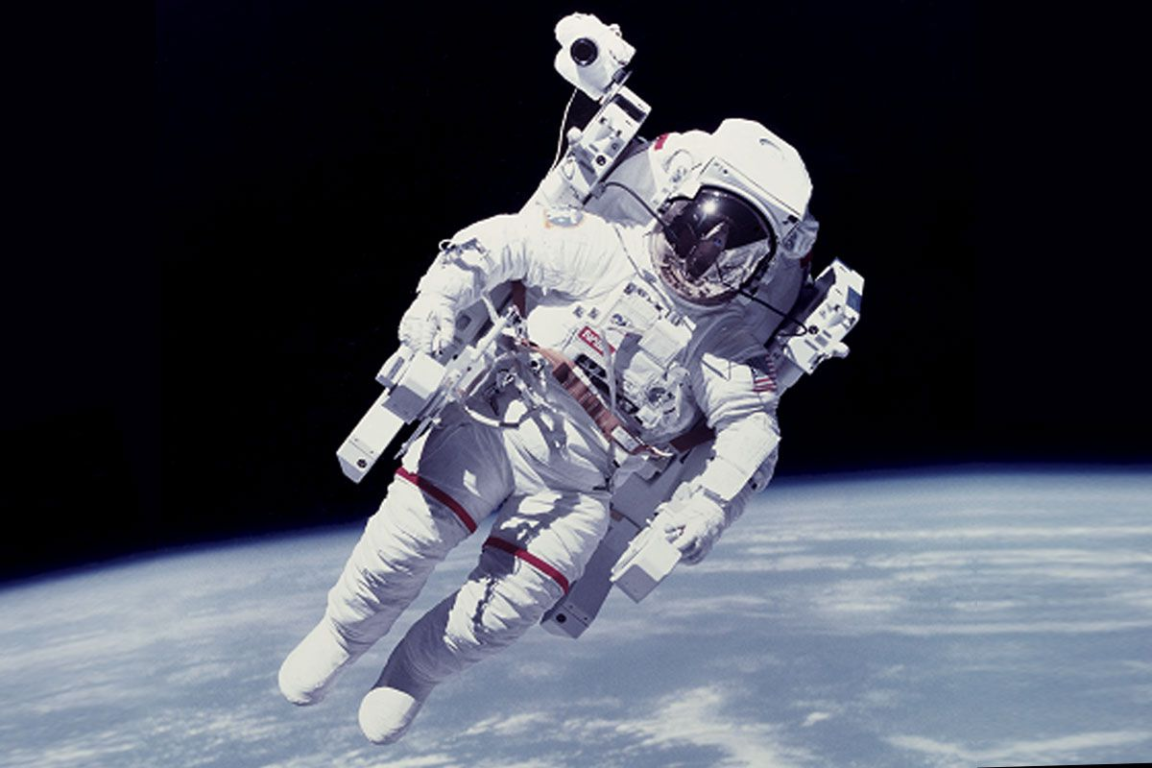
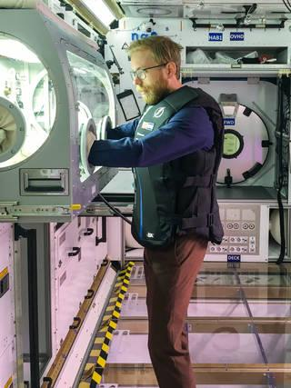
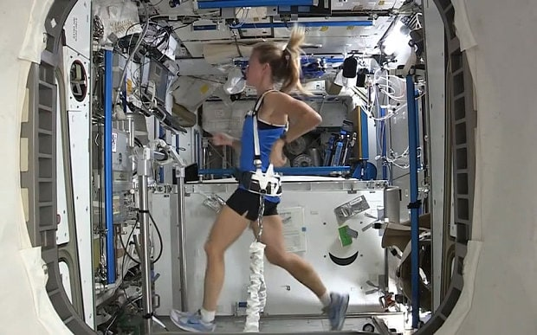
Technology used to stay safe in space
#TechWeCan | Tech for Space
Notes:
Although astronauts have a really cool job, it can also be quite risky and dangerous. There are a number of ways they use different pieces of technology to keep them safe.
One very important piece of technology is an astronaut’s space suit. Without protection, a human would die in space in minutes. The technology in astronauts space suits is amazing. It no only provides them with the oxygen they need to breath but also protects them from extreme temperatures and the pressure their bodies feel in space. They then also have a number of cool tech gadgets from cameras to communication devices.
Another thing that astronauts have to worry about but we don’t is exposure to high energy radiation. This can damage cells within their bodies. Here on Earth, the atmosphere protects us from this but the astronauts live outside of the atmosphere. Space suits and the international space station itself have special shielding that helps protect the astronauts from this. They also have sensors on board to alert the astronauts if the radiation gets too high. The man in the picture on the right is actually testing out a specialised vest to help protect astronauts from harmful radiation whilst on board the international space station.
When is space, astronauts have to exercise for around 2 hours a day. In microgravity, everything is weightless so we don’t need to use our muscles very much. It’s therefore very important that astronauts exercise to make their muscles work. The picture on the bottom left shows an astronaut exercising on the ISS. Because of the lack of gravity, they have to be strapped down onto the treadmill.

Slide 6
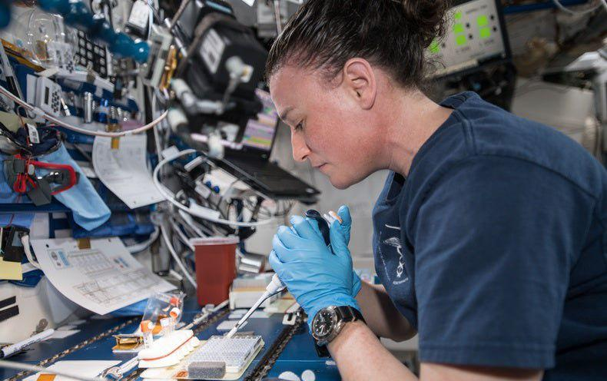
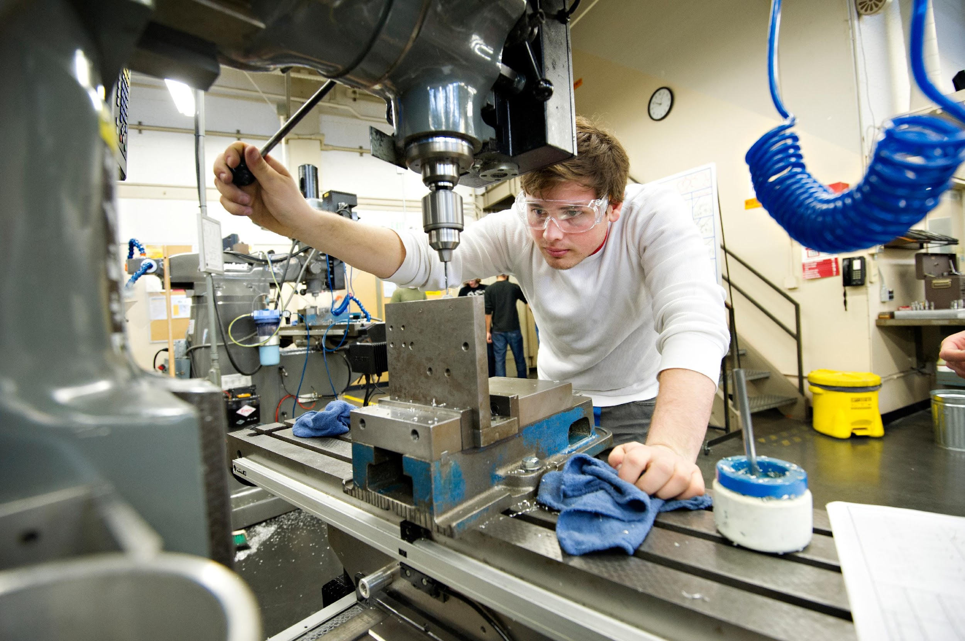
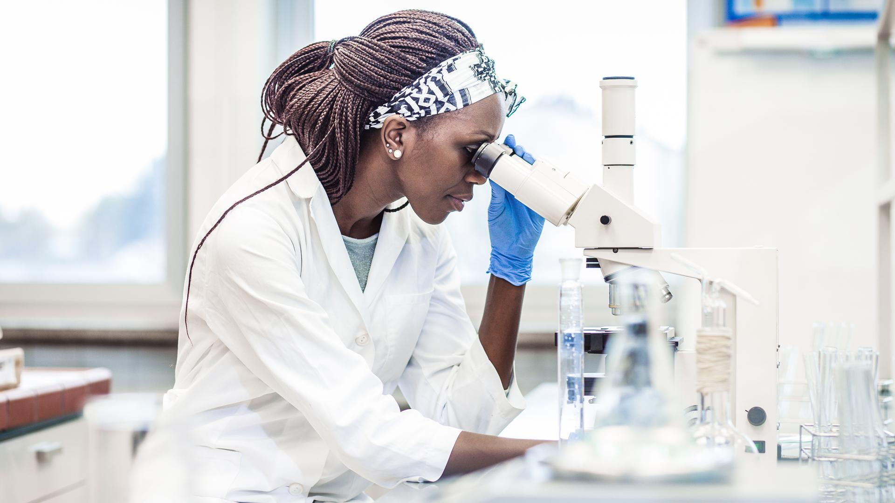
Careers in Tech for Living in Space
Space Medicine Researcher
Materials Engineer
Space Bioscientist
Space medical researchers are doctors and scientists who study the effects of being in space on the human body. They study how space travel effects an astronaut's body physically and mentally.
As a materials engineer, you could specialise in testing, designing and creating new materials to be used in space travel.
As a space bioscientist, you could study how space travel affects living things and help develop new technologies to provide astronauts with the food and water they need to live in space.
#TechWeCan | Tech for Space
Notes:
If designing technology to keep astronauts safe and comfortable sounds fun to you then here are some potential jobs you could have in the future:
You could be a Space Medicine Researcher. These are doctors and scientists who study the effects of space travel on the human body.
You could also be a materials engineer. Your job would involve lots of testing of different materials to create new products which astronauts could use in space. Perhaps things they could wear or tools they could use.
You could also be a space bio scientist and study how spaceflight effects living things. You could develop new technologies to provide astronauts with the food and water they need to live in space. For space travel scientists are always working on making things smaller and lighter because this means astronauts can travel further for longer.

Slide 7
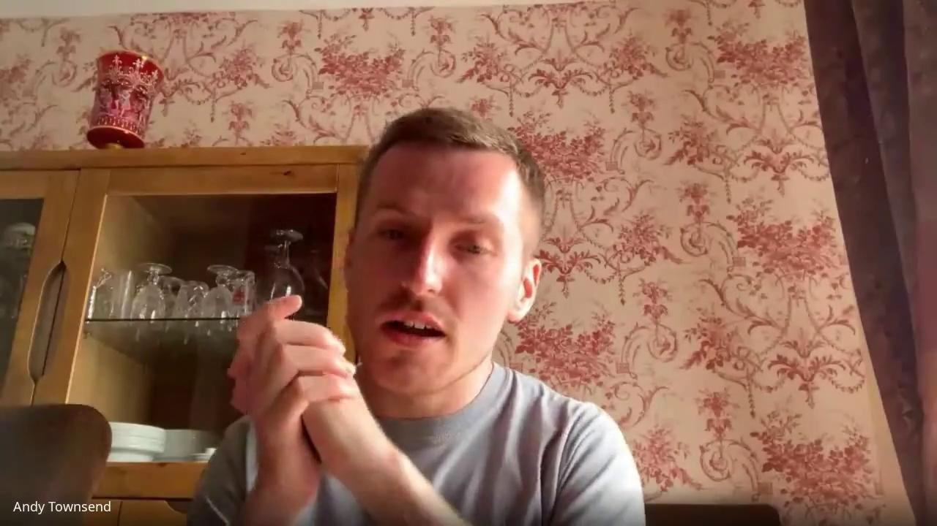
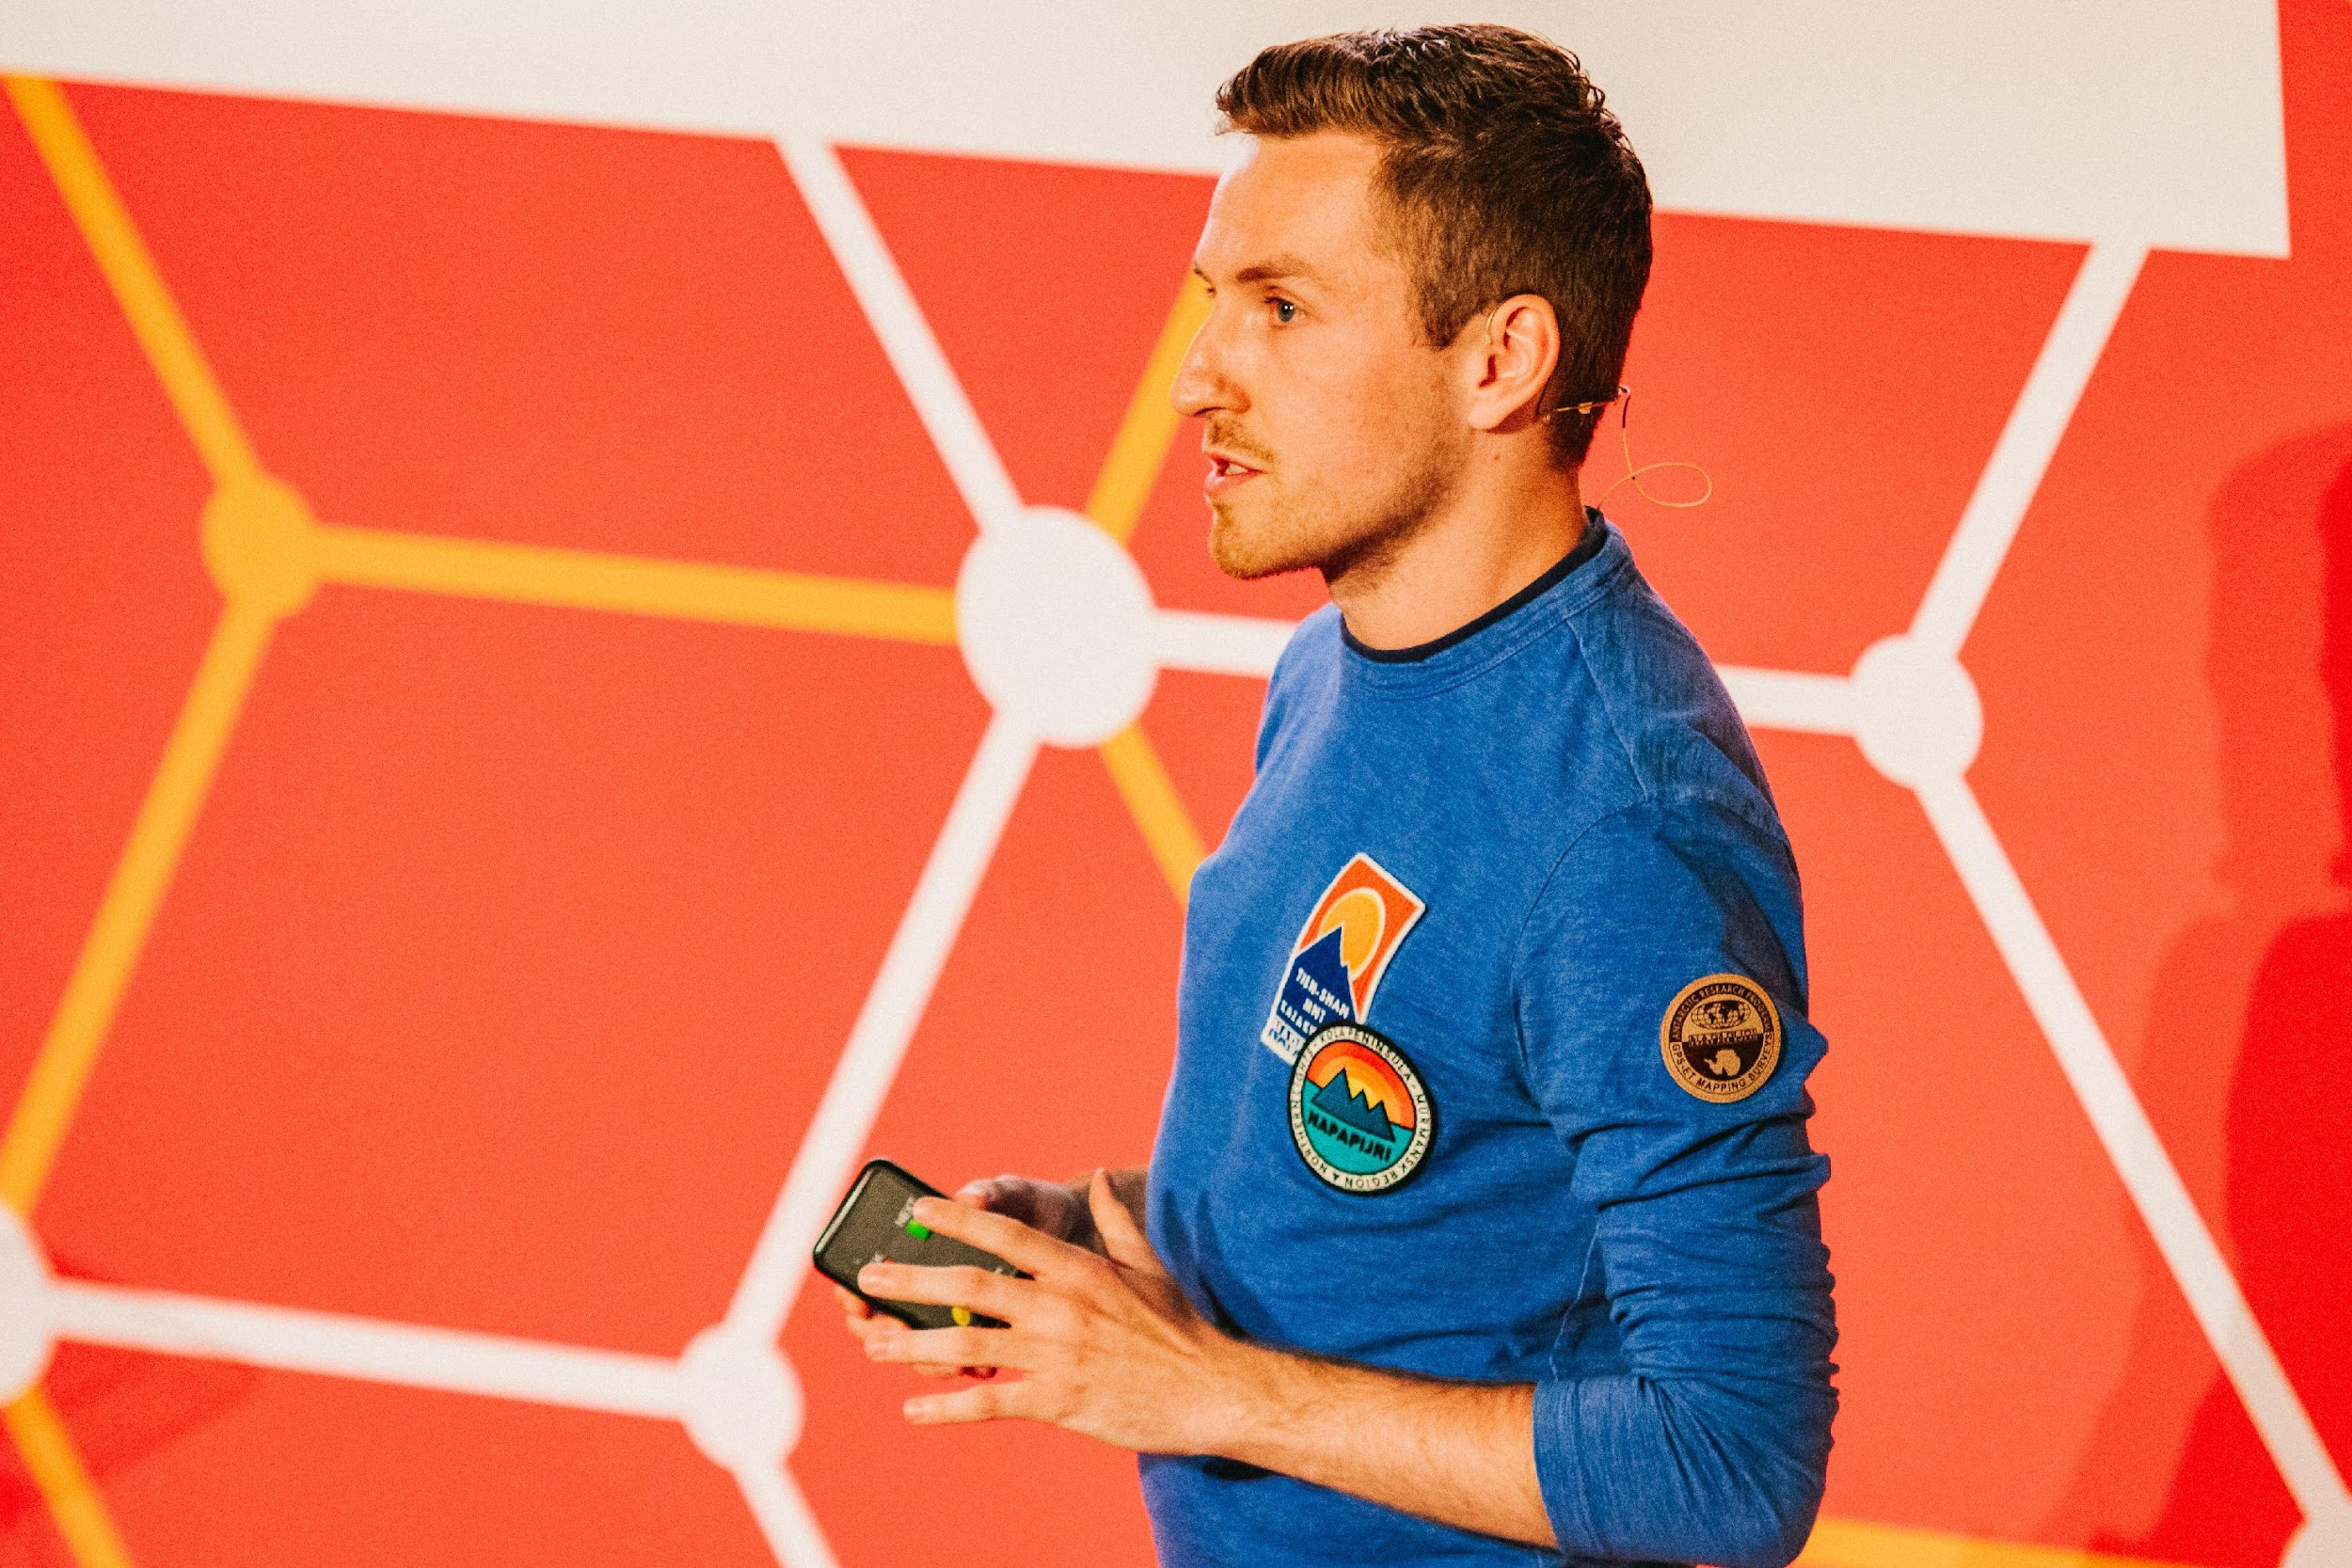
Meet today’s role model
Andy Townsend
#TechWeCan | Tech for Space
Notes:
We are now going to meet our Tech for Space role model. We are going to hear from Andy. Andy is an aspiring astronaut. In the video, Katie spoke to Andy to find out more about his passions and job. Let’s have a listen to what he had to say…
PLAY VIDEO (image hyperlinked) from 17:35 - 23:10
I found it really interesting when Andy said …

Slide 8
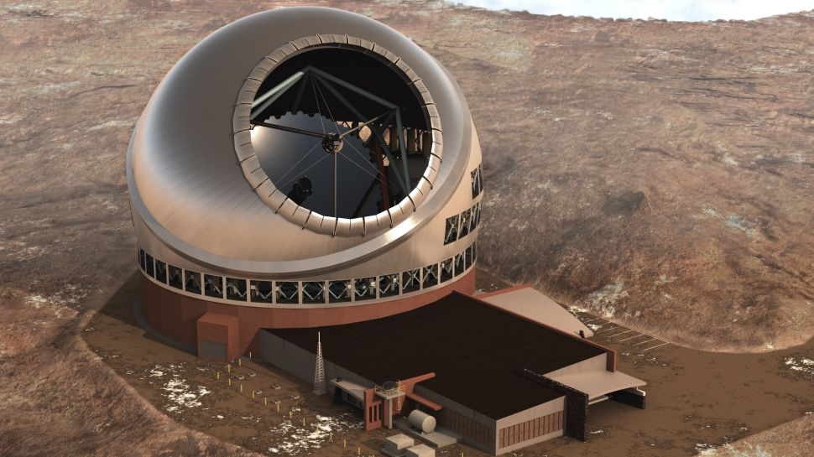
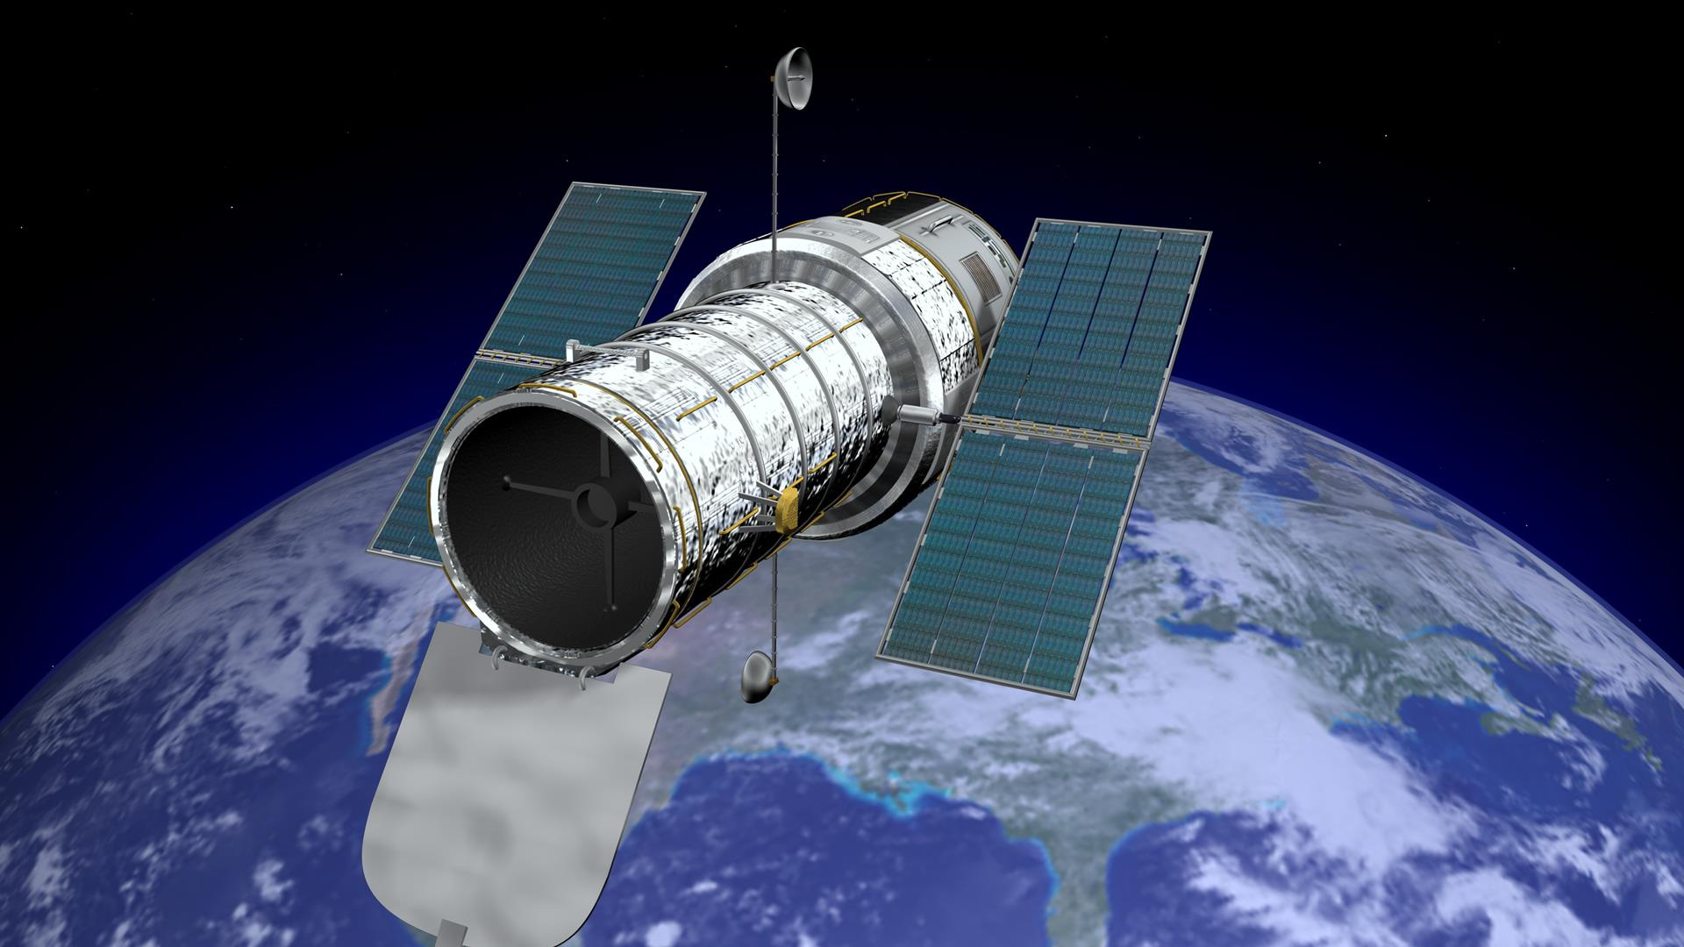
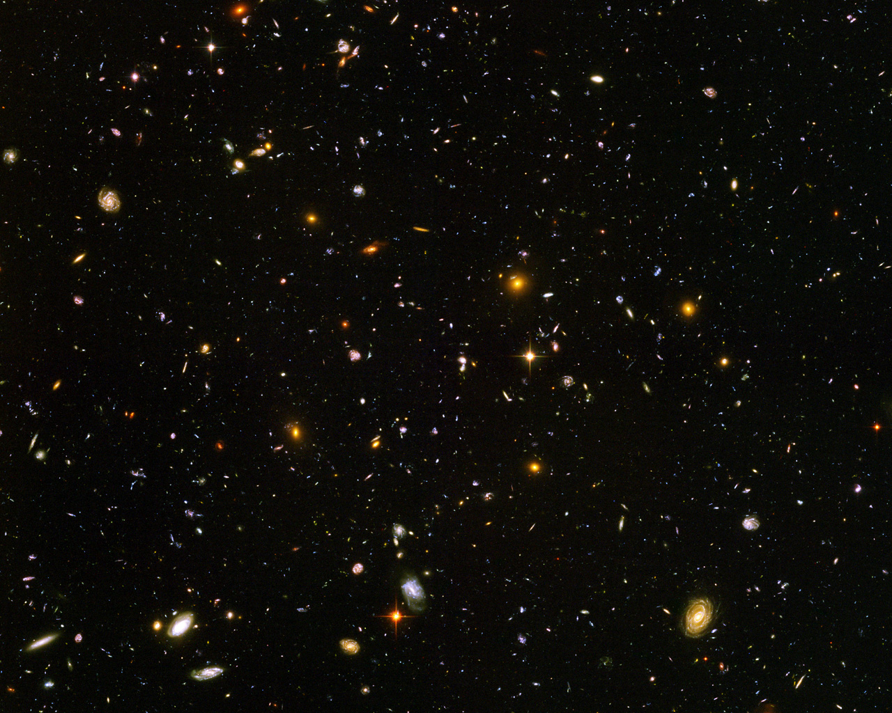
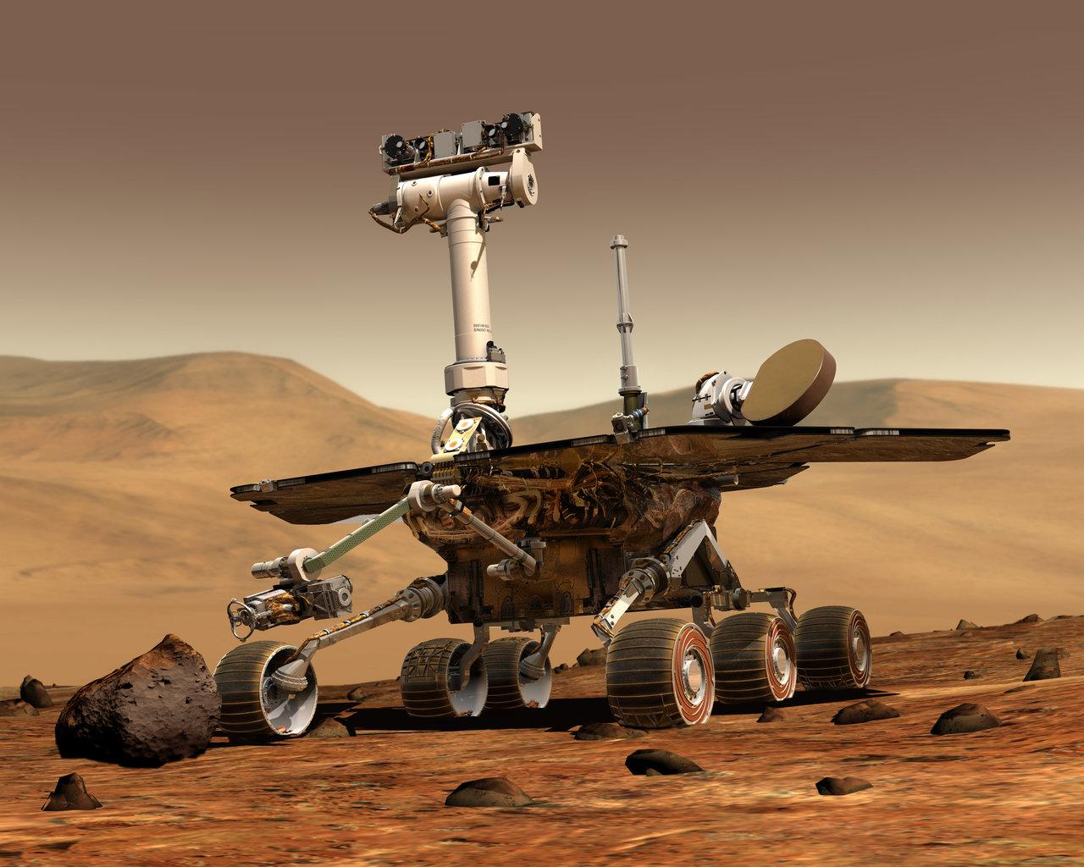
Technology used to explore space
#TechWeCan | Tech for Space
Notes:
We are now going to look into the technology we use to explore space.
For over 400 years telescopes have been one of the main pieces of technology which have helped us to study space from Earth. However, telescope technology has moved on a long way from traditional hand held telescopes. The top left picture is of a new telescope which could be built in the next few years. It’s called the Thirty Meter Telescope or TMT for short. When built, this telescope will allow astronomers to research things which they haven’t been able to before.
The top right picture is of a satellite. Satellites have a number of different uses. They are used to send television and phone signals to and from space, they are used to help people find their location using things like sat navs and they are also used to monitor the weather.
Rather than point towards Earth, some satellites are used to look the other way and study space. The specific satellite in that picture is the Hubble Space telescope. Because this telescope is above the clouds and atmosphere it has a much clearer view of space and takes pictures for astronomers to research and study. The picture in the bottom left was taken by the Hubble telescope and show lots of far away galaxies.
The bottom right picture is of the Mars rover which has now been studying the surface of Mars for over 16 years. Rovers are vehicles designed to move around and explore the surface of a planet or moon. There are also landers which do a similar job however they rest in one place on a surface and do not move around. It can take many years for a lander or rover to be designed, tested and deployed.
There is actually a really great interactive programme where you can explore the surface of Mars using the Curiosity Rover:
Explore the programme live with the students to show some of the features: https://eyes.nasa.gov/curiosity/

Slide 9
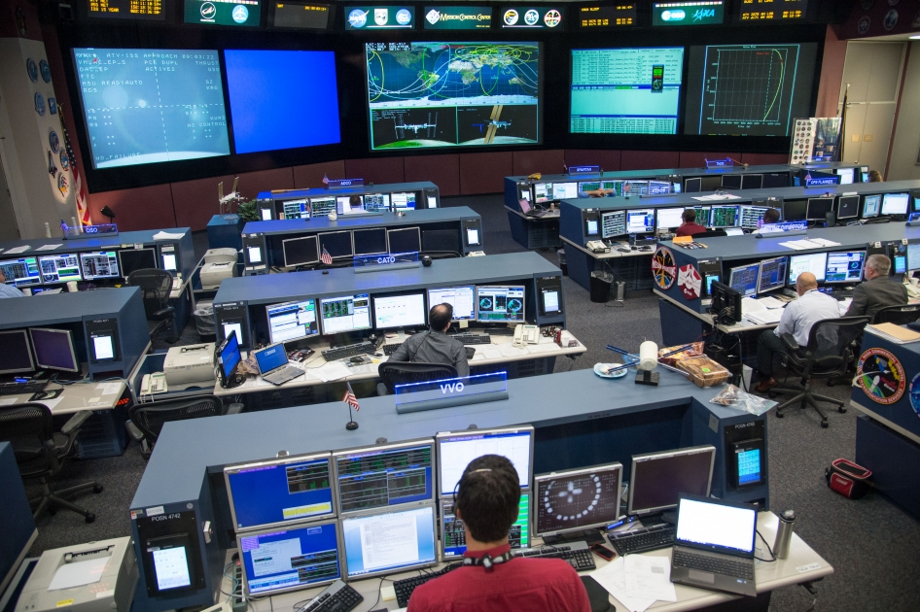
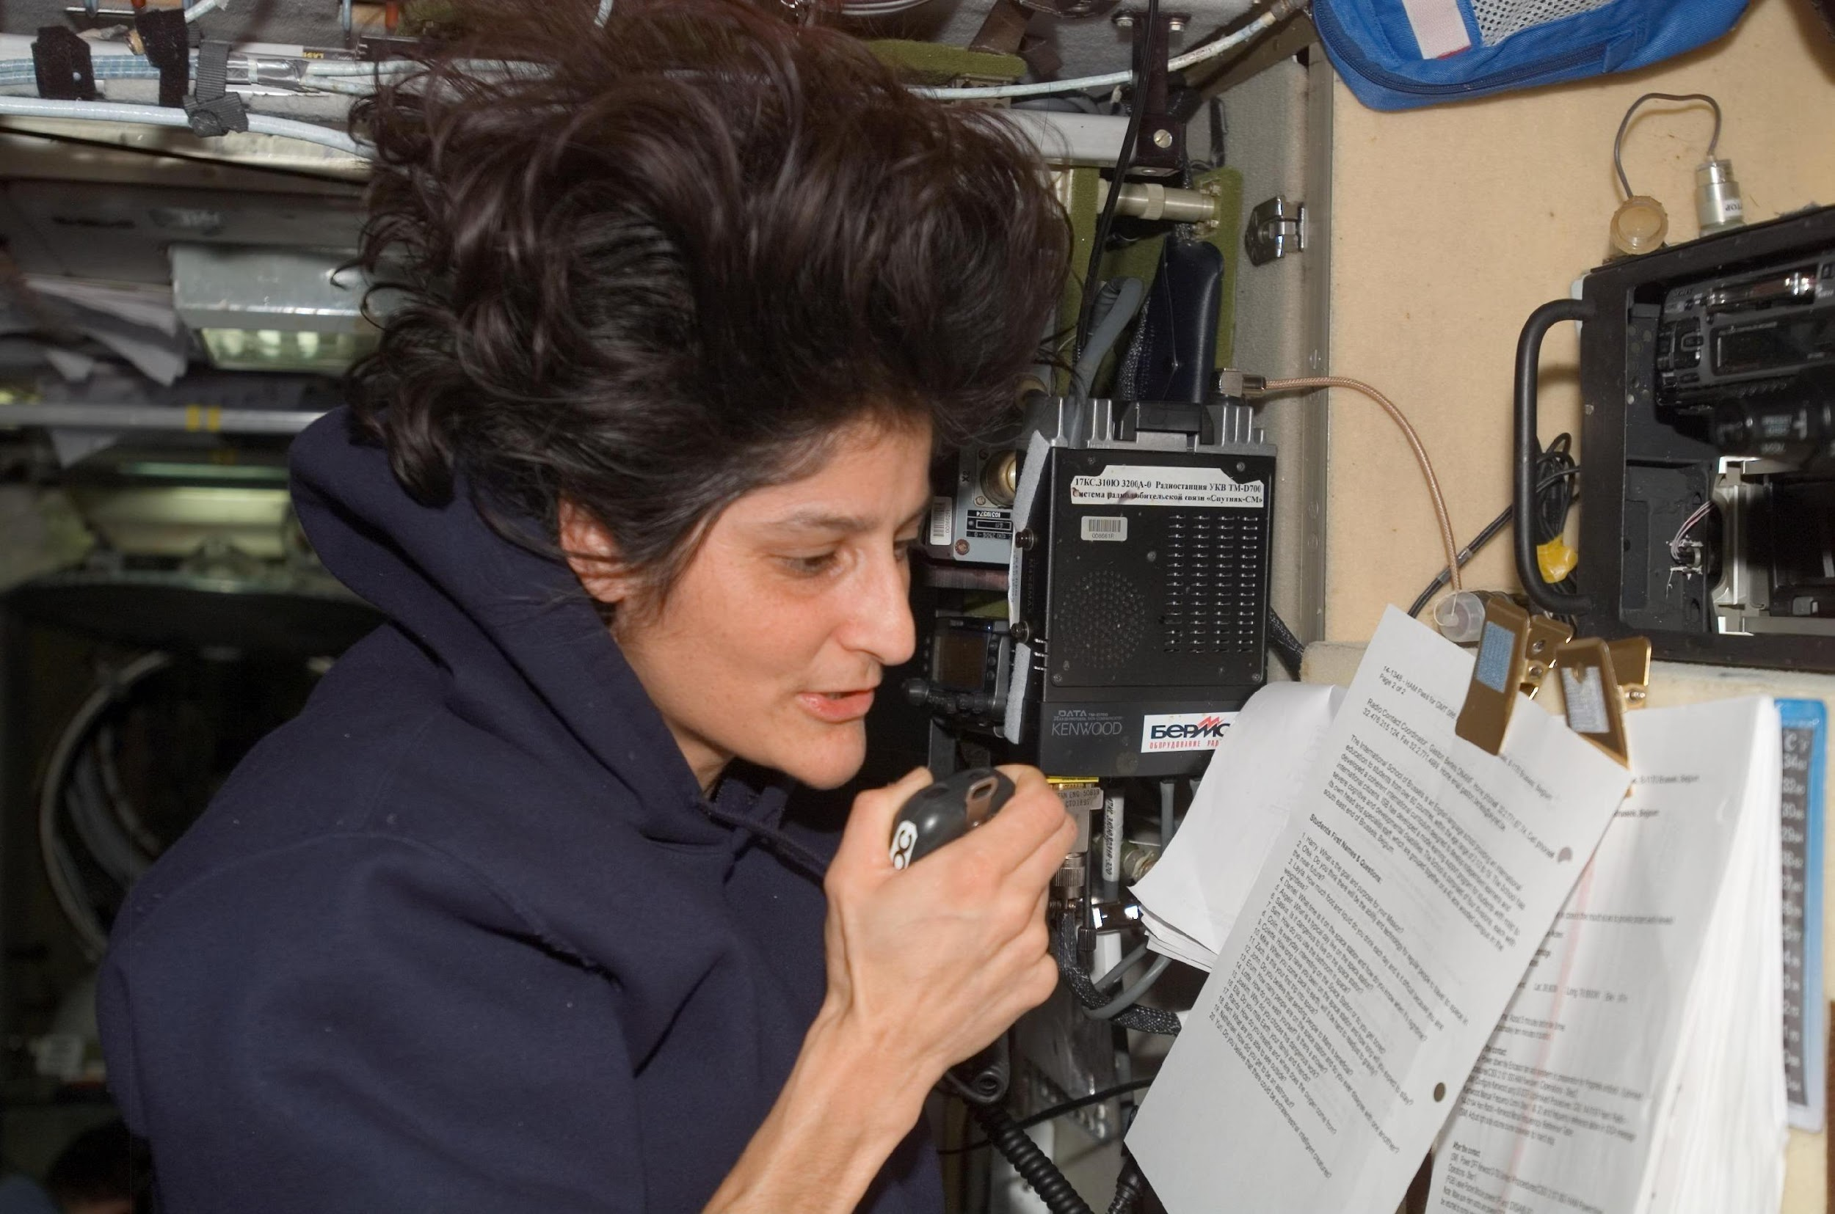
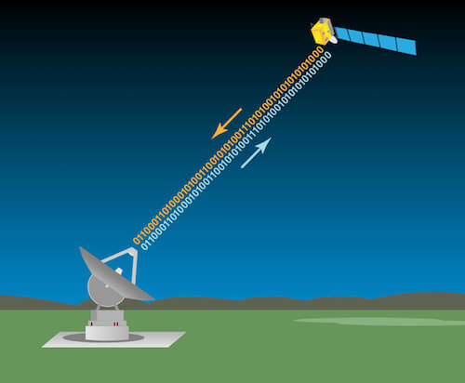
Tech used to communicate to and from space
#TechWeCan | Tech for Space
Notes:
Astronauts are often the people we see on TV and those actually carrying out space missions however their job would not be possible without the huge team on the ground back on Earth. Often in movies we see the mission control centres like the one in the top left picture. It’s important to remember that a successful space mission has such a huge team of people who have worked on that mission – people from lots of different specialities and jobs. We have looked at lots today but there are so many more.
For these teams to work together, having the technology to be able to communicate to and from space is so important. It allows them to keep in touch with family and friends and also allows them to communicate with other experts on the ground so they can carry out their missions safely and successfully.
Onboard the ISS astronauts are able to have a real time conversation with the ground with a very small delay. BUT as spacecraft travel further, it will take longer for signals to travel from the Earth to the craft. For example, it is predicted that it could take 20 minutes for a signal to reach Mars from Earth – that would end up being one very long call!!
It’s therefor really important that we continue to find faster ways of sending communications to and from space craft.

Slide 10
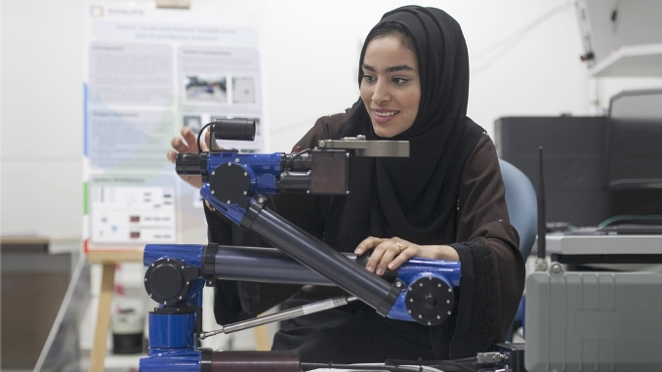
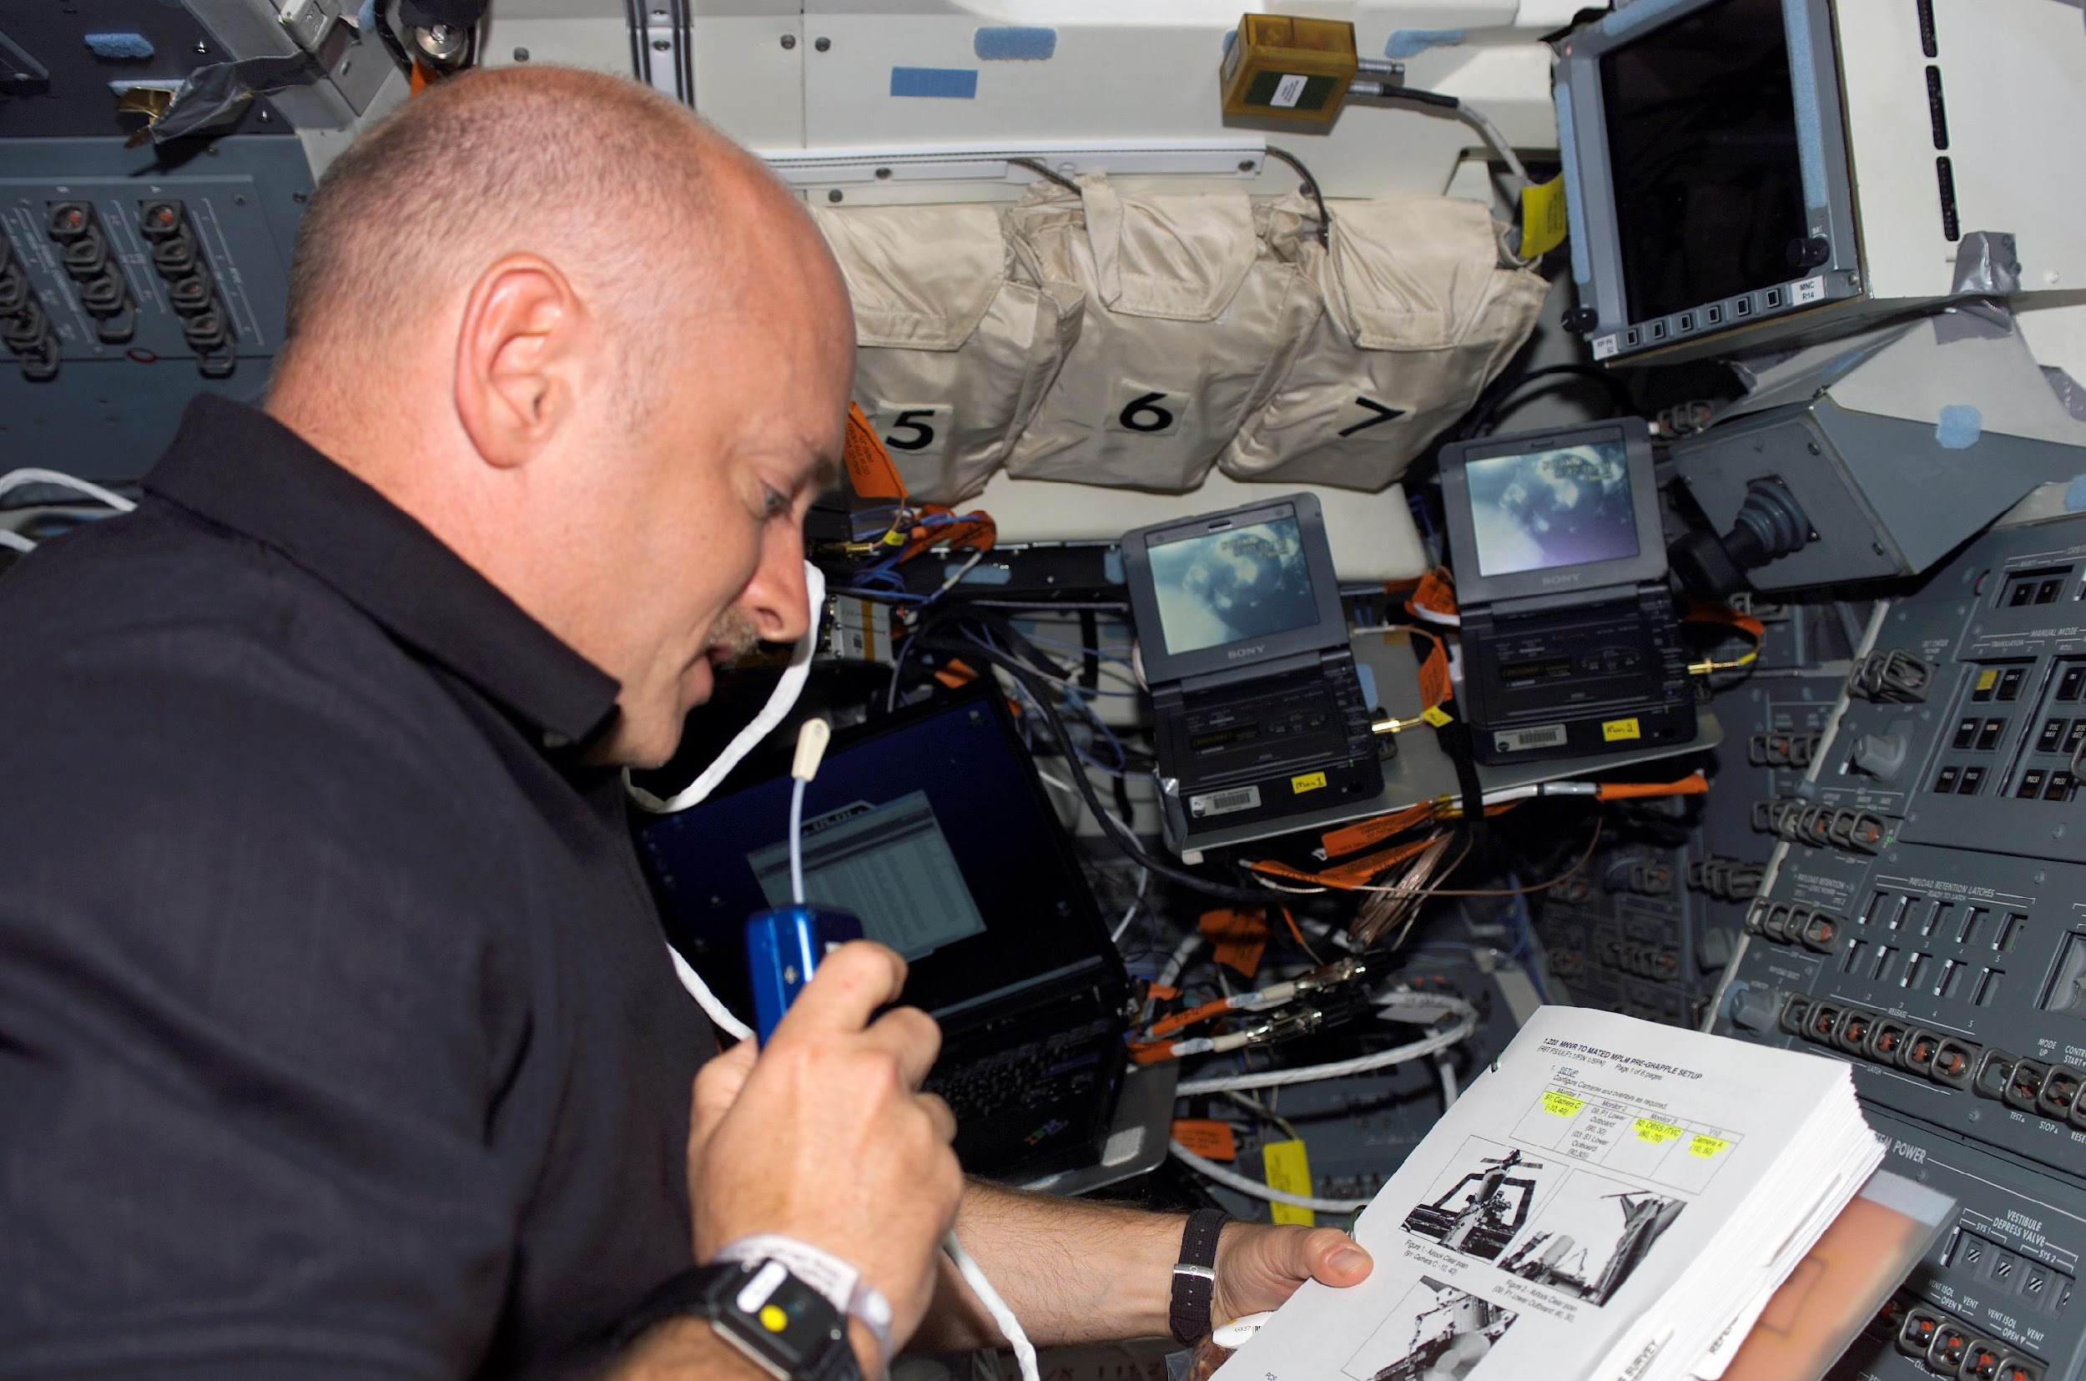
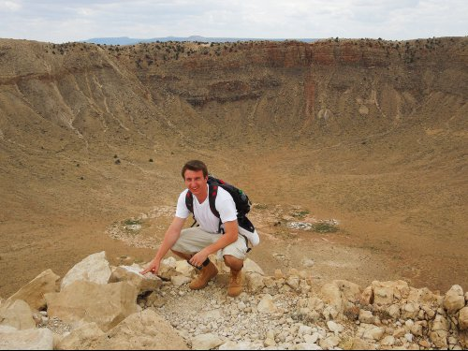
Careers in Space Exploration and Communication
Space Robotics Engineer
Telecommunications Engineer
Planetary Geologist
As a robotic engineer, you could be responsible for building and programming robots, landers and rovers to explore and work in space.
As a telecommunications engineer, you could work to develop and improve how astronauts in space can communicate with Earth.
As a planetary geologist, you could use your knowledge of soils and rocks on Earth to study the surface of other moons and planets.
#TechWeCan | Tech for Space
Notes:
If creating technology to explore space and communicate with space sounded interesting to you then here are some jobs specialising in that area.
You could be a space robotics engineer and help to design the next lander or rover to research and explore a planet.
You could be a telecommunications engineer and help astronauts travel further by developing technology to improve their communication with Earth.
Or you could be a planetary geologist and use your knowledge of soils and rocks on Earth to study the surface of other moons and planets.

Slide 11
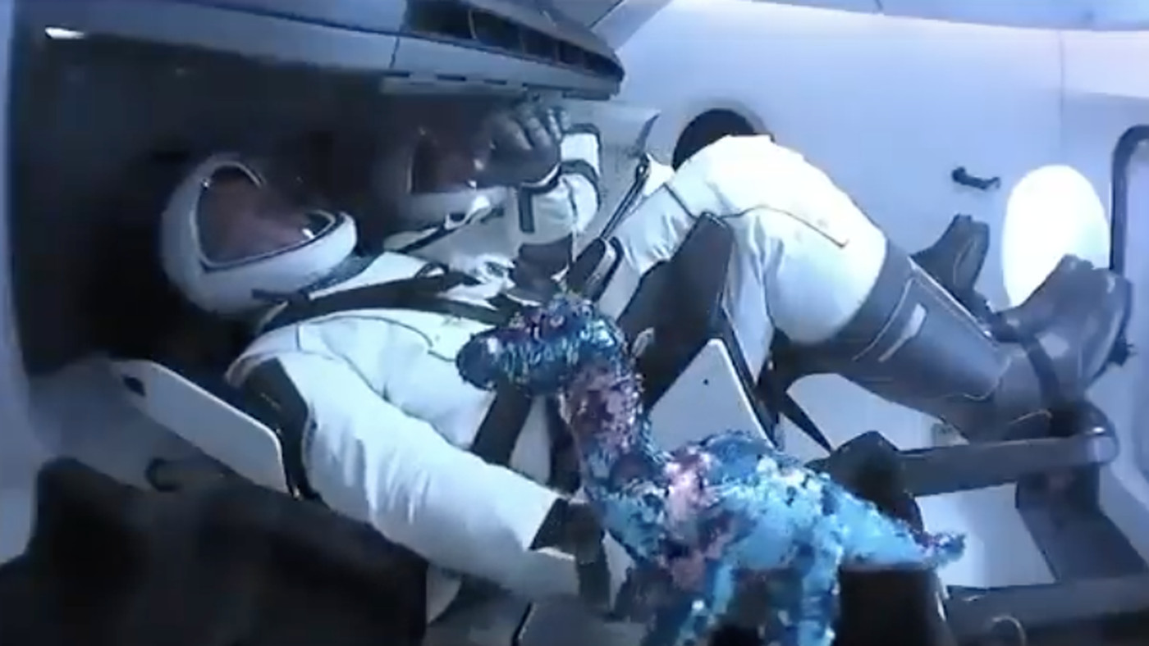
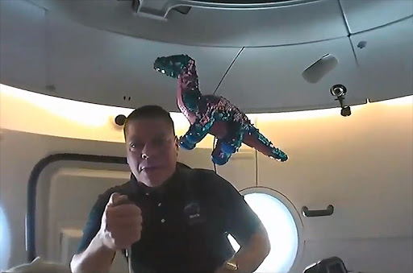
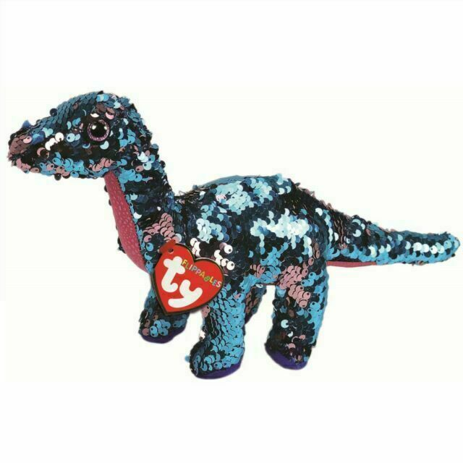
Tremor
#TechWeCan | Tech for Space
Notes:
And finally …. Something we want you to remember is that space agencies all around the world are looking for people who specialise in all of the STEM subjects. They especially want people who are creative, bring new ideas and think outside of the box.
Sometimes it’s the simplest ideas which can help us with space travel. Here’s my very own example of that:
For example, the little teddy in the bottom picture is a dinosaur called Tremor. Tremor was actually used on a Space X launch as an zero gravity indicator. When Tremor started to float around the cabin, the crew knew they were now experiencing zero gravity. Clever thinking!

Slide 12
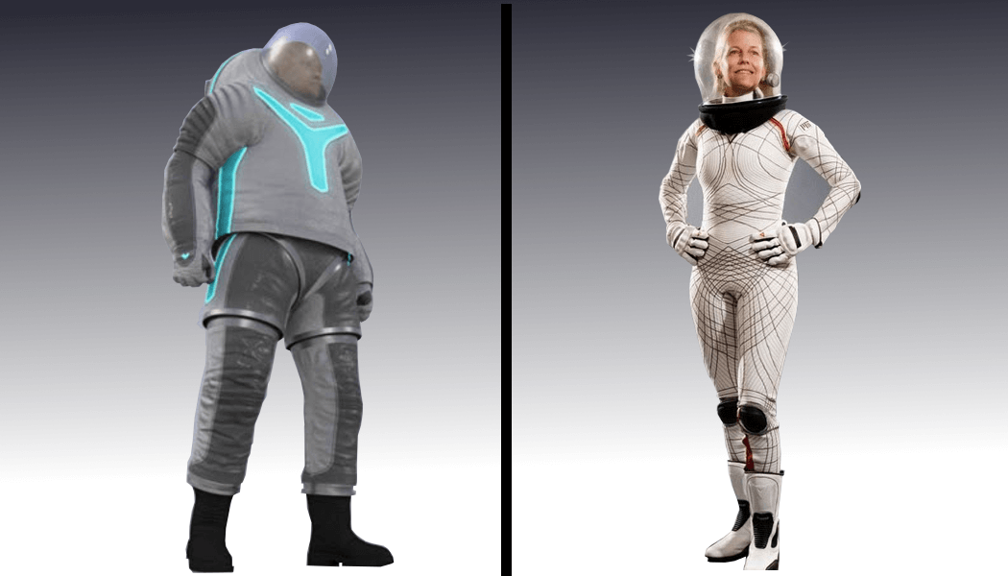
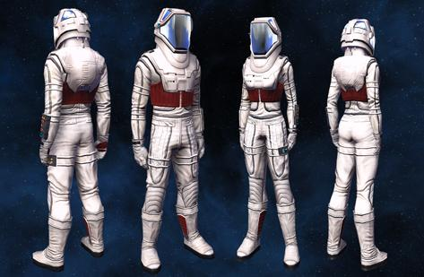
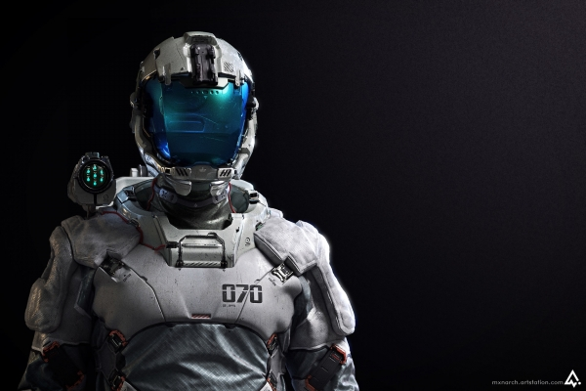
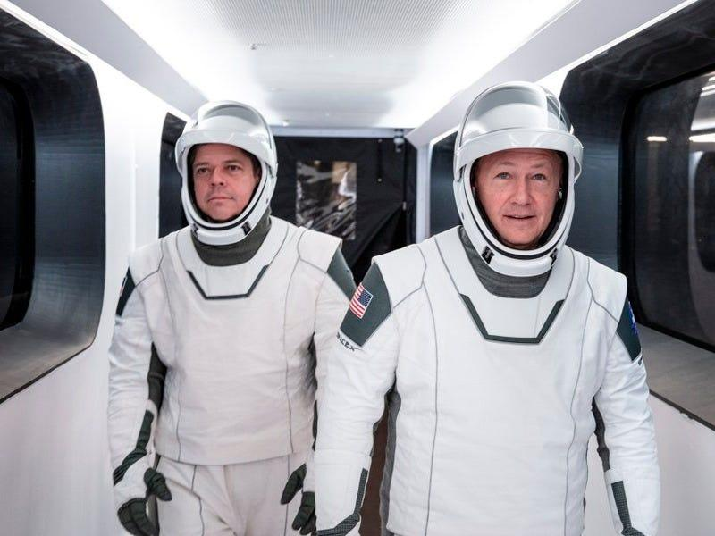
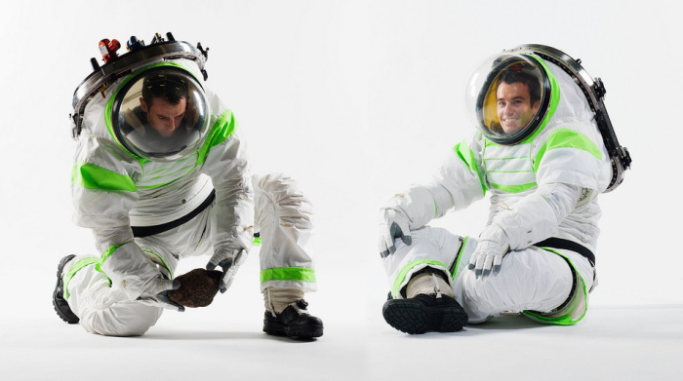
Your challenge: Design a space suit and label your suit with all of the technology you have added to keep the astronauts comfortable and safe.
Please ask your parents or teachers to share your work on social media using #TechWeCan or email us at info@techshecan.org
#TechWeCan | Tech for Space
Notes:
Time for your Tech for Space challenge.
By 2024 NASA would like to land the next man and first ever woman on the moon which is very exciting. In the next decade they would also like to send a crew to land on Mars (this will take them 7 months to get there).
Within the next decade, they would like to build a base so their will be humans living on the moon all of the time. The humans living on the moon will be going out on many spacewalks.
For your challenge we would like you to become a space suit engineer (another actual job you could have in the future). We would like you to design a space suit for people who live on the moon. We want you to label your space suit with all of the technology added for comfort, safety and communication.
As always, you can present your work in any way of your choice. You could hand draw and label your design, create it on a computer programme or create a 3D model of your space suit.
We absolutely love to see your Tech We Can challenges and if you would like us to give you feedback on your work then please email it to us or ask your teachers or parents to share it on social media using the #TechWeCan.

Slide 13
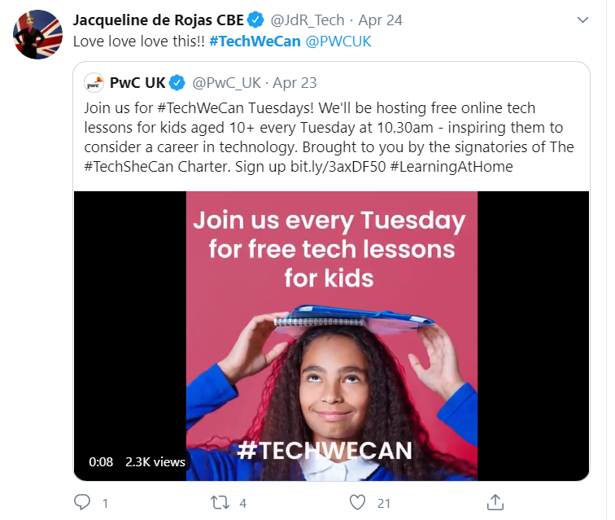
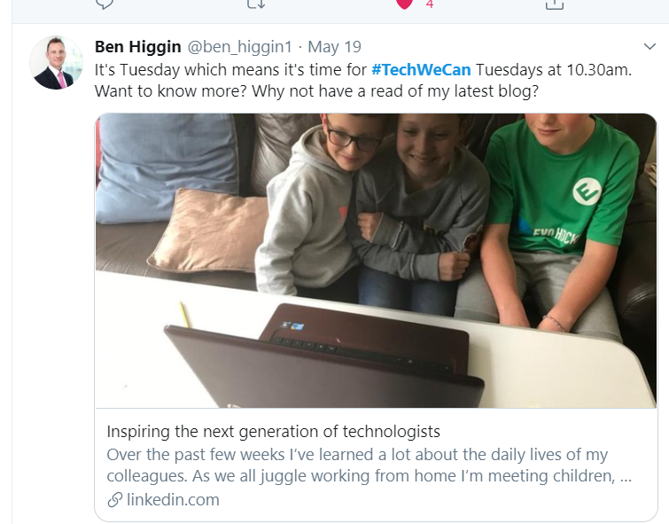
“Our Tech We Can lesson plans are part of our commitment to upskill the communities we’re part of - without urgent attention, many risk getting left behind as technology changes how we live and work. The current crisis we face has provided a stark reminder of the critical value of skills in science and technology.”
Sheridan Ash, co-CEO Tech She Can
For more information about Tech She Can and free access to all of the Tech We Can resources we have spoke about today, please visit: https://www.techshecan.org/
Follow the hashtags #TechSheCan and #TechWeCan to stay up to date with us on social media.

