Slide 1

Sport
TECH FOR
To understand how technology is used in the sport industry and broaden my knowledge of careers available in this field
Notes:
Hi Everyone, my name is ????????? and this Tech We Can lesson is Tech for Sport
So …. our aim today is to show you lots of different and interesting ways technology is being used to train athletes, help avoid injuries, improve inclusion in sport and help stick to rules. We also want to give you lots of ideas for the kinds of jobs you could have working with and creating the technology we cover today.
Today we are going to focus on Tech for Sport but we have lots of other Tech We Can lessons available for you to choose from. We want to show you how your interests and passions could lead you into a career in tech.

Slide 2
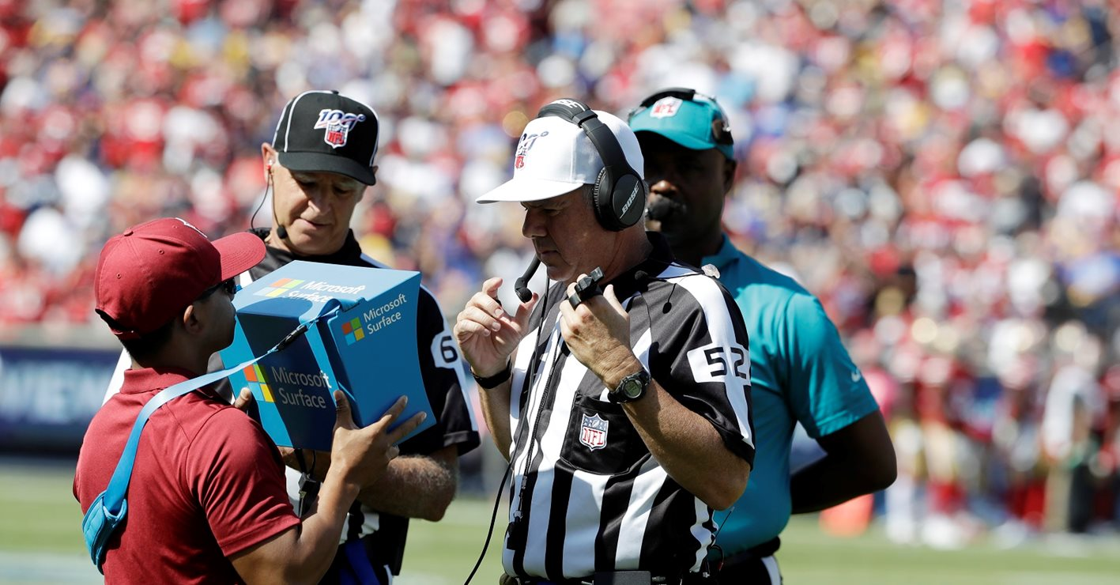
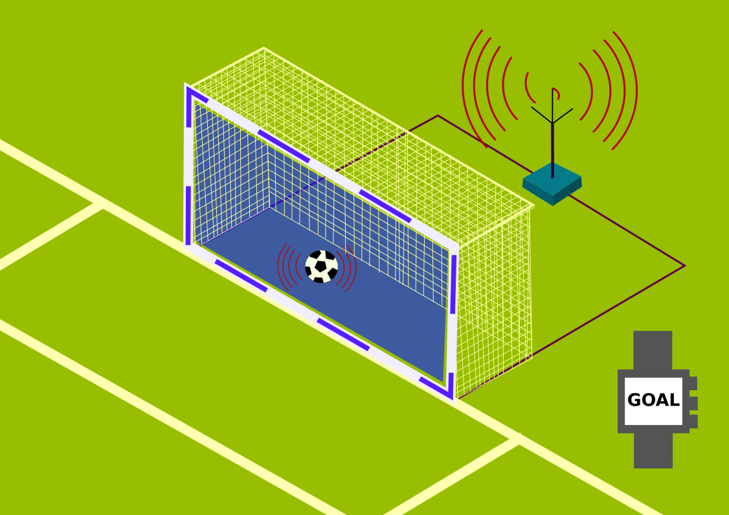
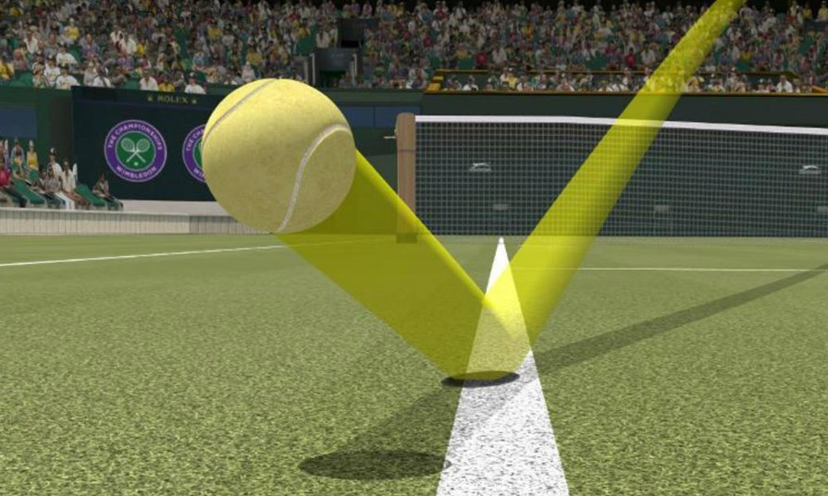
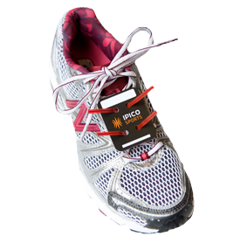
Technology used to support sports officials
#TechWeCan | Tech for Sport
Notes:
So whenever you think of the sport industry you might just immediately think of athletes. But there are actually lots of other people involved behind the scenes with many different types of jobs. We are going to start our lesson today looking into how technology is used to help monitor the game play in sports and help referees and umpires make decisions.
Sometimes referees may miss something which happens, or their view may be blocked or it may have happened really quick. This is where Instant video feedback helps. Instant feedback using video recording has been a major ongoing development supporting referees over the last few decades. If referees are unsure, they can watch a slow motion replay of the event to help them make a decision. The picture in the top left is of a referee in the NFL (which is the National Football League in America). He is watching instant feedback to help him make a decision. As referees are humans, different referees could come to different decisions for the same event. The NFL use something called Art McNally GameDay Central to help make sure that decisions are more fair and consistent no matter who your referee is. Art McNally GameDay Central is a hub of people supporting all NFL referees at the same time. So you are less likely to have a strict referee one match and an easy going referee the next as they are all advised by the same team.
The picture in the top right shows how Goal Line technology works. In football, the ball has to completely cross the line in order for the goal to count. Again, this can be very tricky for a referee to see if they are not level with the goal. Goal line technology involves the use of around 7 cameras per gaol, the cameras are used to detect if the ball crosses the goal line, if it does, the sensors immediately send a signal to a watch to warn the referee and alert them of a goal. This technology is very expensive so at the moment it is only used in the top football leagues.
The picture in the bottom left shows a technology called Hawk Eye. Hawk-Eye is a camera system which traces the ball's trajectory during the game – this means it follows the exact movements of a ball and can replay this or predict exactly where it went within a few mm. This is actually one of the most advanced tech tools used by official in sports like tennis and cricket. Here’s a little clip to explain more:
https://www.youtube.com/watch?v=6wjhSR5Dcyk
If you look closely at the picture in the bottom right, you will see something called an RFID chip in the middle of the laces on the trainers. RFID stands for radio frequency identification – it basically uses radio waves to be able to track items and people. In sport, these are often used in long distance running events like the London Marathon. The chips time a runner as the cross the start and finish line. They can also be used at points around the race so you can keep track of a runner and when they last passed a checkpoint with a point with an RFID sensor in. Clever stuff!

Slide 3
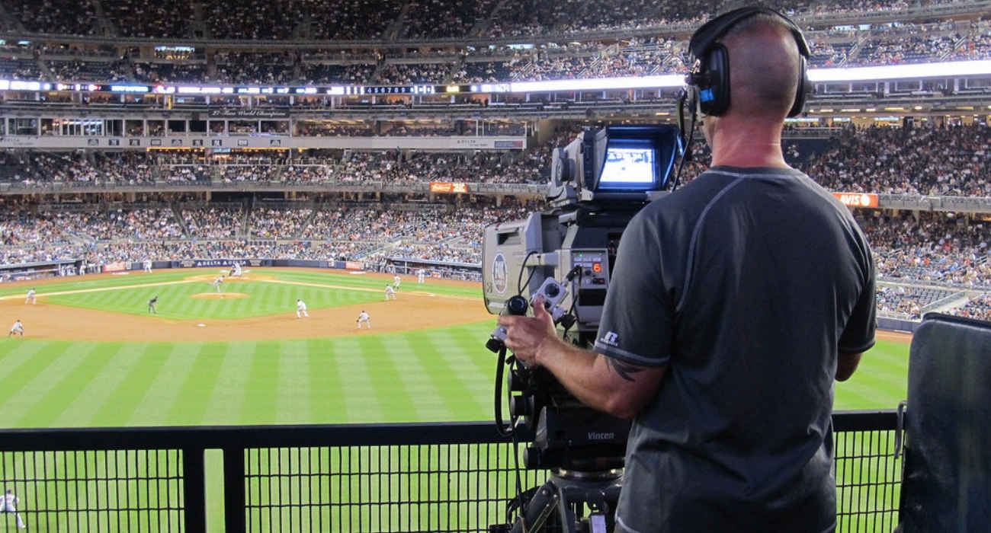

Careers in Tech used to support sports officials
Hardware Technician
Software Engineer
As a hardware technician you could work with the cameras and tools used in technology like Hawk Eye and goal line technology. You will be responsible for ensuring the equipment is installed, used and maintained correctly.
As a software engineer you could use your knowledge of computer science to programme products to help monitor athletes and competitors.
#TechWeCan | Tech for Sport
Notes:
If working with technology to help monitor sports interests you then you could be a hardware technician. As a hardware technician you could work with the actual cameras and tools used in technology like Hawk Eye and goal line technology. You would be responsible for ensuring the equipment is installed, used and maintained correctly. If working in somewhere like a football stadium sound cools then this could be a potential future job for you.
Also all of the tech used to help referees needs to be designed and coded by someone. The technology needs to be told what to do. This is the job of software engineers. Software engineers work in many different roles but you could programme the future technology used to monitor athletes and competitors.

Slide 4
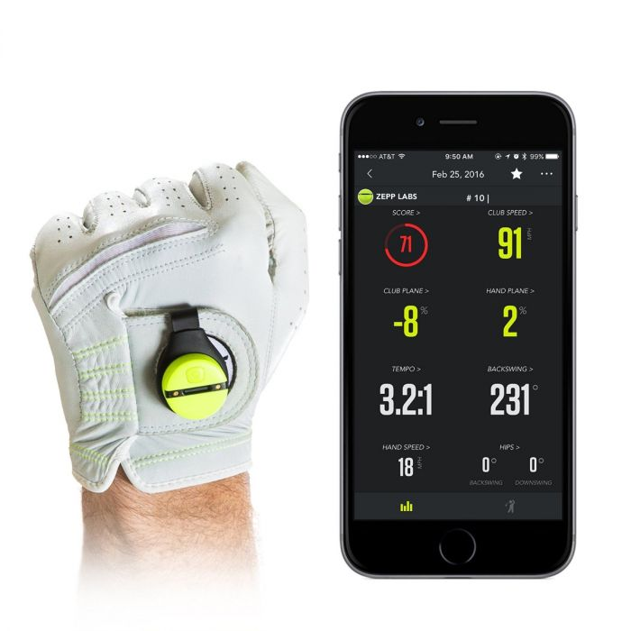
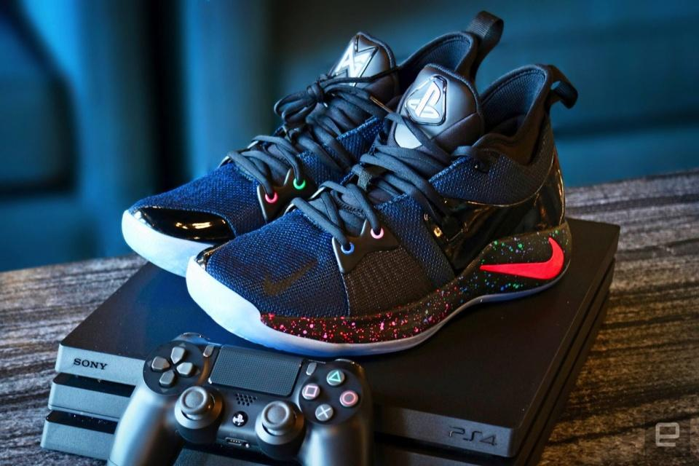
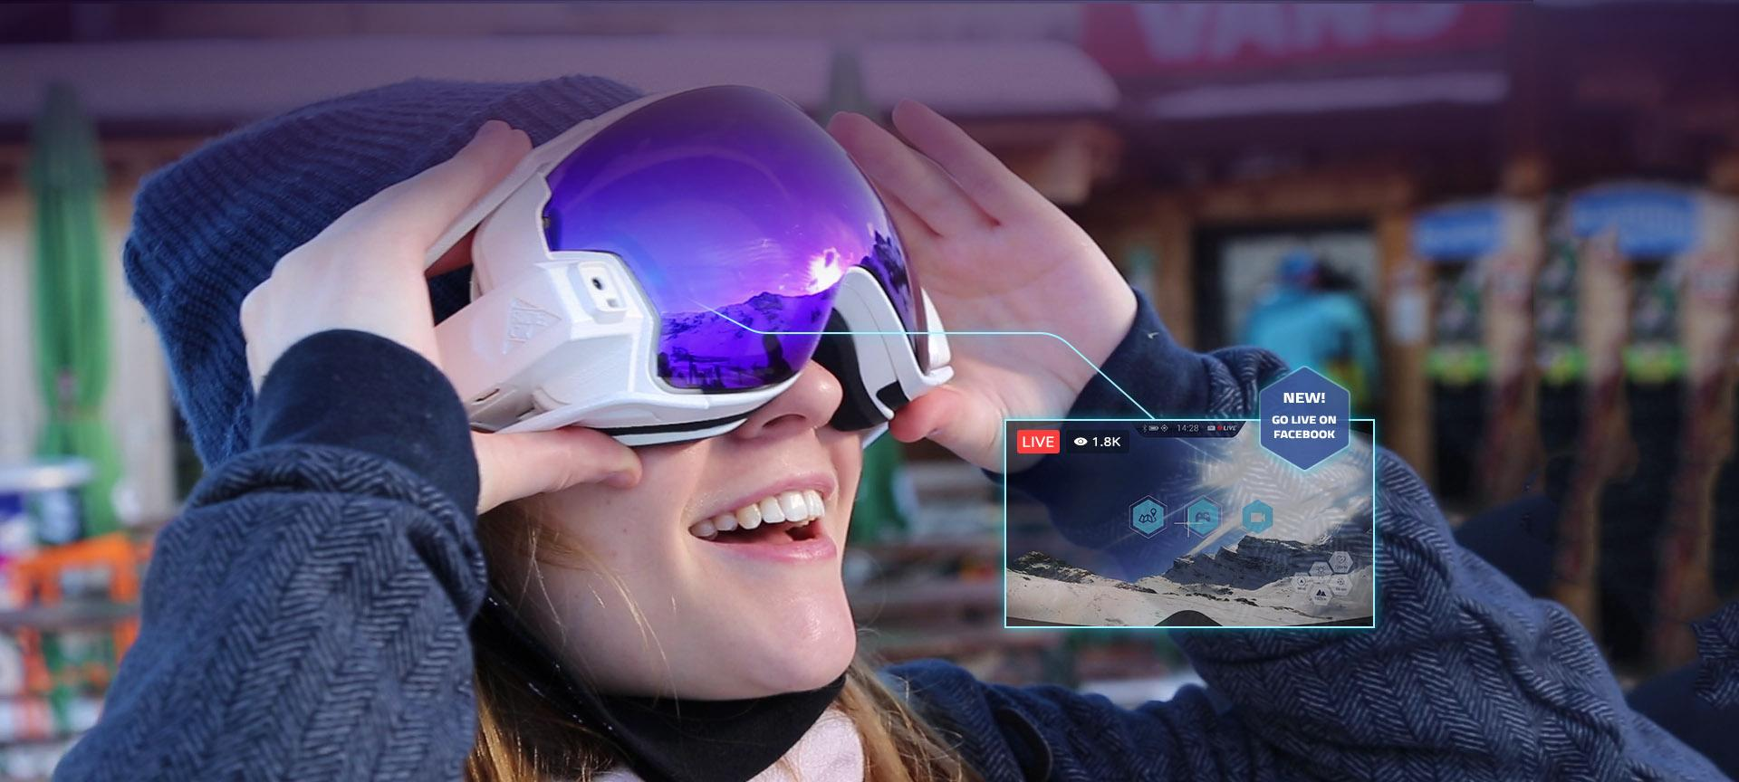
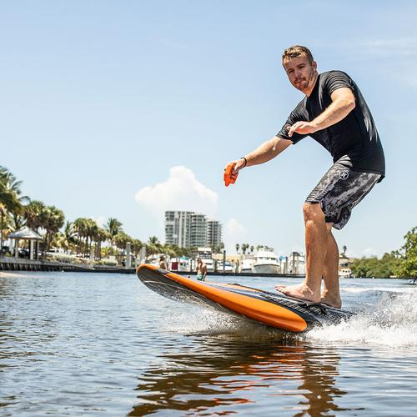
Technology used in sport equipment
#TechWeCan | Tech for Sport
Notes:
We are now going to move onto how technology is being used in sports equipment.
The picture in the top left is called the Zepp 3d Golf Swing Analyser. The sensor is attached to the back of a golfers glove. When they swing, the sensors measures and analyses things like the length and speed. This information is then sent directly to the players smart watch or phone so they can see how they can improve and even watch an animation replay of their swing.
The picture in the top right is of a pair of trainers created by Nike called PG2. The design was inspired by the PlayStation console and controller. The trainers have hidden technology inside them and I just think they are really cool – have a little look at this clip: https://www.youtube.com/watch?v=LaGl4eio4rk – (Play start of clip 0:00– 0:45)
In the bottom left picture, that lady is wearing a pair of ski goggles called the RideOn AR ski goggles. As you might be able to guess from the name, the AR stands for Augmented Reality. This means that when the wearer looks through the glasses they can see images and information projected in front of them. Using the AR the user can do things like chat to other skiers and follow arrows which shows them where to go.
And the man in the bottom right is riding something called a YuJet surfboard. With a YuJet surfboard you don’t need waves as the board is jet powered. I’m not sure my balance is good enough but these look so much fun to ride.

Slide 5
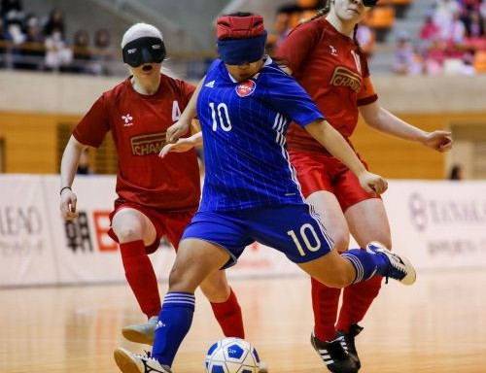
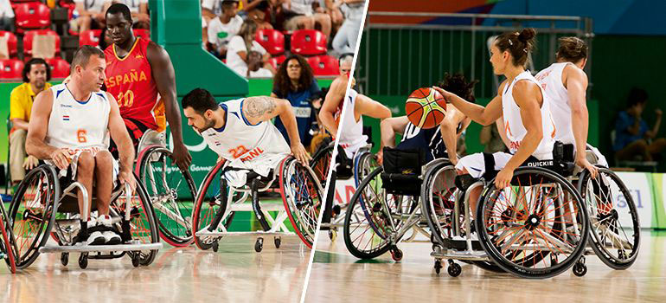
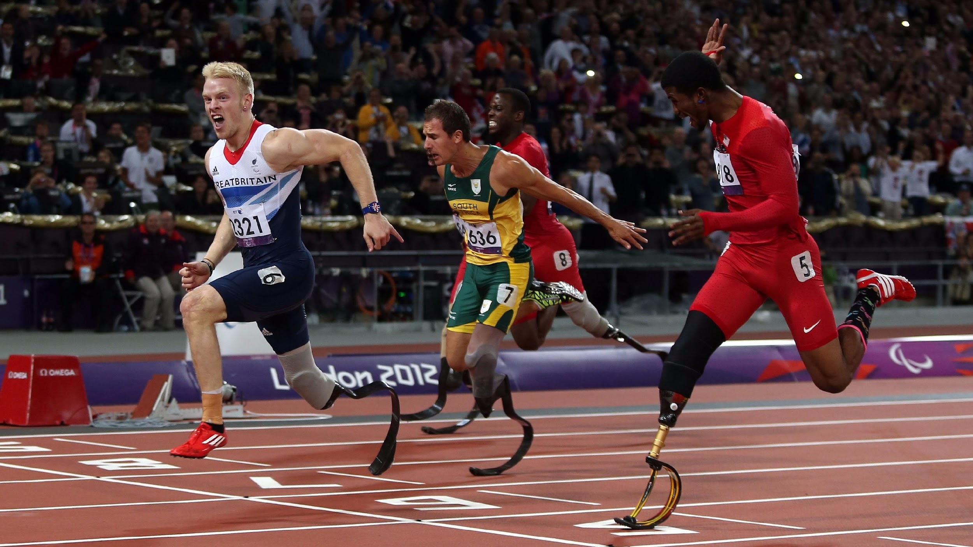
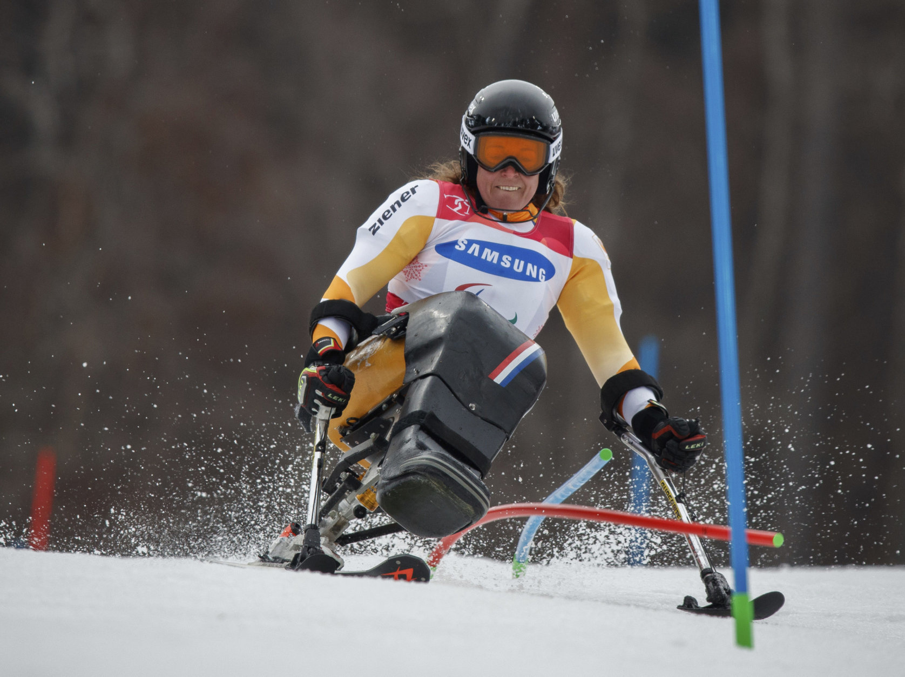
Technology used for inclusion in sport
#TechWeCan | Tech for Sport
Notes:
I’m now going to move onto how technology is used for inclusion in sports. Inclusion means allowing everyone, no matter their abilities or disabilities access to try any sports they would like to. For people who have disabilities, technology in the form of specialist equipment can help them experience a wider range of sports. This type of technology is often called assistive technology. There are lots of amazing examples of assistive technology but here are just a few.
The ladies in the top left picture are playing blind football. This sport allows people who are full sighted and those who have problems with their sight to play together. They all wear blindfolds to make it fair. The technology they use includes, a ball which contains materials which rattle so the players can hear it. They also have specially designed sound boards around the pitch which create an echo. The players can click their fingers to find out their own position, to locate other players and to find the ball as it goes in and out of play. I think that’s so clever!
The athletes in the top right picture are playing wheelchair basketball. Wheelchairs have been adapted for a number of sports including tennis, sailing, golf and rugby. The wheelchairs are specially adapted for each individual sport to suit the moves and actions the players need to do. Have a look at these children playing wheelchair basketball:
https://www.youtube.com/watch?v=FcUjQbmcQGw (0:36 – 1:42 - play section of clip)
The men in the bottom left picture are running on something called blades. The blades are made of something called carbon fibre and are really strong. They allow people without feet or legs to run.
And the lady in the bottom right is competing in the winter Paralympics using a specially adapted chair with skis on the bottom. Imagine the coordination and upper body strength she must have to be able to control that at such high speeds.
It’s so important we continue to design and develop assistive technology of all kinds to make sure all sports can be accessible to anyone who would like to give them a try.

Slide 6
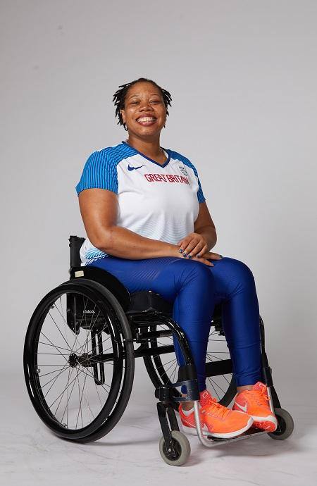
Meet today’s role model
Vanessa Wallace
British Paralympic Shot Put Athlete
#TechWeCan | Tech for Sport
Notes:
We are now going to meet our Tech for Sport role model. We are going to hear from Vanessa. Vanessa is an amazing accomplished Paralympic athlete and a truly inspirational lady. Katie had a chat with Vanessa – lets see what she said: PLAY VIDEO (image hyperlinked) from 19:08 – 26:28
Some of that technology Vanessa used in her training sounds so cool and I loved her advice that everyone should just give sport a go. It’s so true that you never know until you try.

Slide 7
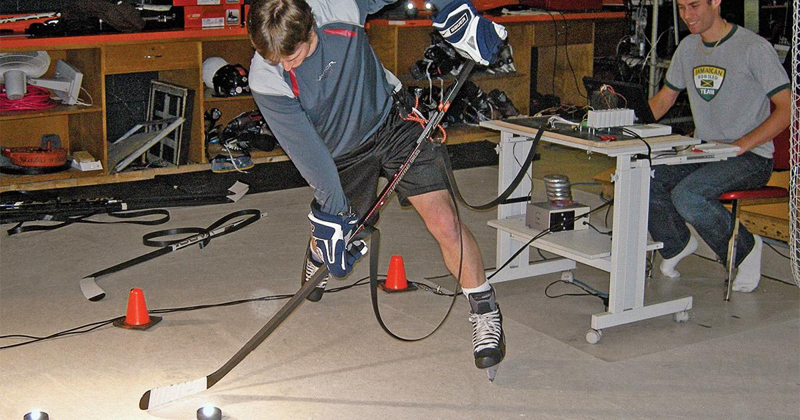

Careers in Tech for Sports Equipment
Sports Engineer
Product Designer
As a sports engineer you could research the technology used in future sports equipment for athletes and competitors to use.
As a product designer you could work with the sports engineers to create the final piece of sports equipment. Product designers use their design skills and tech knowledge to improve the way products work and look.
#TechWeCan | Tech for Sport
Notes:
If designing and building the technology in future sports equipment interest you then you could be a Sports Engineer. Sports engineers complete a variety of different jobs but you could be responsible for researching and developing sports equipment like those we have just spoken about. Or even support Paralympians by developing new technology to help them train and compete.
You could also be a product designer and work with the sports engineers to create the final piece of sports equipment. Product designers use their design skill and tech knowledge to improve the way products work and look.
Could you develop a new way to use technology to surf the oceans or perhaps even a piece of tech equipment to be used in a brand new sport not even invented yet? If you’re a Harry Potter fan, I’m thinking something like Quidditch but on hoverboards. How cool would that be?!?

Slide 8
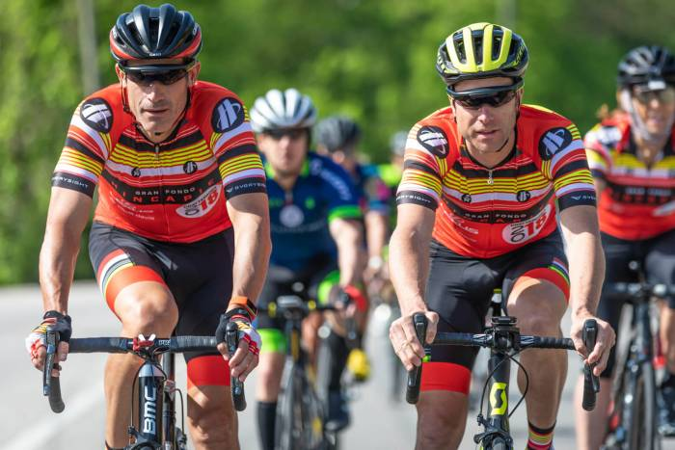
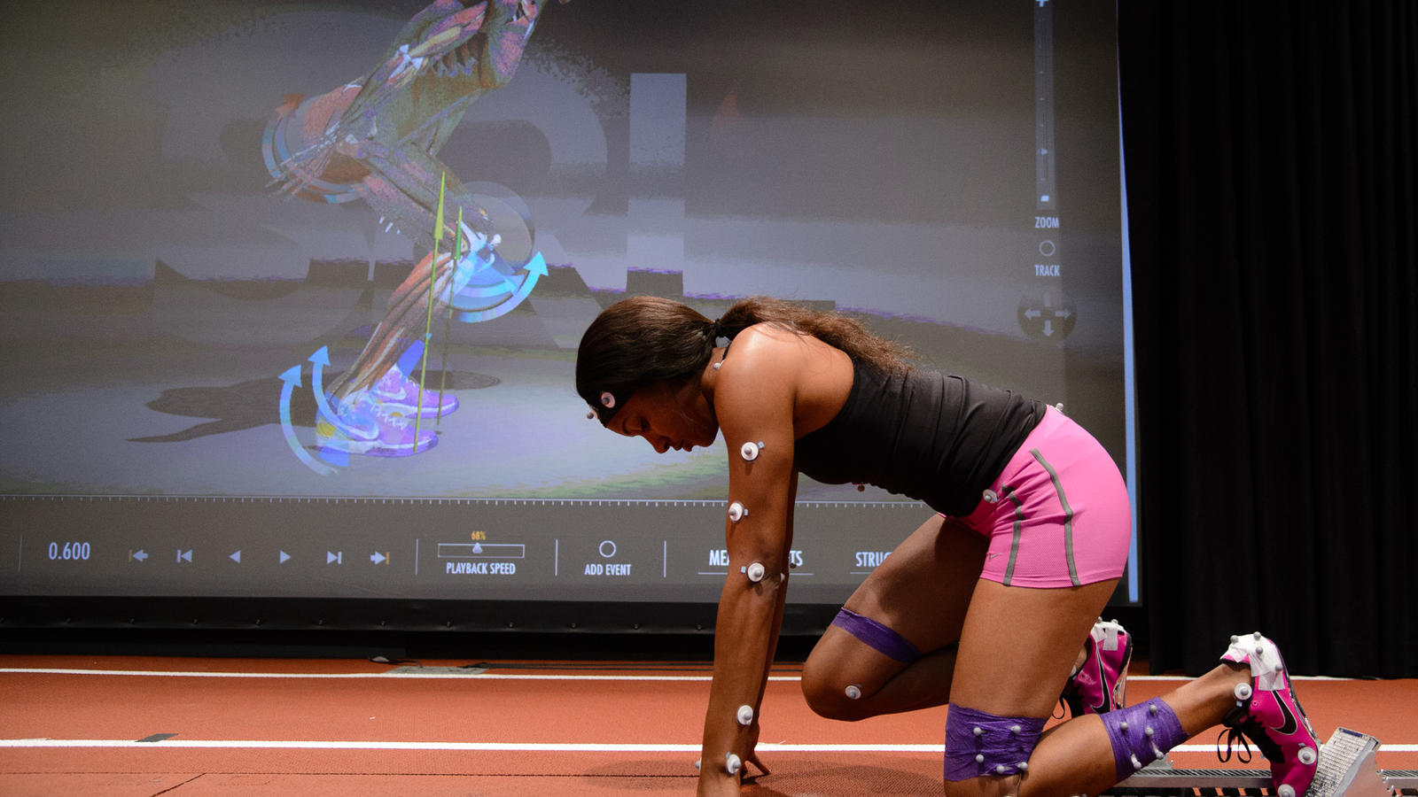
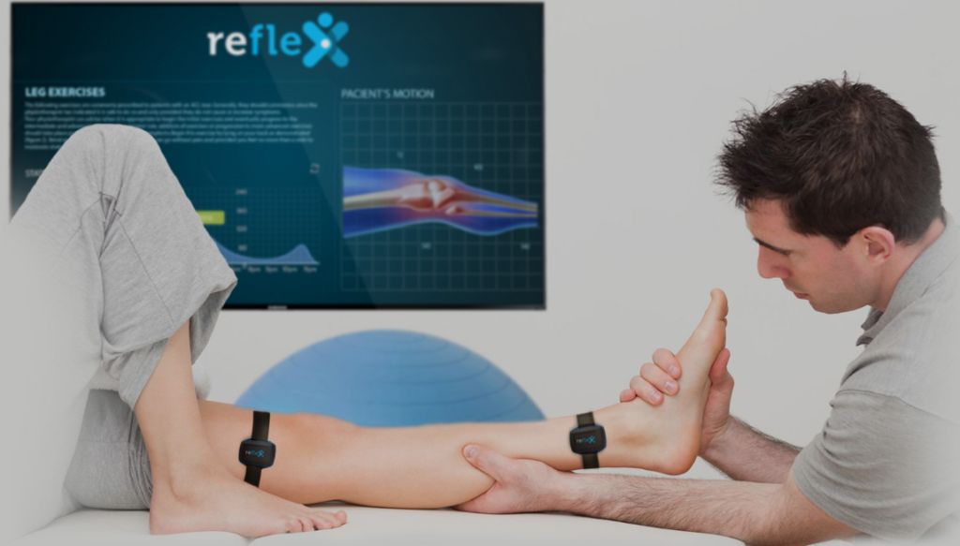
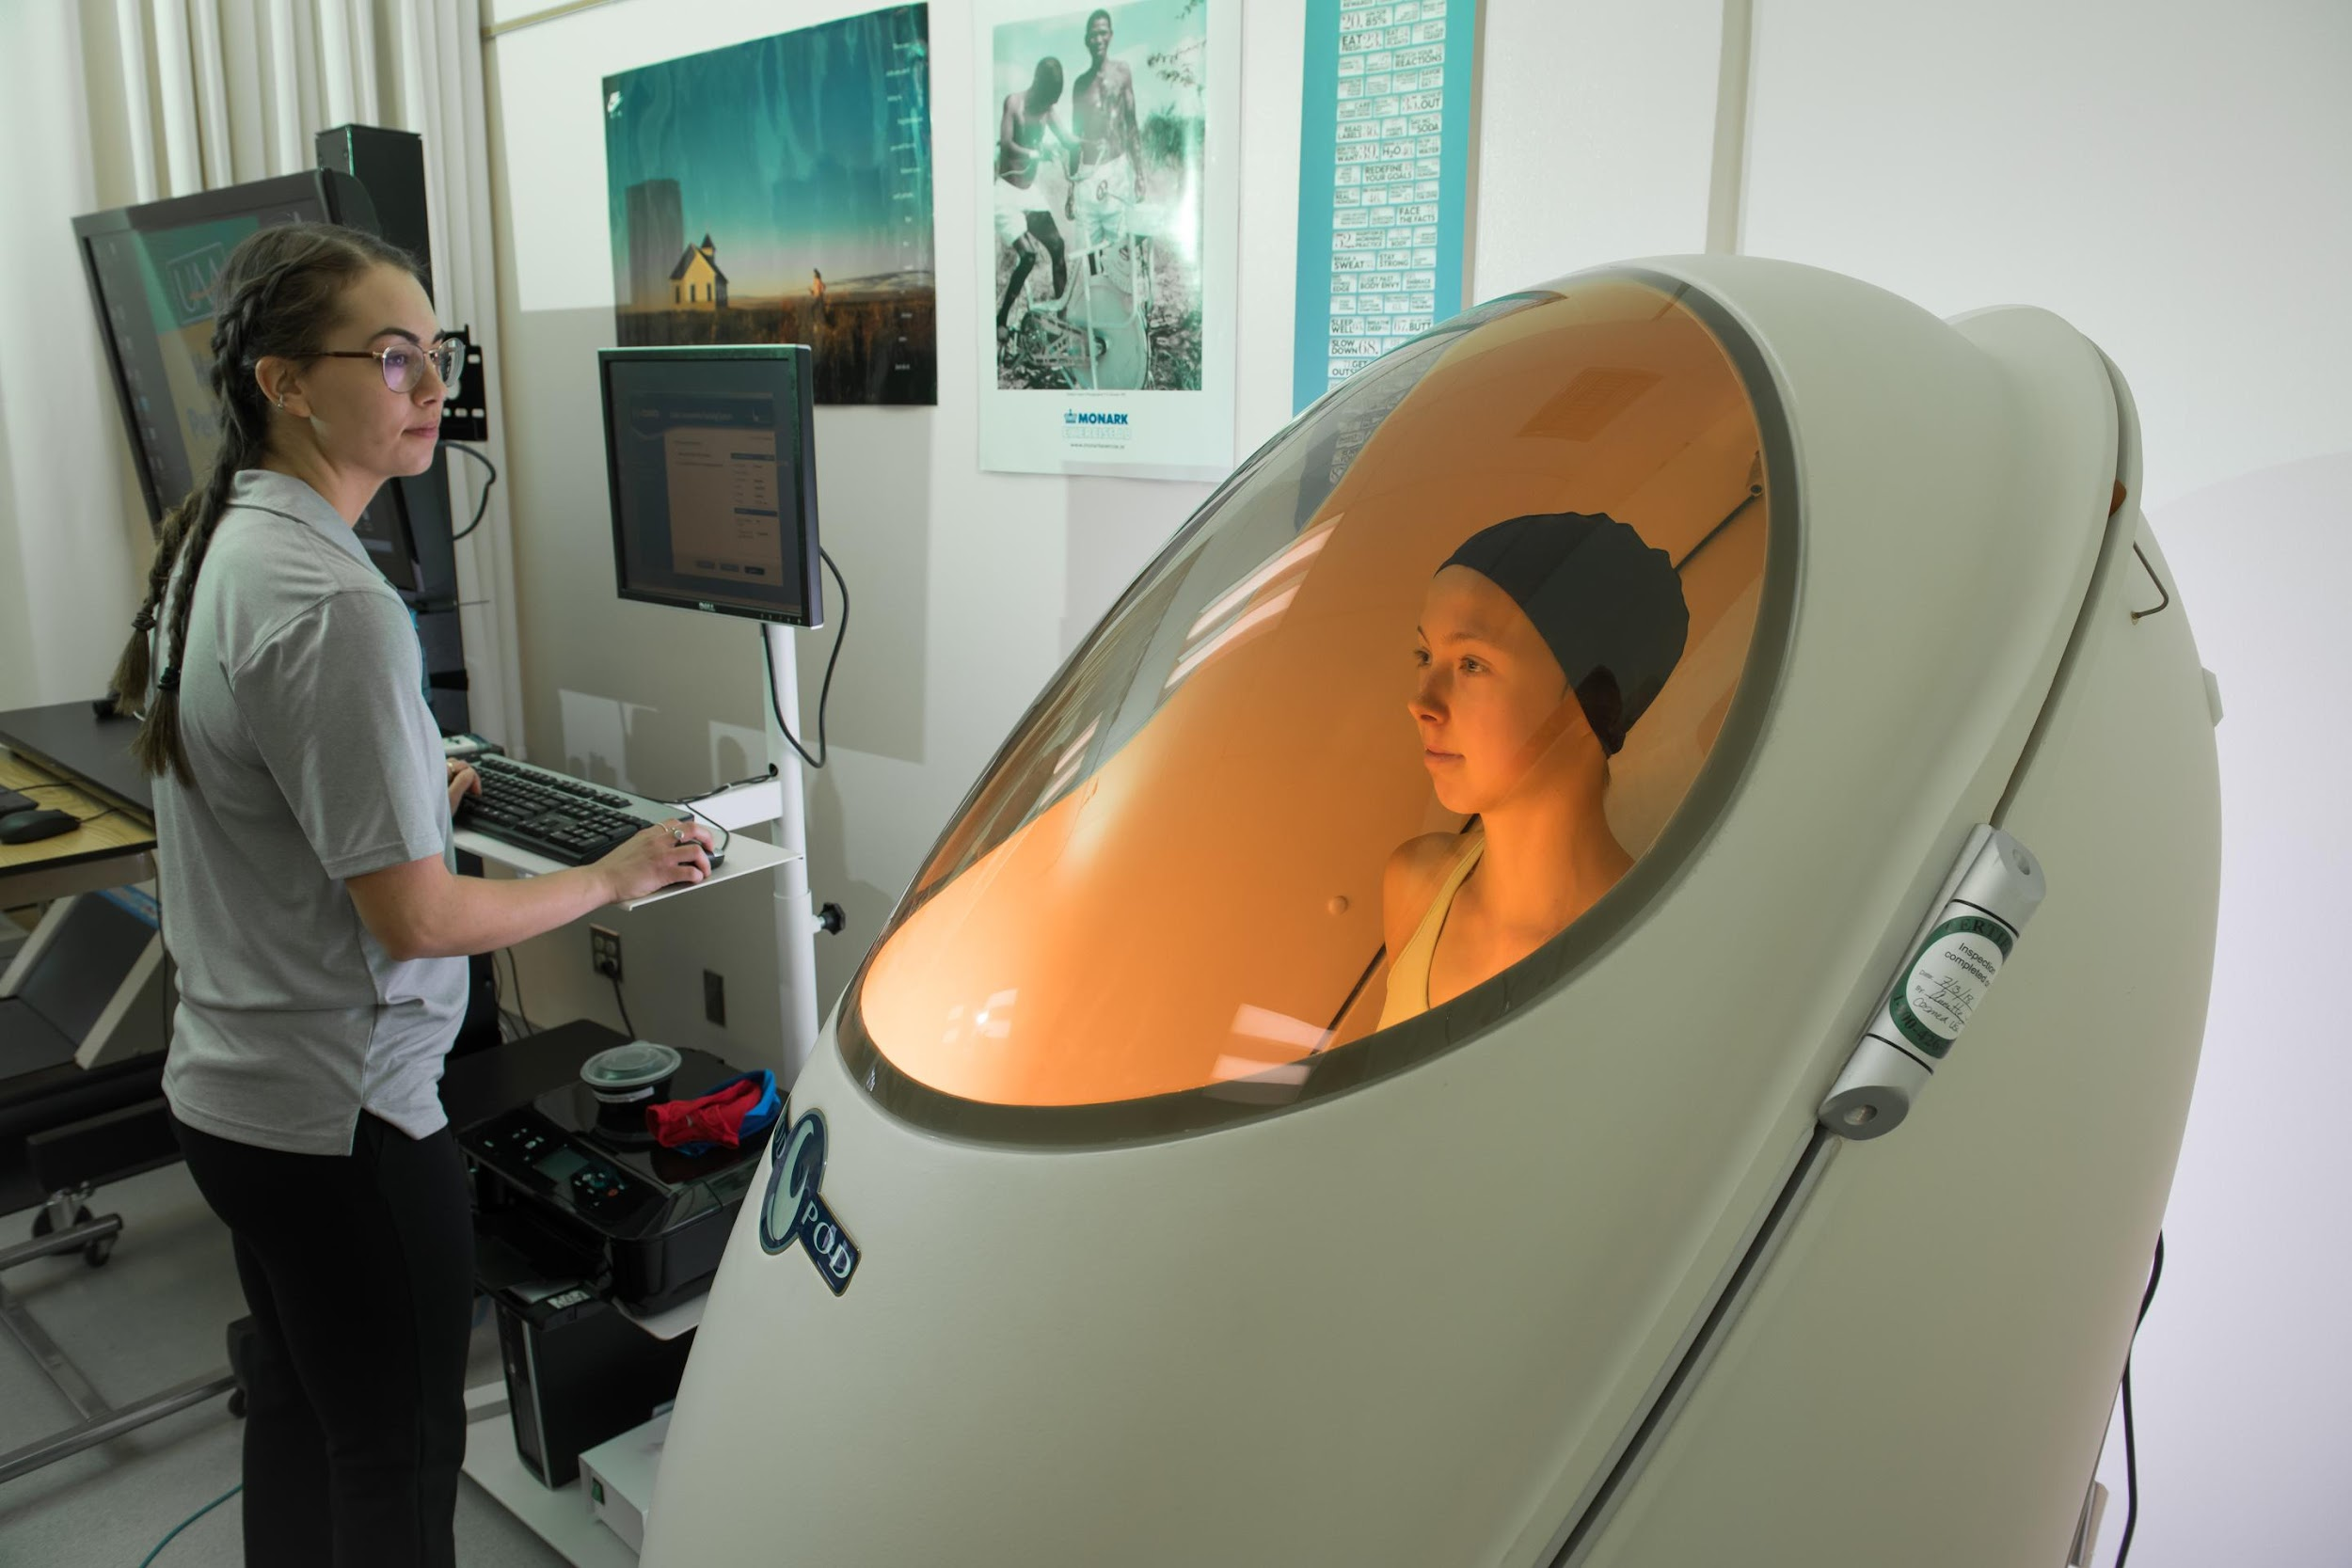
Tech to help athletes train and improve performance
#TechWeCan | Tech for Sport
Notes:
We are now going to have a look at how technology is developing to help athletes train and improve their performance.
The cyclist in the top left picture are wearing HUD glasses (this stands for heads up display). These glasses use augmented reality to project things like the riders heart rate and speed right in front of them. This information helps a cyclist improve because they can make changes in the middle of their ride. For example they might see that their heart rate is still quite low so try even harder.
If you look closely at the lady in the top right picture she has lots of white dots stuck to her clothes and body. These are all very sophisticated sensors that measure the exact movements of her body. This information is then sent to a computer to create a 3D model of their actions. This can then be used for the athlete and trainer to watch and try to perfect their technique.
The man in the bottom left picture is a physiotherapist. He is using a set of sensors on his patient called ReFlex. ReFlex is a set of wearable sensors which detect all of the patient's movements. The sensor can track, monitor and analyse every movement done by a patient struggling with an injury. It will tell them and their physio if they are doing exercises correctly, if they are performing a movement which might injure them and even count their exercises for them. Imagine the technology physiotherapists could be using when you graduate school. You could be a physio using this tech or someone creating, designing and programming tech like this.
And finally, the picture in the bottom right is of a lady using the Bod Pod which Vanessa mentioned earlier. It’s a large egg shaped chamber which people climb into. It uses air to measure someone's weight and body fat percentage. It definitely looks a bit alien like to me.

Slide 9
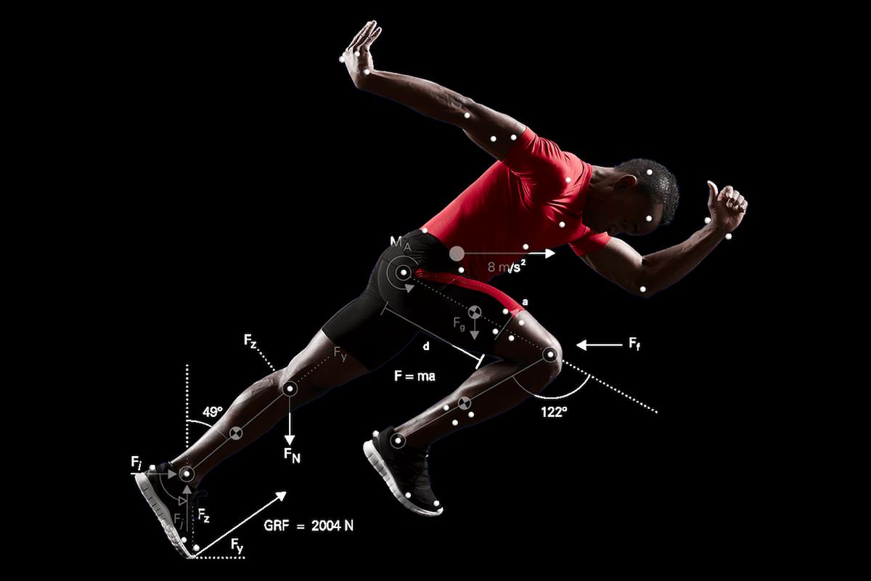
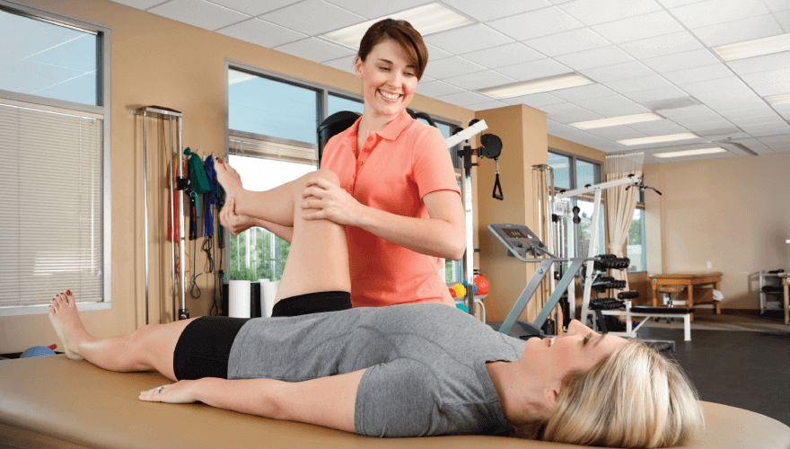
Careers in tech to help athletes train and improve
Biomechanist
Sports Medicine Technician
As Biomechanists you could use technology to study movement in living things. You could help athletes improve their performance, understand their bodies better and reduce their chance of being injured.
As a Sports Medicine Technician you could work with athletes, using technology, to treat and prevent sports related injuries and medical issues.
#TechWeCan | Tech for Sport
Notes:
If studying they way athletes perform and train and how the body works interests you then you could be a biomechanist. As a biomechanists you could use and develop technology to study movement in living things. You could help athletes improve their performance, understand their bodies better and reduce their chance of being injured.
Or you could be a Sports Medicine Technician and work with athletes, using technology, to treat and prevent sports related injuries and medical issues.
So hopefully this lesson has shown you a snapshot of the many careers you could have using and creating technology for sports.

Slide 10
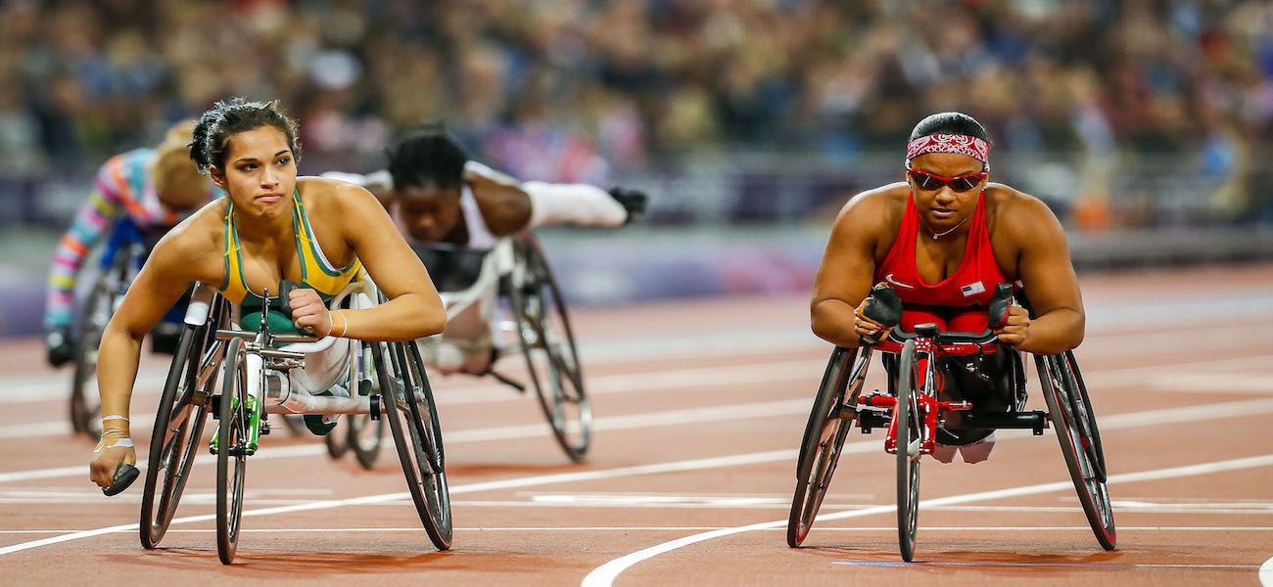
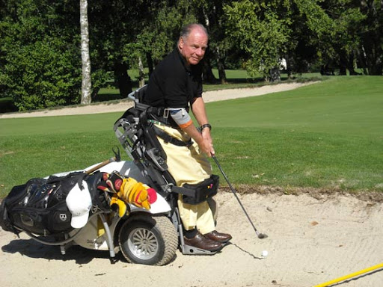
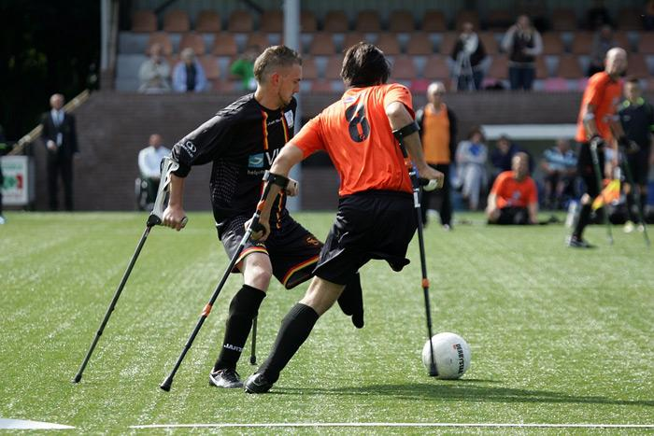
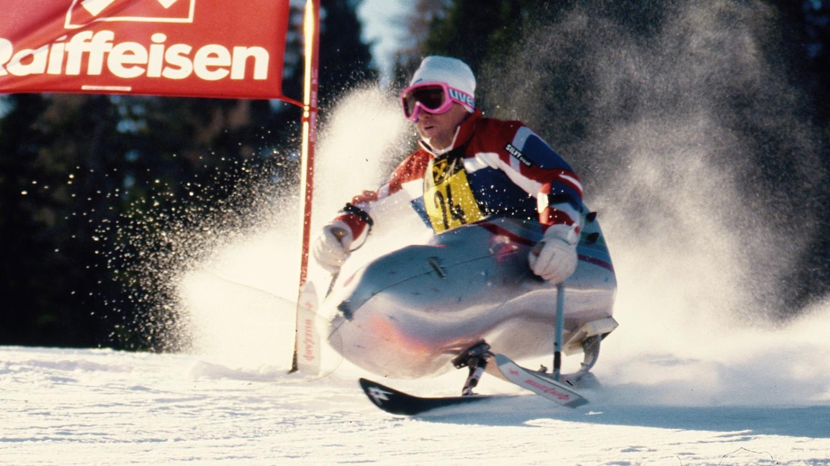
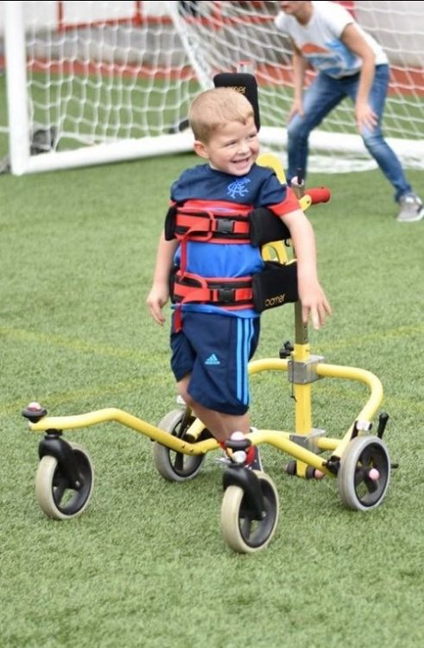
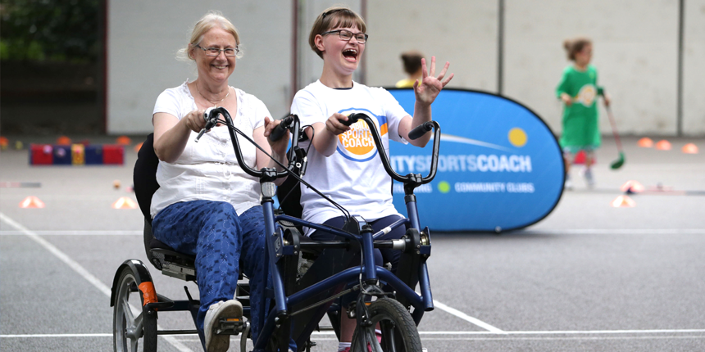
Your challenge: Take on Vanessa’s challenge and create a piece of tech to help a person with disabilities train or compete in a sport.
Please ask your parents or teachers to share your work on social media using #TechWeCan or email us at info@techshecan.org
#TechWeCan | Tech for Sport
Notes:
Time for your Tech for Sport challenge.
When Katie spoke to Vanessa, Vanessa mentioned that she would love to see any tech designs you could come up with to help people with disabilities train and compete. For your Tech We Can challenge for Tech for Sport we would like to use Vanessa as our inspiration and ask you to draw a design of a piece of tech to help a people with disabilities experience a sport which they wouldn’t usually have access to without that technology.
Remember, people can have a range of different disabilities. You could design a brand new wheelchair for a wheelchair sport, you could draw a new way of allowing someone without an arm or leg to compete in athletics. You might think of a way to allow a disabled person to surf. Or even better, a way for people with disabilities to access a sport which technology doesn’t exist for them to do that yet.
We absolutely love to see your Tech We Can challenges and if you would like us to give you feedback on your work then please email it to us or ask your teachers or parents to share it on social media using the #TechWeCan.
Have fun designing – I can't wait to see what you come up with. You never know, your tech designs could change someone else life. How great would that be!

Slide 11


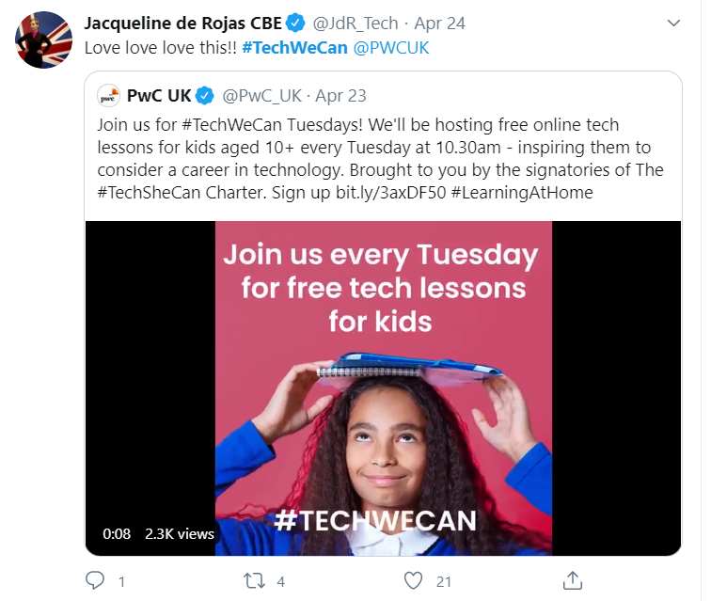

“Our Tech We Can lesson plans are part of our commitment to upskill the communities we’re part of - without urgent attention, many risk getting left behind as technology changes how we live and work. The current crisis we face has provided a stark reminder of the critical value of skills in science and technology.”
Sheridan Ash, co-CEO Tech She Can
For more information about Tech She Can and free access to all of the Tech We Can resources we have spoke about today, please visit: https://www.techshecan.org/
Follow the hashtags #TechSheCan and #TechWeCan to stay up to date with us on social media.

