Slide 1
techshecan.org
@Tech_She_Can
#TechSheCan
Tech We Can Assembly
Registered charity number: 1195284
Notes:
Introduce yourself, your role and the organisation you are from.
I am here today to talk to you about how technology is changing the world, some new inventions which you may not have heard of yet and the different jobs you could have working with and creating technology when you are older.

Slide 2
Have you ever thought about what you would like to do for a job when you are an adult?
Would you like a future job working with technology?
Notes:
Before we start I have a quick question. Have you ever thought about what you would like to do for a job when you are an adult? If you think you would like a future job working with technology, please raise your hand.

Slide 3
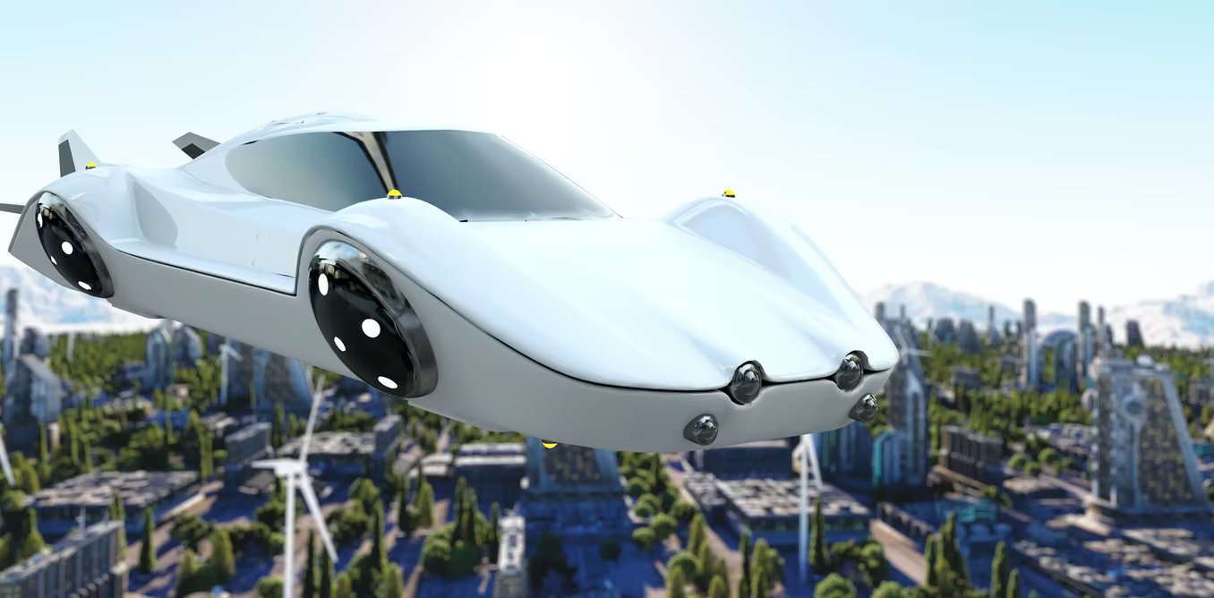
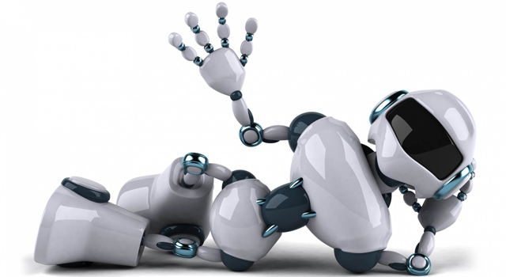
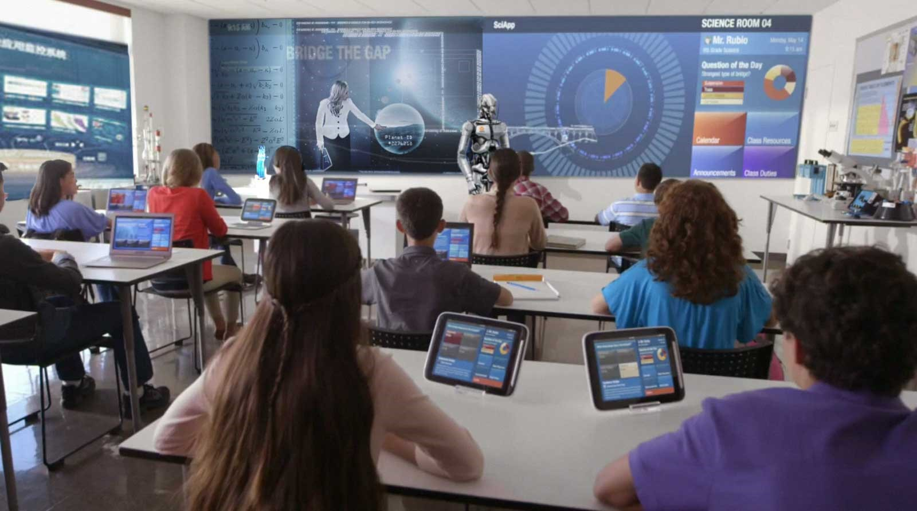
Tech facts
Technology is changing very quickly.
Most of the jobs you will do when you are adults don’t even exist yet.
Technology is the use of science and knowledge to solve problems or invent
useful tools.
New technology is being invented all of the time.
Technology can help both people and our planet.
Notes:
So what do we mean by technology? Well there are lots of different definitions of technology but I quite like this one:
‘Technology is the use of science and knowledge to solve problems or invent useful tools.’
Technology is changing very quickly. It’s changing faster than it ever has in the history of our planet which means new technology is being invented all of the time. Right now, people around the world are working on technology such as: flying cars, robots to live in our houses and teachers who are holograms.
All of these inventions already exist but people are working on the technology to make it more useful, more reliable and more affordable (as lots of these types of technologies are far too expensive for the average person to have in their home or school at the moment).

Slide 4
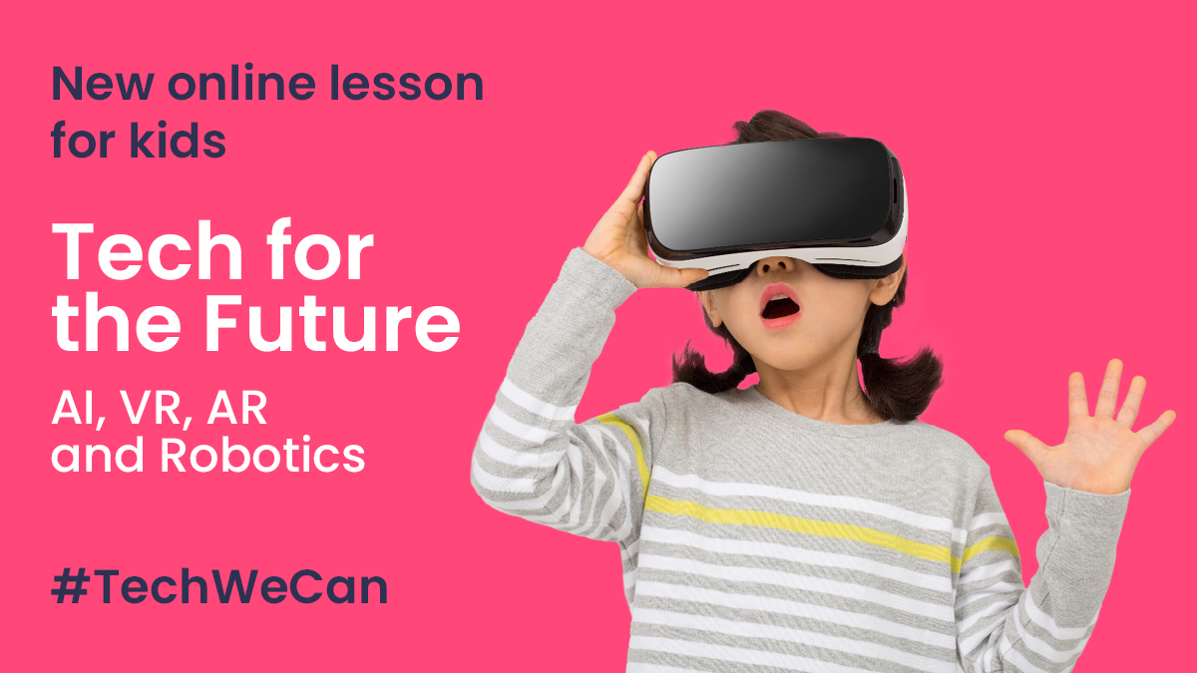
Do you know how your hobbies and passions are related to jobs in technology?
Notes:
Some of you might already really enjoy computing and technology but some of you may not and that’s ok. Today, I want to show you how there are so many different types of technology in the world and there are jobs to suit everyone's hobbies and passions.

Slide 5
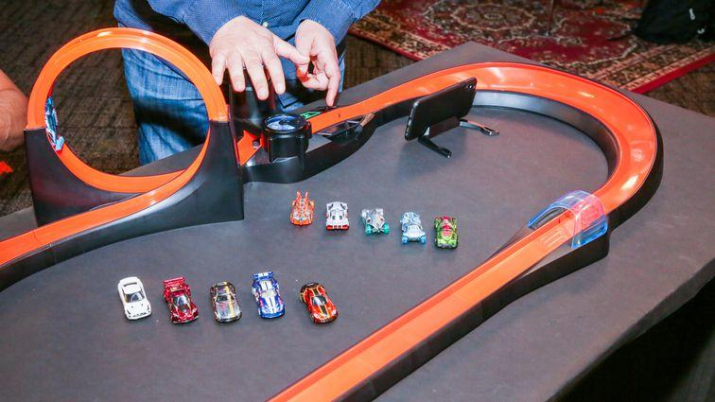
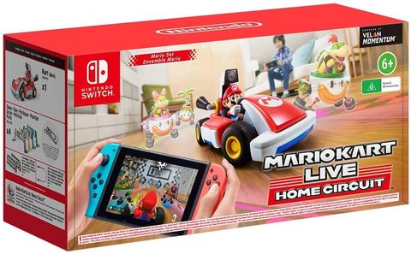
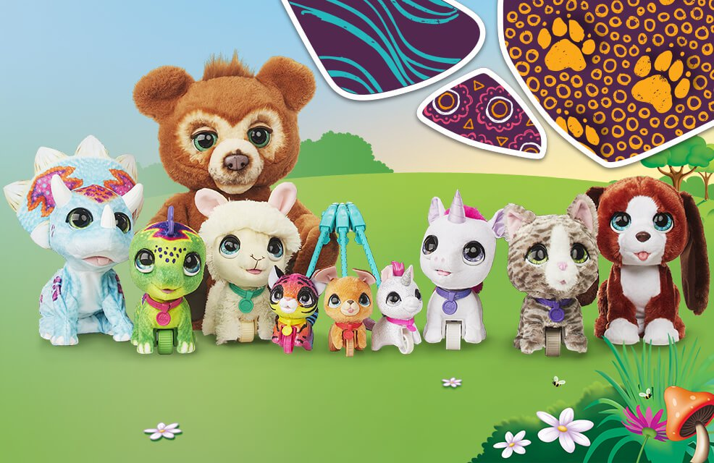
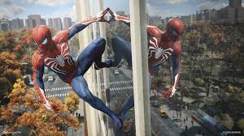
Technology for toys and gaming
Notes:
One area of technology i’m sure lots of you use everyday is technology used in toys and gaming. We now have robot toys which are really realistic, games like Mario Kart which we can drive around our house and computer games with more special effects and features than ever before. Have you ever stopped to think though that all of these toys and games are created by people working in technology jobs.

Slide 6
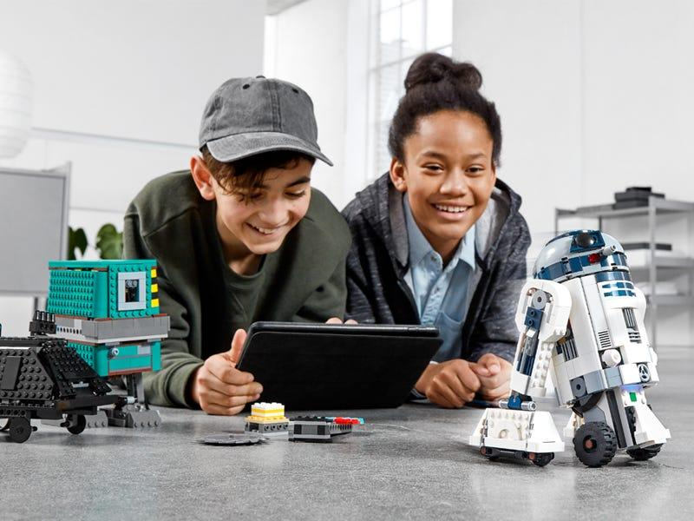
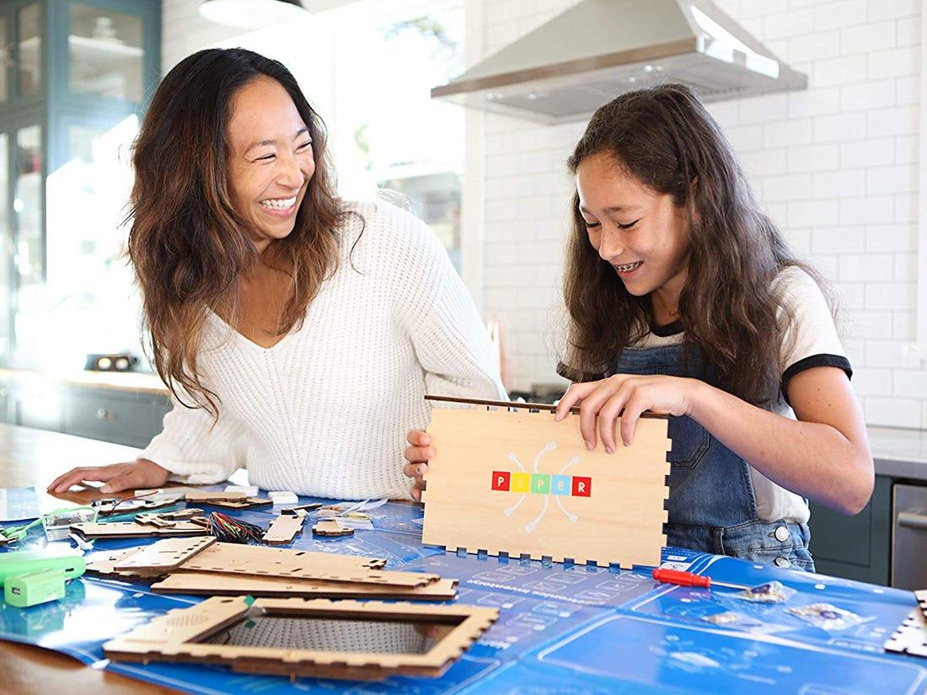
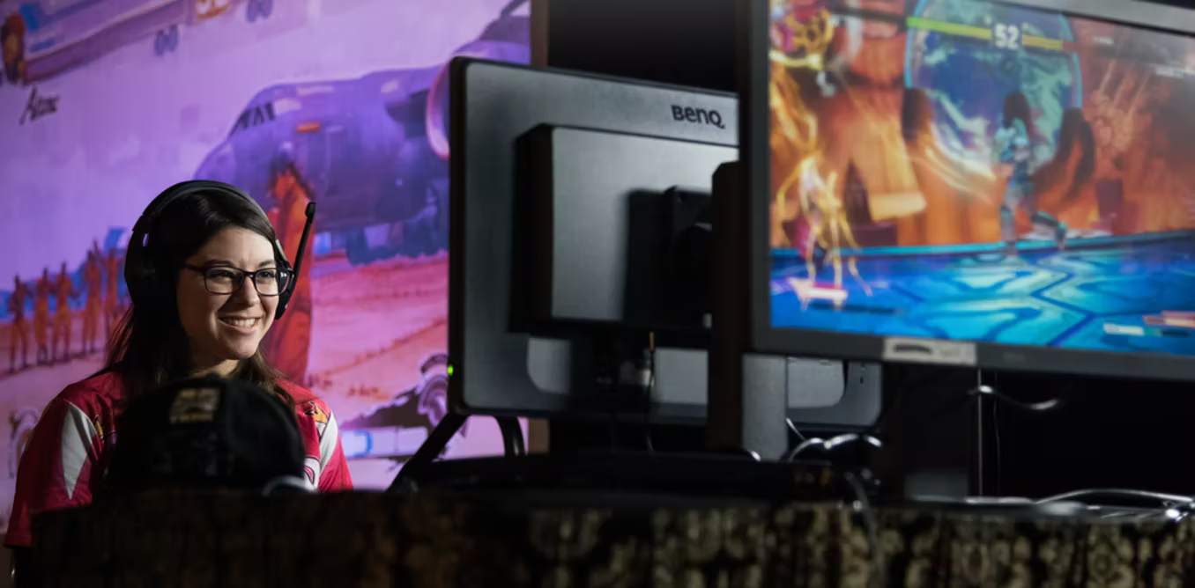
Careers in technology for toys and gaming
Toy designer
Game programmer
Videogame designer
As a toy designer, you could design the toys of the future. You could investigate how children play with toys, create prototypes and try to design toys which are safe and enjoyable to play with.
As a game programmer, you could use computers and technology to write the code which makes a game or toy fun to play with. You would be responsible for programming the technology inside the toy so it knows what to do.
As a videogame designer, you could be an artist who draws and creates what the game will look like, or you could be a programmer writing the code which tells the game how to work and you could even be a tester to check the game works properly.
Notes:
In the future, you could be a toy designer. As a toy designer, you could be responsible for researching and designing the toys of the future. You would research how children interact with toys, create prototypes (which means example toys which you think will work) and try to design toys which are safe and enjoyable to play with. You could try and figure out how to include new technology into your toy designs.
You could also be a game programmer. Toys which contain technology, like the ones we just looked at, all need to be programmed so they know how to react and what to do when children play with them. Game programmers write the code so the technology within the toy knows what to do .
And if you love computer games then you could be a videogame designer in the future. As a videogame designer, you could be an artist who draws and creates what the game will look like, or you could be a programmer writing the code which tells the game how to work and you could even be a tester to check the game works properly. It takes a whole team of different people with different skills to create a video game ready to go into things like your Xbox, Playstation or Nintendo Switch.

Slide 7
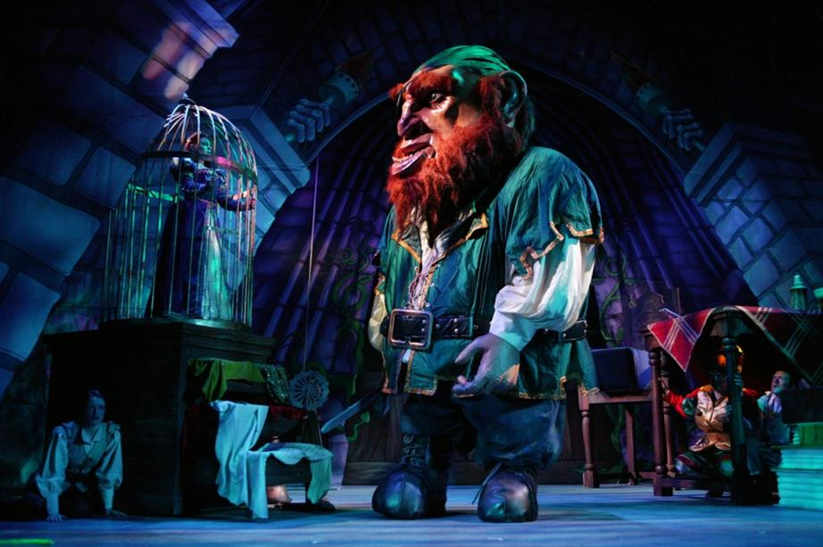
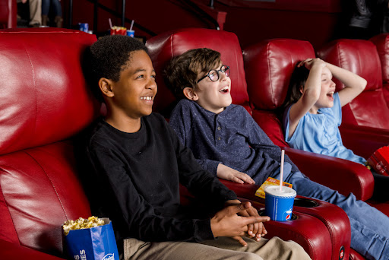
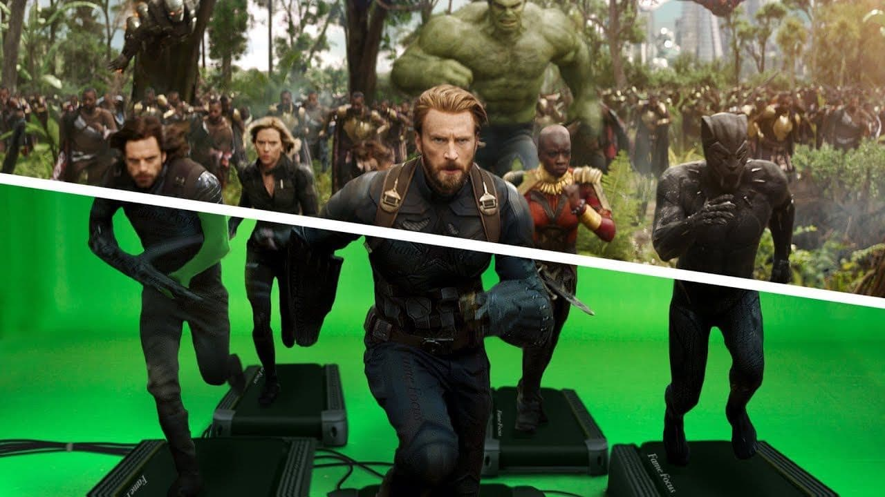
Technology for movies and the theatre
Notes:
Do any of you enjoy watching movies or going to the theatre? Have you ever seen the really long list of people's names which come up at the end of a movie (that’s something called the credits). That HUGE list of names are all of the people who actually worked on the movie and lots of them have a job in technology. Everything you see on a stage or screen was created by a team of people working together to make the movies and stage shows interesting and fun for you to watch. The big giant in the top picture is from a Jack and the Beanstalk theatre show and is actually controlled by a robot inside of the giant. The picture on the bottom shows how a scene in the Avengers movie was filmed. The actors filmed the scene running on treadmills and then visual effects artists added everything else around them using a computer after the filming had finished.

Slide 8
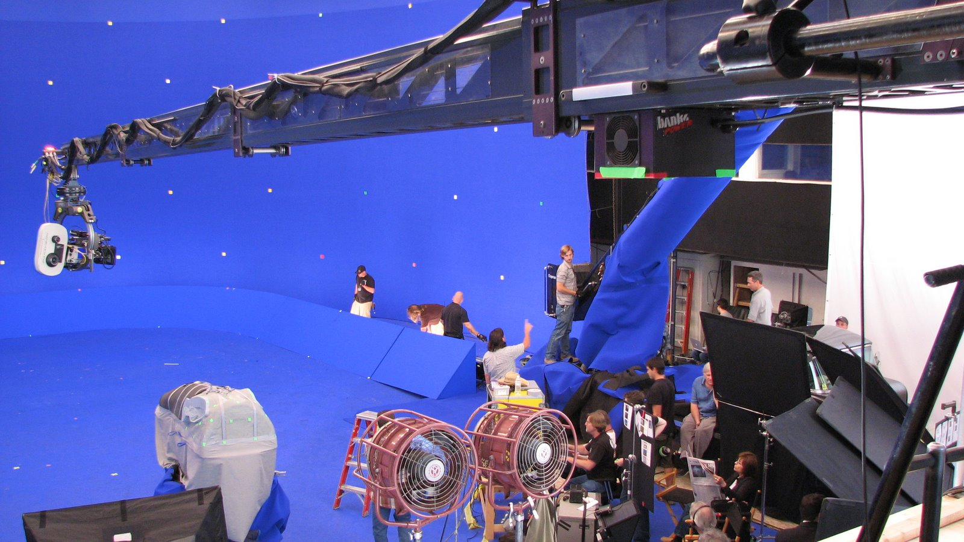
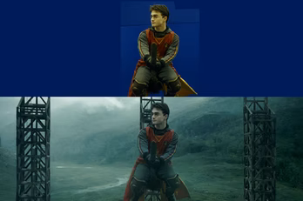
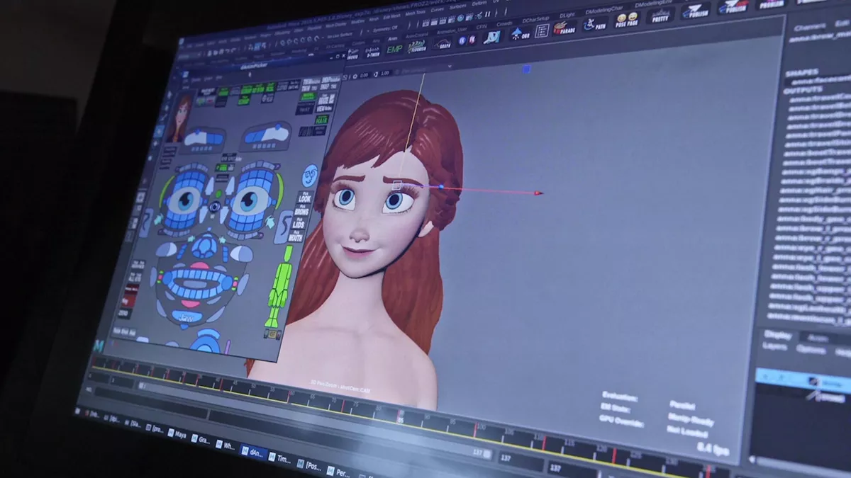
Careers in technology for movies and the theatre
Special effects artist
Visual effects Artist
Animator
As a special effects artist, you could use technology to create things like controlled explosions, rain and robotic characters. This would be on movie sets or actually at the theatre.
As a visual effects artists, you would use clever programmes on the computer to add visual effects, on top of and around the live actors after they have been filmed.
As a animator, you could use your artistic skills to draw characters and settings for the movies of the future. You could then use technology to make these characters speak and move.
Notes:
If you like the thought of working on creating movies and theatre shows then you could be a special effects artists. As a special effects artist, you could work at the theatre or on the sets of movies to use technology to create things like controlled explosions, rain and robotic characters. This would be on movie sets or actually at the theatre.
You could also be a visual effects artist, these are different to special effects artists. Special effects artists work at the theatre or on the movie set but visual effects artists use computers to change and add things to the recording after a movie has been filmed. As a visual effects artists, you would use clever programmes on the computer to add visual effects, on top of and around the recording of the live actors. This could include things which don’t actually exist in real life, like the aliens in the Avengers movies or making Harry Potter fly on his broomstick. Or it could include adding real life things which would be too tricky or dangerous to film in real life, like a volcanic eruption maybe.
There are of course also movies which don’t have live actors and are all completed animated. Movies like Frozen, Moana and Toy Story. If you like drawing and creating characters, then in the future, you could work with technology to create animations and drawing on the computer which then create a cartoon or film. As a animator, you could use your artistic skills to draw characters and settings for the movies of the future. You could then use technology to make these characters speak and move.

Slide 9
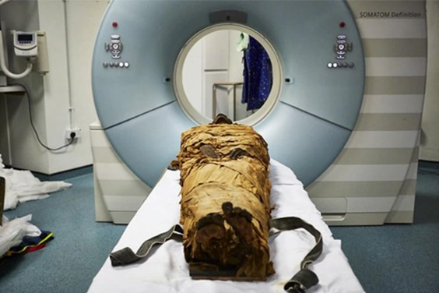
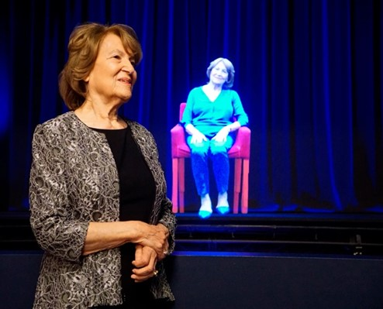
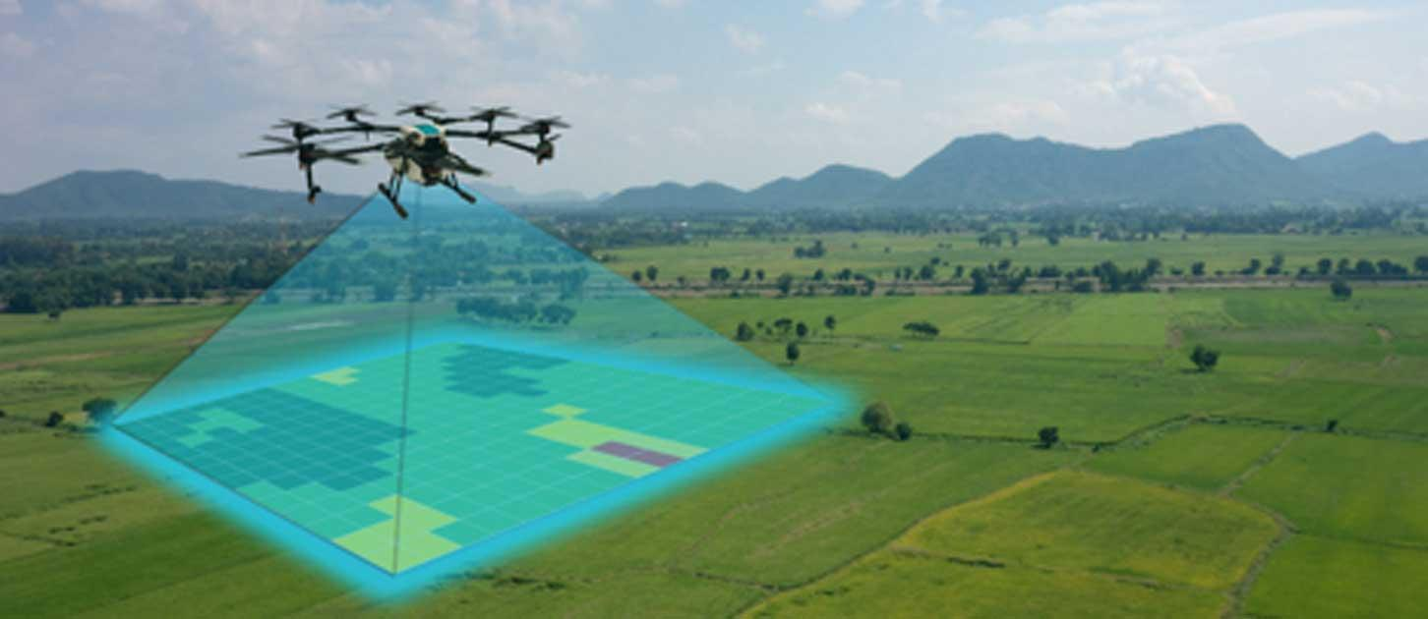
Technology for history
Notes:
Do any of you like history and learning about things which have happened in the past? Well archeologists are people who study the past to find out about events which happened and how people like the Ancient Egyptians, Romans and even cavemen lived. The pictures on left hand side of the slide show a couple of ways archeologists are inventing and using technology to find out about the past. The top picture shows a ancient egyptian mummy going through a medical scanner. The scientist who did this actually took a really detailed scan of the mummies throat and recreated what they think his voice sounded like - how cool is that?! And the picture on the bottom shows a drone flying over the land scanning and taking pictures. As things like houses from a long long time ago get covered in land and disappear into the ground, the drone scanners help archaeologists easily find areas where they should dig. And the big picture on the right of the slide, shows a lady who lived through the holocaust in WW2. A hologram of this lady describing her past has been recorded so people far into the future can continue to hear her story and learn from it. A hologram makes the person look like they are there but lots of clever projectors working together.

Slide 10
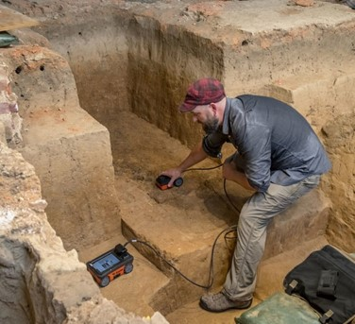
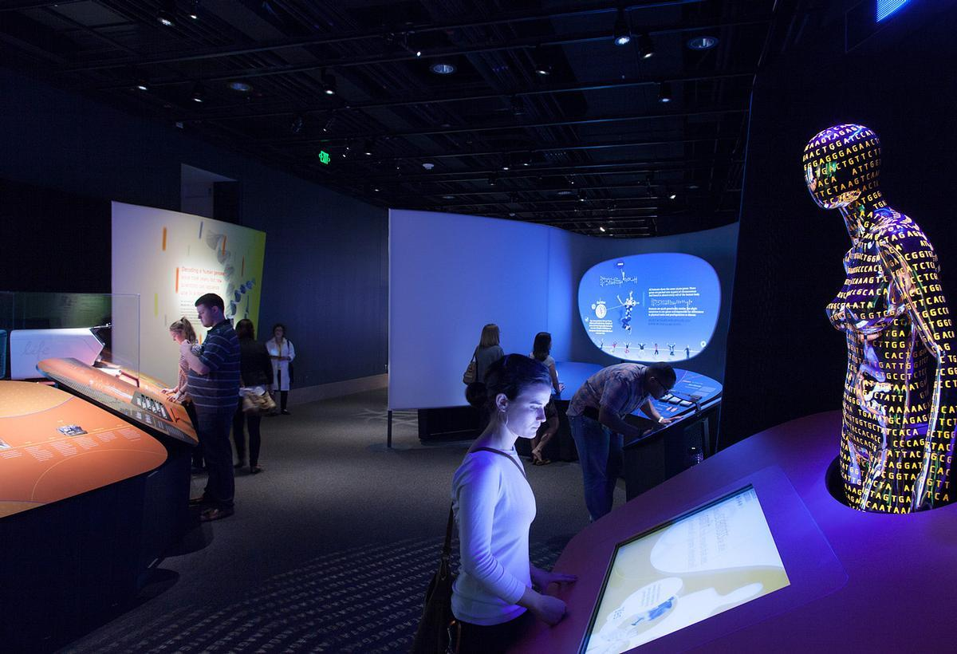
Careers in technology and history
Archaeologist
Digital interactive experience developer
As an archeologist, you could be an inventor and use technology to help us learn about the past.
As a digital interactive experience developer, you could bring history to life in places like interactive displays and experiences in museums.
Notes:
If any of those technology examples sound interesting to you then you could have a future job as an archeologist using or inventing technology to help us learn about the past. You could also be a Digital Interactive Experience Developer. Now that job title might be hard to remember but basically if you have ever been to a museum and looked at or played on a display to help you learn something then that would have been created by someone whose job it is to bring history to life using technology.

Slide 11
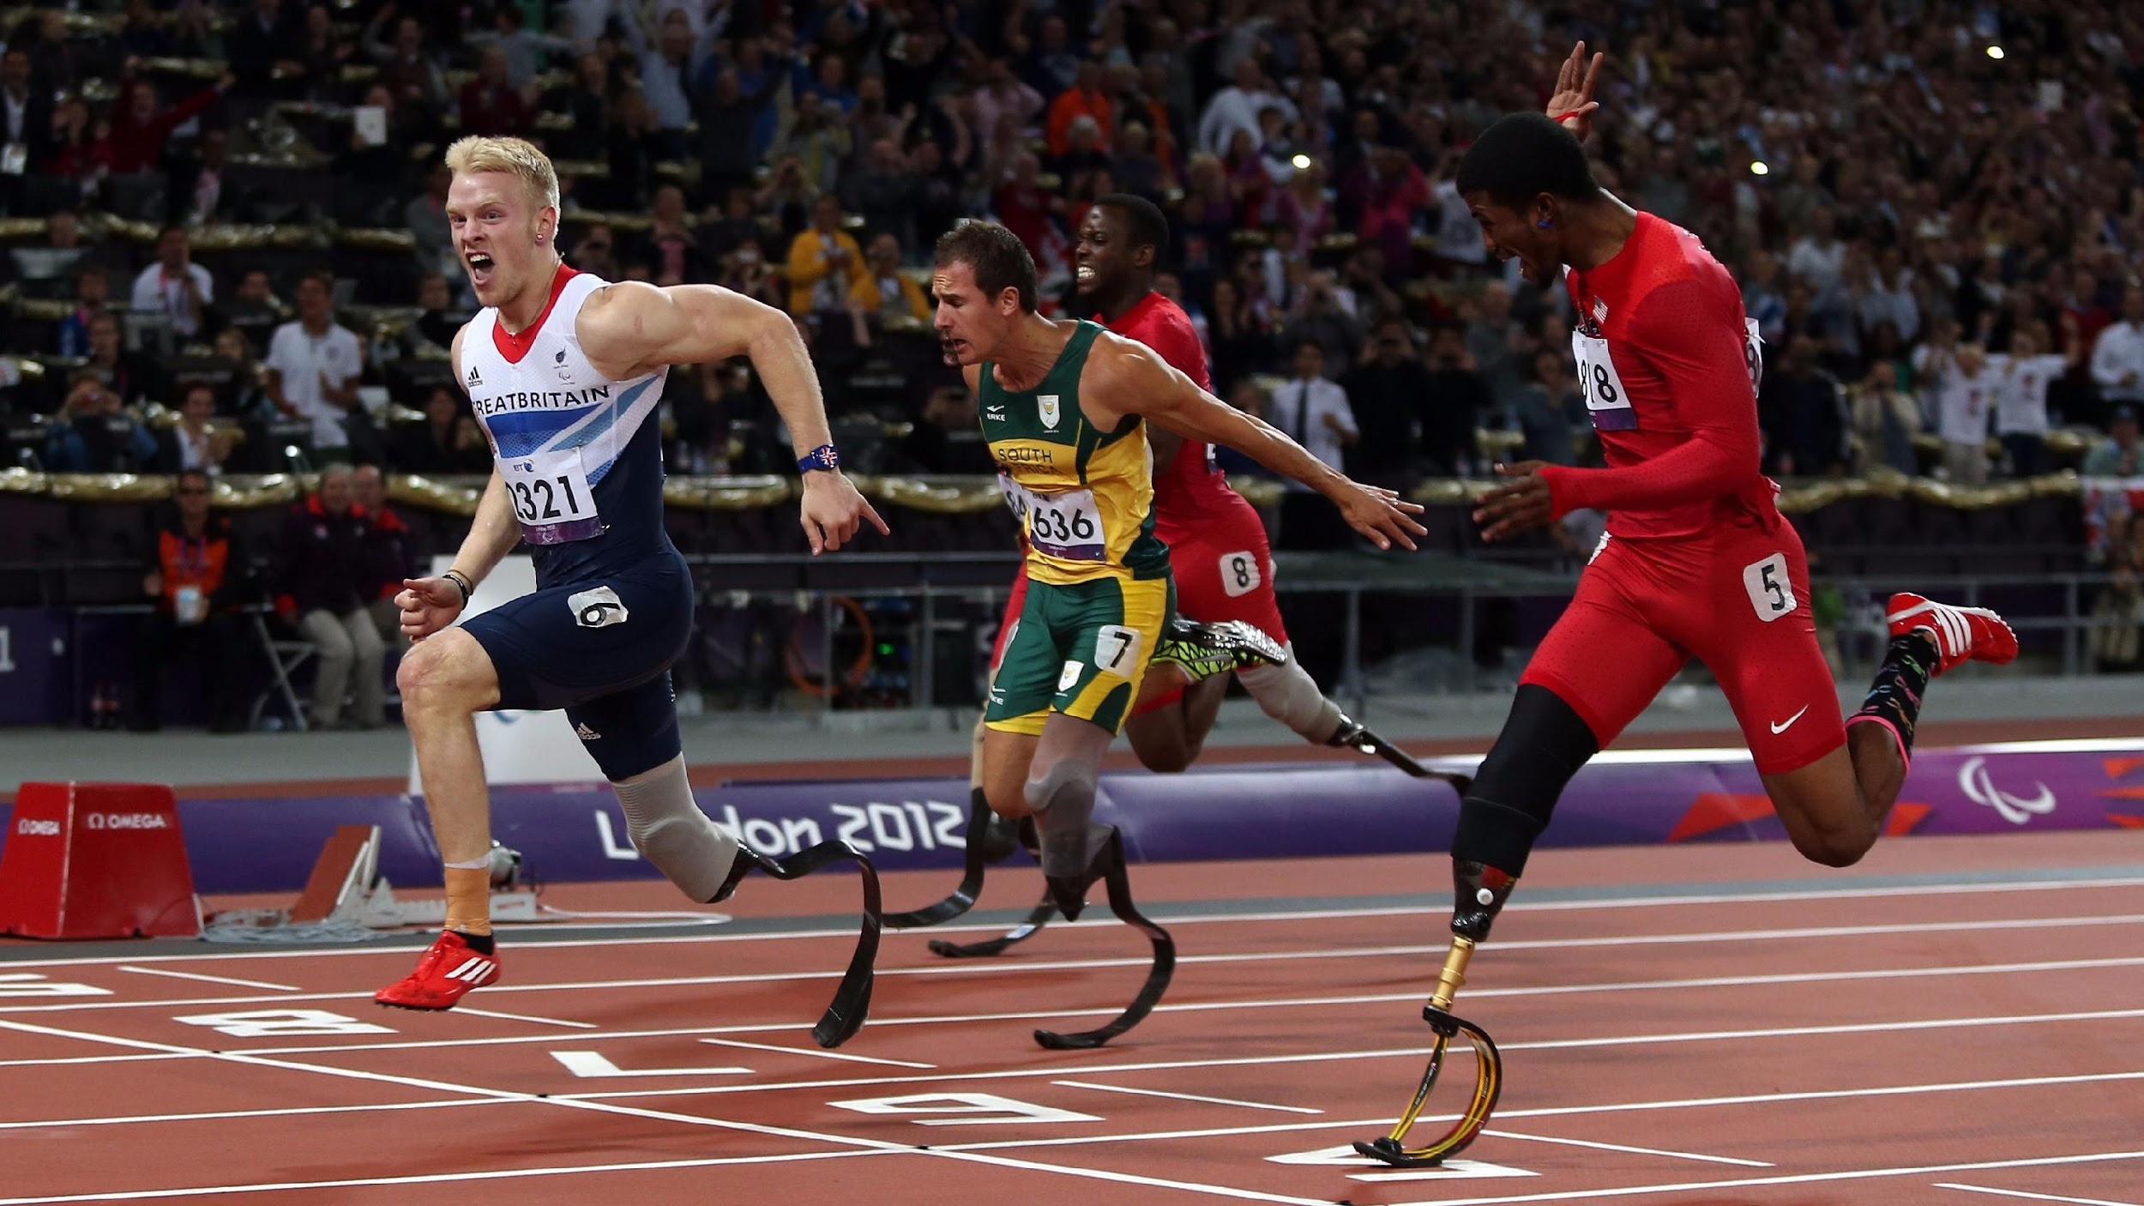
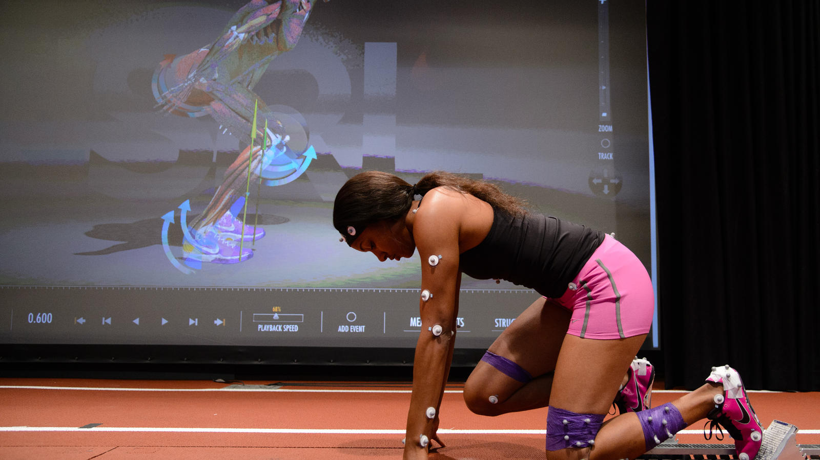
Technology for sport
Notes:
Some of you might also really enjoy watching or playing different types of sports. Their are so many different ways technology is used in sports. Sports equipment is created to help people with disabilities access sports they wouldn’t normally be able to - for example the men running in the top picture have specially made blades to replace their legs or feet. Technology is also used to help athletes understand their bodies and help them perform better. The lady in the top right picture has lots of little sensors stuck all over her body which are tracking exactly how she starts her run. There are also really cool new sports technology being invented like the jet powered surfboard in the bottom picture.

Slide 12
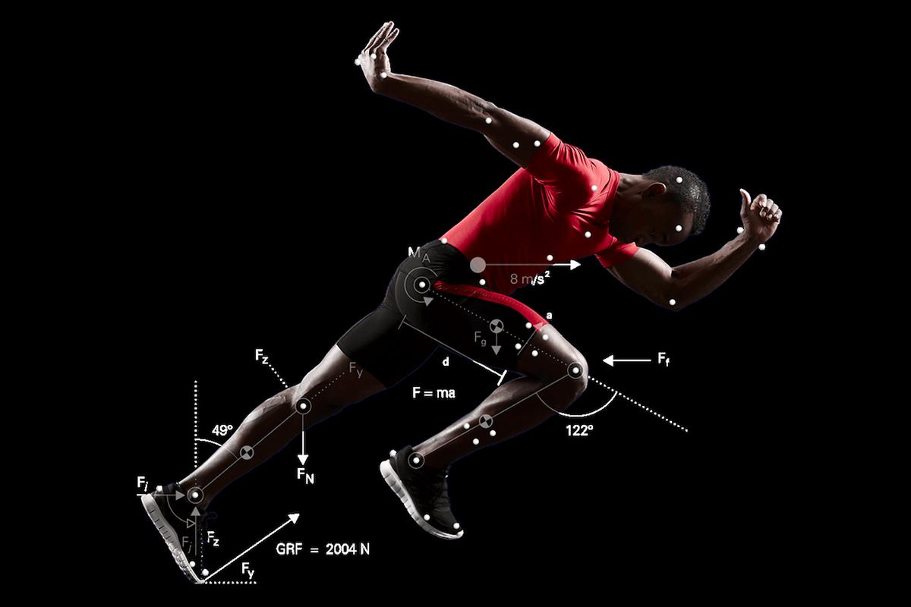
Careers in technology and sports
Product Designer
Biomechanist
As a product designer, you could use your design skills and tech knowledge to improve the way sports products work and look or even invent a brand new piece of sports equipment.
As biomechanists you could use technology to study how humans move. You could help athletes improve their performance, understand their bodies better and reduce their chance of being injured.
Notes:
If you like the sound of working with both sports and technology then you could be a product designer in the future and work to create new or improved sports equipment. Product designers use their design skills and technology knowledge to improve the way products work and look.
Could you develop a new way to use technology to surf the oceans or perhaps even a piece of tech equipment to be used in a brand new sport not even invented yet. If you’re a Harry Potter fan, I’m thinking something like Quidditch but on hoverboards. How cool would that be?!?
You could also be a biomechanist. These scientists work with technology to help athletes understand how their body works and how they can be even better at their sport.

Slide 13
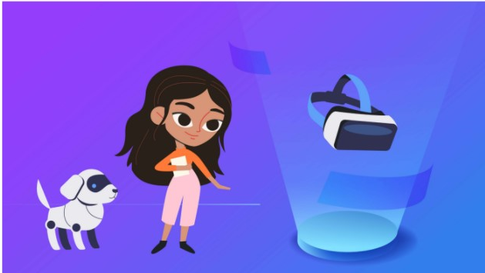
Technology for the future
Notes:
I am now going to let my friends Katie and Tex tell you a little more about ……. (play an animation of your choice to the children)

Slide 14
Would you like a future job working with technology?
Notes:
That’s the end of our assembly today but I just want to go back to the question we started with. Can you please put your hand up if you think you would like a future job working with technology.
We have covered lots of different examples of technology careers today but these are just some and there are so many more. Hopefully you can now see that there are lots of different jobs in technology related to many different hobbies that you might have. By the time you leave school, who knows what kinds of technology people will be designing and working on then. I find that really exciting!

Slide 15
For more information about Tech She Can:
techshecan.org
@Tech_She_Can
#TechSheCan

